Slide 1

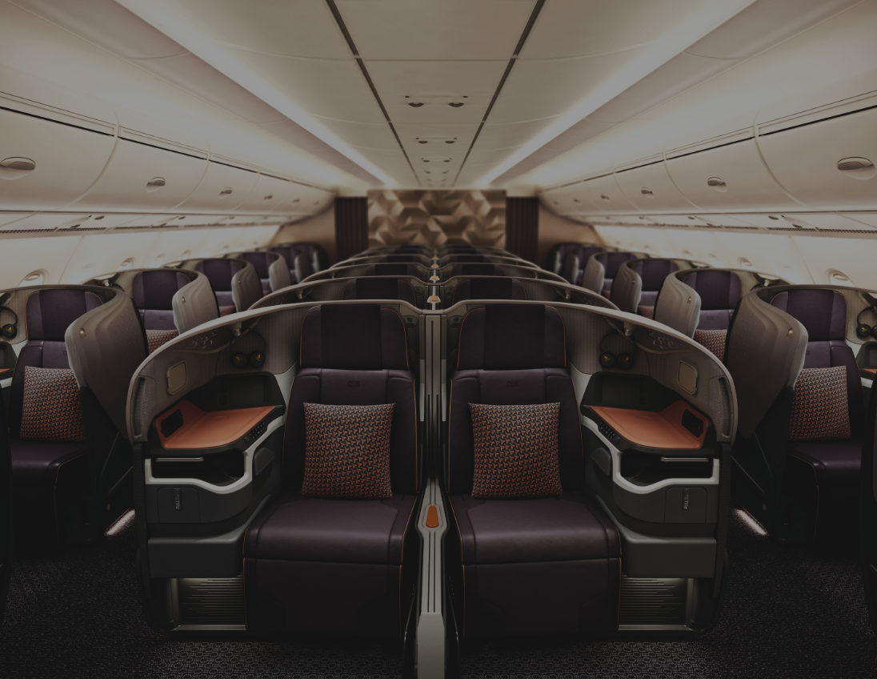

Service Request Forms

Slide 2
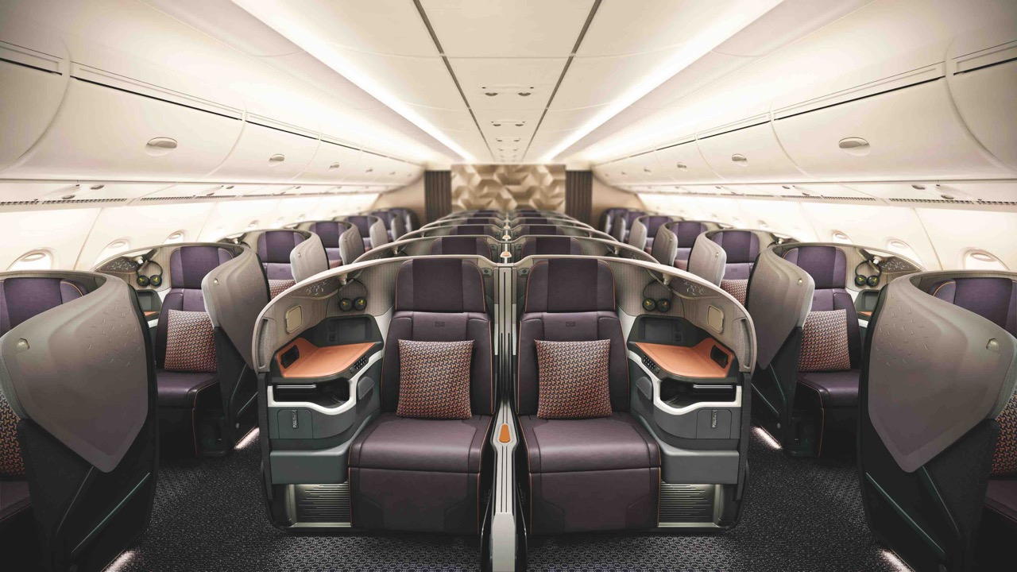
SERVICE REQUEST
FORMS

Slide 3

WHAT ARE SERVICE REQUEST FORMS FOR
FLIGHT SEARCH
Agents can self-service via the AGENT 360 portal to raise queries and submit requests
Service requests are handled and processed faster
Reduce the need for SIA to call / email agents to extract required information and seek further clarification
Allow agents to have visibility of requests statuses from the AGENT 360 Dashboard and automatic email notifications
Available for all agents – IATA, TIDS, non-IATA / non-TIDS

Slide 4
TYPES OF
SERVICE REQUEST FORMS

Slide 5
New!
Refund Fee Waiver
Reissuance Fee Waiver
Excess Baggage Allowance
Name Error Correction
Ticketing Time Limit (TTL) Extension
Waitlist Confirmation (DAPO)
General Form (all others)*
Service Request
Forms
*Non-IATA/TIDS agents will only be able to submit the General Form

Slide 6

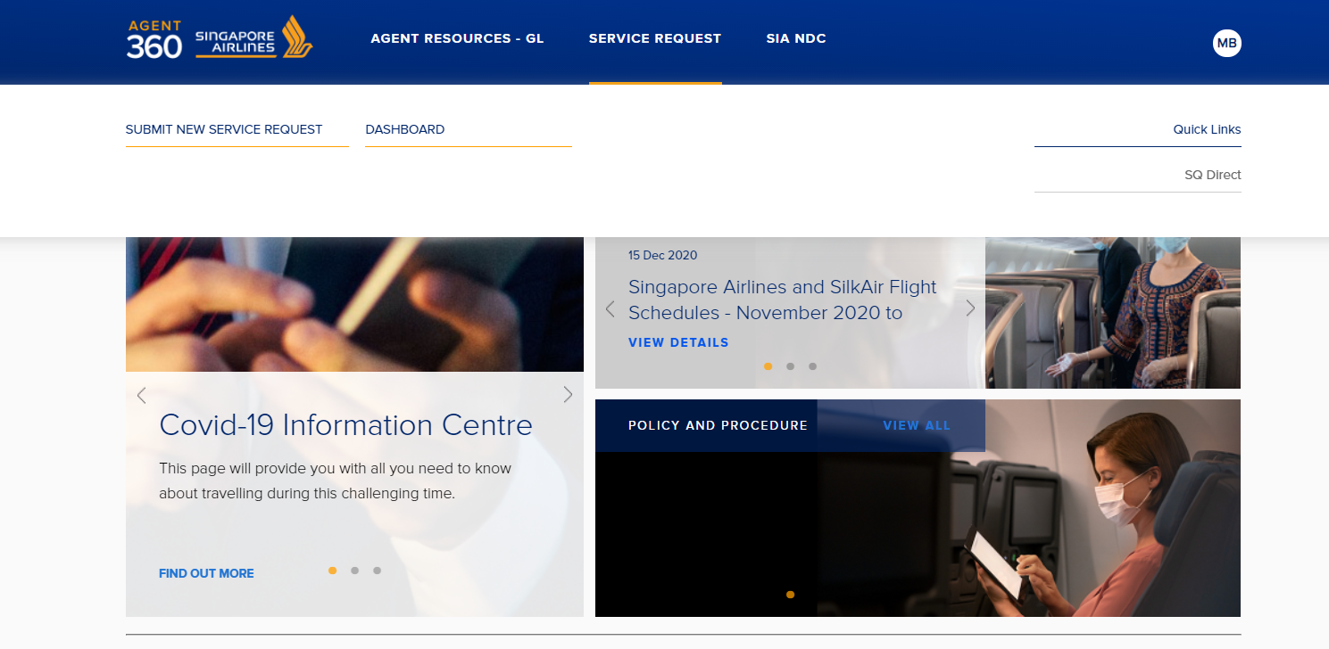

ACCESSING SERVICE REQUESTS
FLIGHT SEARCH
How do Travel Agents access service requests?
Log into AGENT 360 > Service Request
You will see two options available: (1) Submit a Service Request, and (2) view Dashboard

Slide 7
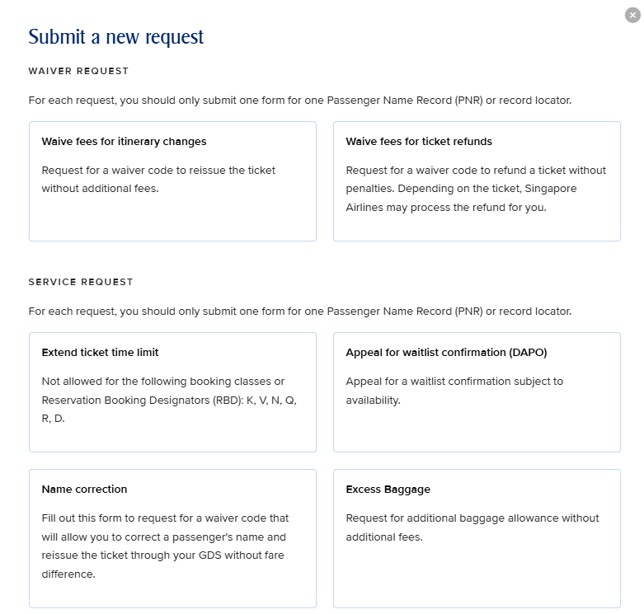

ACCESSING SERVICE REQUESTS
New!
FLIGHT SEARCH
Service Requests are split into 3 categories:
Waiver Request
Waive fees for Itinerary Changes (Reissuance)
Waive fees for Ticket Refunds
Service Request
Extend Ticketing Time Limit (TTL)
Name Error Correction
Apply for Waitlist Confirmation (DAPO)
Request for Excess Baggage Allowance
General Form*
*Non-IATA/Non-TIDS agents will only be able to submit the General Form

Slide 8
SRF
DEFINITIONS

Slide 9
SRF Reason Definitions
FLIGHT SEARCH
Agents will need to select a reason for every SRF submission. Here is a full list of reasons:
Legal name change | Passenger had made a legal change to his/her name
Medical | Passenger that is unfit to travel, or immediate family members’ / passenger within the travelling party / require passenger’s assistance / presence due to their medical condition.
Compassionate | Demise or critical condition of passenger within the travelling party/ immediate family members.
Situations beyond passenger’s control | The passenger is stuck in an unforeseen situation that he or she cannot control. This could be due to unexpected airport or flight restrictions, changes in government policy, visa rejections or refusals.
Involuntary Schedule / Aircraft Changes / Downgrade | Schedule Change: Flight schedule has been changed due to unforeseen circumstances. Flight Disruptions / Aircraft Changes: Flight has been cancelled or postponed due to unforeseen circumstances. Visa Rejection: Passenger is unable to enter the country due to invalid or missing visa. Downgrade: Passenger has been downgraded to a lower cabin class due to unforeseen circumstances. Natural Disaster: Situations such as tsunami, volcanic eruption Political situation/ crisis: Situations such as riot, civil unrest, crisis that are happening in the country.
System Limitation / Error | Unable to process due to the system issue or mistakenly process due to system error.
Genuine error | Mistake made on the booking (e.g. misspelled name, missing corporate code, typos in fare basis and waiver codes, calculation error)
Others | Any other reason not covered above.

Slide 10
FORM 01
REISSUANCE FEE WAIVER

Slide 11
ACCESSING SERVICE REQUESTS
FLIGHT SEARCH
How do Travel Agents access service requests?
Log into AGENT 360 > Service Request
You will see two options available: (1) Submit a Service Request, and (2) view Dashboard

Slide 12
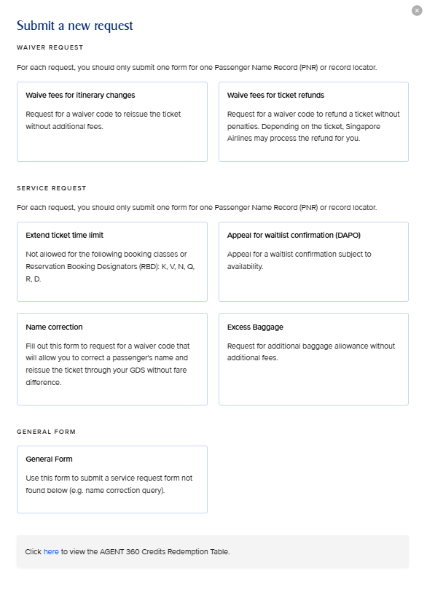
01. Reissuance Fee Waiver
FLIGHT SEARCH
Waive Fees for Reissuance
Request for a waiver code to reissue ticket without additional fees

Slide 13
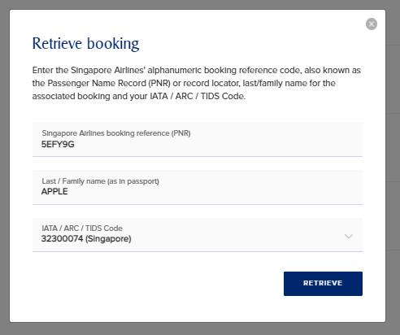
01. Reissuance Fee Waiver
FLIGHT SEARCH
Waive Fees for Reissuance
You should key in the PNR, Last Name and IATA used to make the booking or issue the ticket
Proceed to retrieve the booking by clicking Retrieve
NDC and EDIFACT bookings can be retrieved
2A3BCD

Slide 14
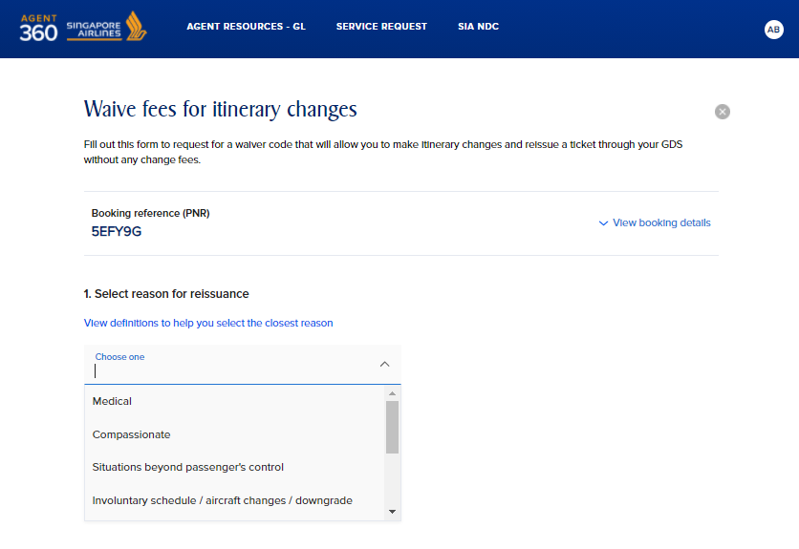
01. Reissuance Fee Waiver
FLIGHT SEARCH
2A3BCD
Waive Fees for Reissuance
Proceed to select reason for reissuance
View definitions to select the closest reason

Slide 15
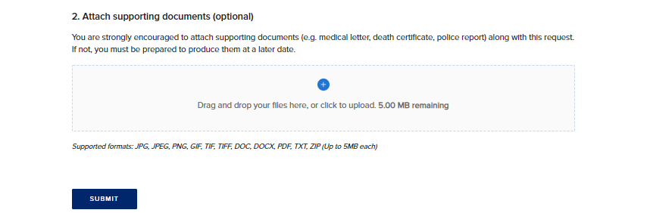
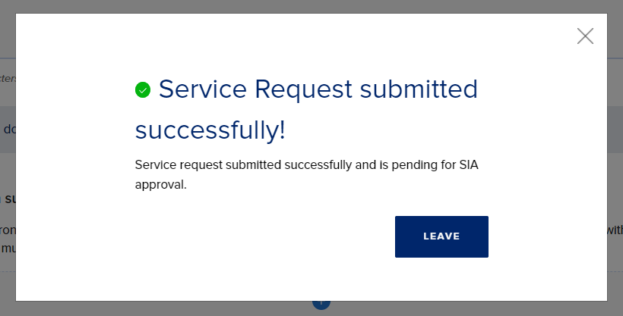
01. Reissuance Fee Waiver
FLIGHT SEARCH
Waive Fees for Reissuance
We strongly encourage attaching supporting documents to aid processing of your service request

Slide 16
FORM 02
REFUND FEE WAIVER

Slide 17
02. Refund Fee Waiver
FLIGHT SEARCH
Waive Fees for Refund
Request for a waiver code to refund ticket without additional fees

Slide 18
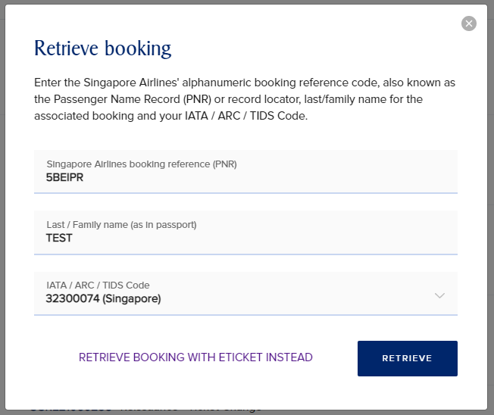
02. Refund Fee Waiver
FLIGHT SEARCH
Waive Fees for Refund
There are 2 ways to retrieve your booking
1. Retrieve PNR
You should key in the PNR, Last Name and IATA used to make the booking or issue the ticket
Proceed to retrieve the booking by clicking Retrieve
NDC and EDIFACT bookings can be retrieved
3A4BCD
SMITH

Slide 19
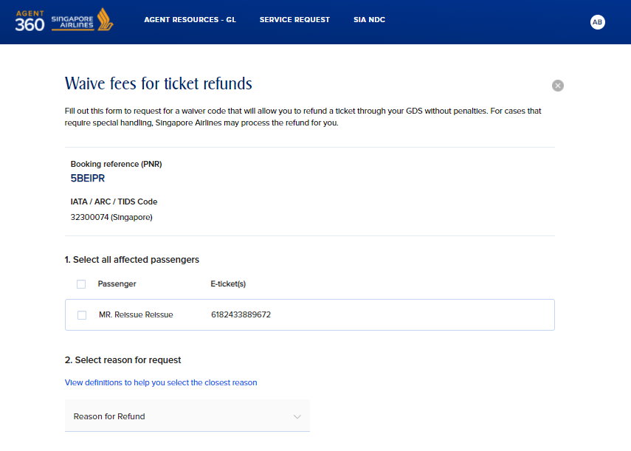
02. Refund Fee Waiver
FLIGHT SEARCH
3A4BCD
Waive Fees for Refund – Retrieve PNR
Select the passenger you would like to service
For PNRs with multiple passengers in the booking, all pax information will appear here.
Sam Smith

Slide 20
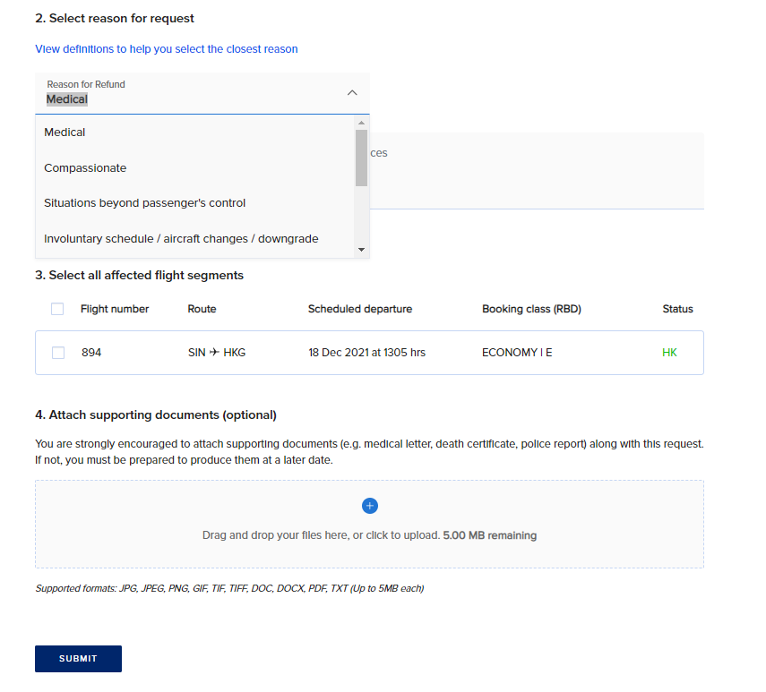
02. Refund Fee Waiver
FLIGHT SEARCH
Waive Fees for Refund – Retrieve PNR
Proceed to select reasons for refund
View definitions to select the closest reason
Select affected flight segments
We strongly encourage attaching supporting documents to aid processing of your service request

Slide 21
02. Refund Fee Waiver
FLIGHT SEARCH
Waive Fees for Refund – Retrieve e-Ticket
There are 2 ways to retrieve your booking
2. Retrieve e-Ticket
If you do not have the PNR on hand or have a purged PNR, you can choose to retrieve via e-Ticket instead
If unsure, you can still enter the PNR, last name, and IATA before clicking “Retrieve”. If AGENT 360 detects that the PNR is purged it will redirect you to the Refund (e-Ticket) form
Click Retrieve Booking with eTicket Instead
3A4BCD
SMITH

Slide 22
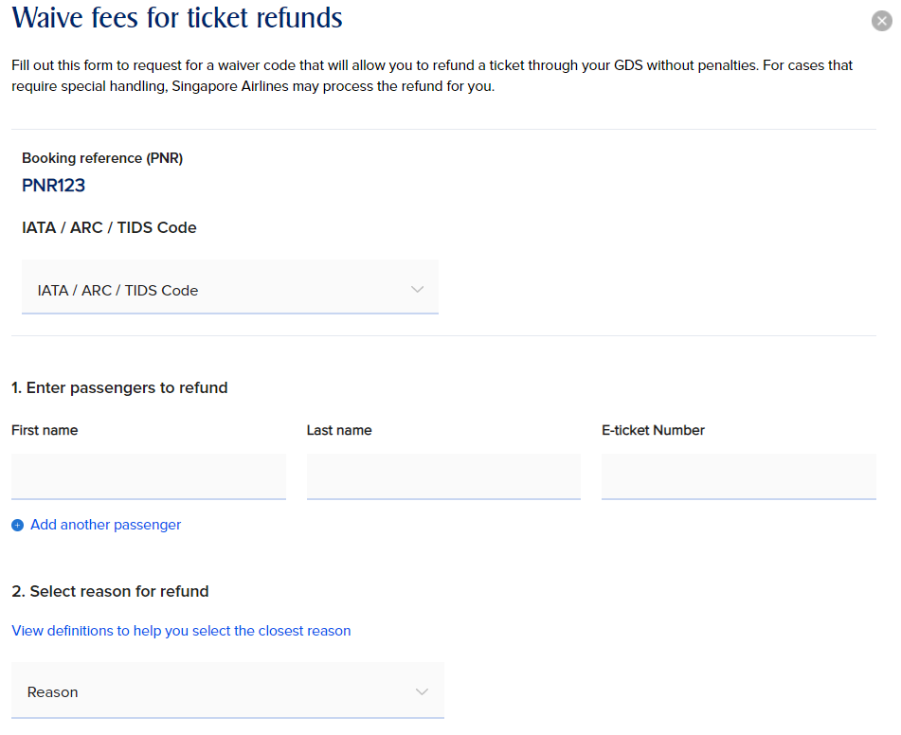
02. Refund Fee Waiver
FLIGHT SEARCH
Waive Fees for Refund – Retrieve e-Ticket
Select IATA/ARC/TIDS code booking was ticketed under
Enter the first name, last name, and e-ticket number
Select reason for refund

Slide 23
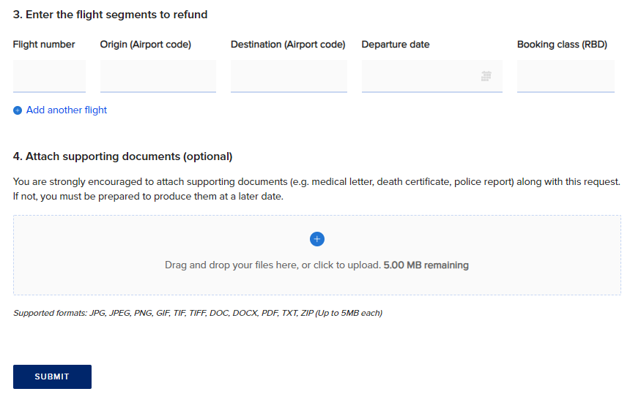
02. Refund Fee Waiver
FLIGHT SEARCH
Waive Fees for Refund – Retrieve e-Ticket
Enter the flight segments
We strongly encourage attaching supporting documents to aid processing of your service request

Slide 24
New!
FORM 03
EXCESS BAGGAGE

Slide 25
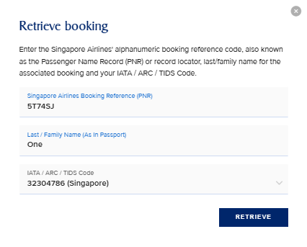
03. Excess Baggage
New!
FLIGHT SEARCH
Excess Baggage
You should key in the PNR, Last Name and IATA used to book or issue the ticket
Proceed to retrieve the booking by clicking Retrieve
NDC and EDIFACT ticketed bookings can be retrieved

Slide 26
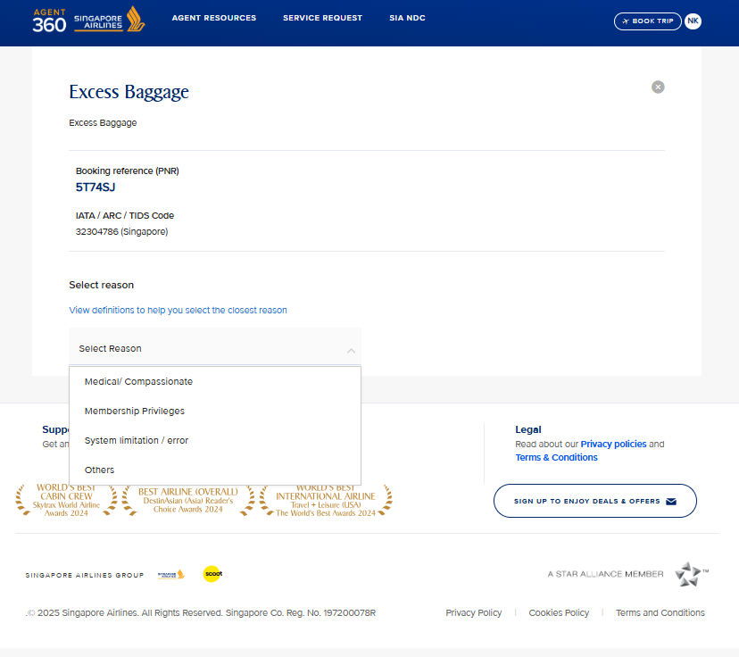
03. Excess Baggage
New!
FLIGHT SEARCH
Excess Baggage
Proceed to select reason for excess baggage
View definitions to select the closest reason

Slide 27
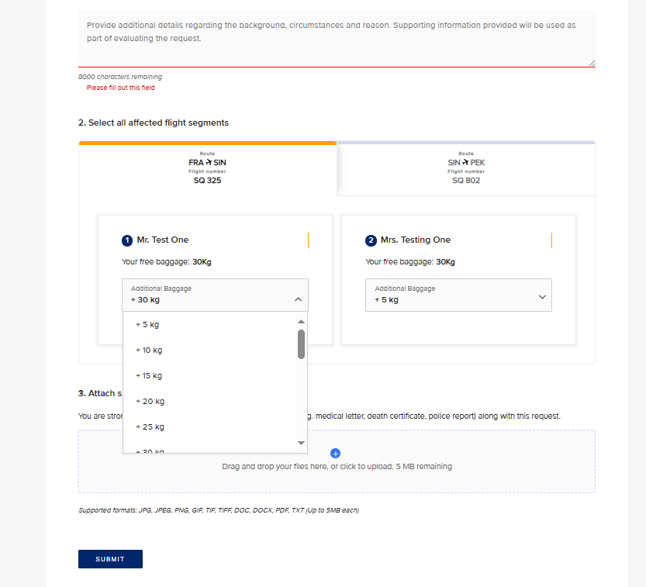
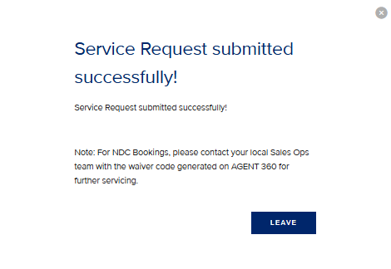
03. Excess Baggage
New!
FLIGHT SEARCH
Excess Baggage
Provide background details related to your request
For non-US itineraries, select the amount of excess baggage (in blocks of 5kg) needed for each passenger and flight segment
We strongly encourage attaching any supporting documents to aid processing of your service request efficiently
If you face an error, please submit your request via the General Form

Slide 28
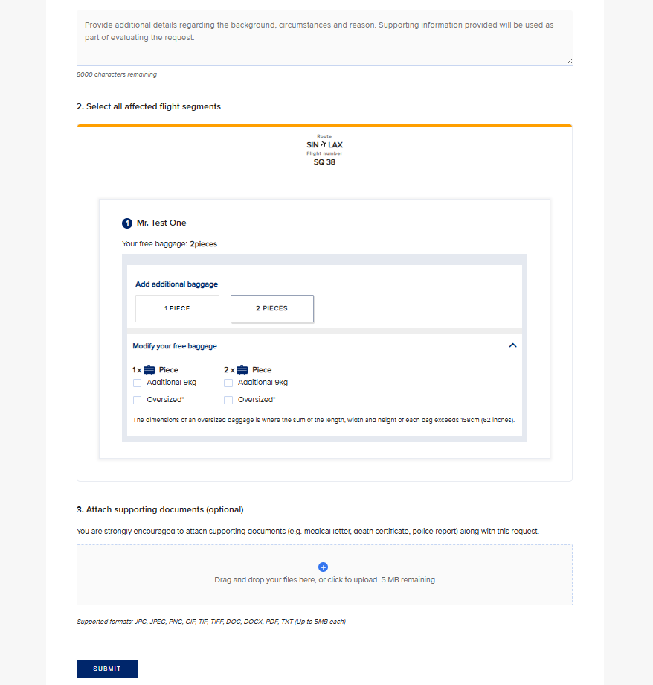
03. Excess Baggage
New!
FLIGHT SEARCH
Excess Baggage
Provide background details related to your request
For US itineraries, select the form of excess baggage (in terms of piece, oversize or overweight) needed for each passenger and flight segment
You may wish to specify the excess baggage details in the Additional Information section
We strongly encourage attaching any supporting documents to aid processing of your service request efficiently
If you face an error, please submit your request via the General Form

Slide 29
FORM 04
TICKETING TIME LIMIT (TTL) EXTENSION

Slide 30
04. TTL Extension
FLIGHT SEARCH
Service Request for TTL Extension
Request to extend ticket time limit
Service Request Form | Ineligible RBDs for SRF (cannot submit SRF)
TTL Extension | QNVK, R, D

Slide 31
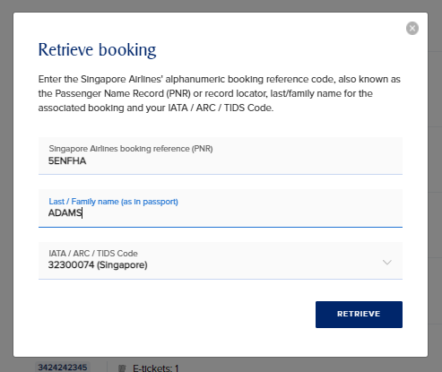
04. TTL Extension
FLIGHT SEARCH
Service Request for TTL Extension
You should key in the PNR, Last Name and IATA used to make the booking or issue the ticket
Proceed to retrieve the booking by clicking Retrieve
NDC and EDIFACT bookings can be retrieved
4A5BCD

Slide 32
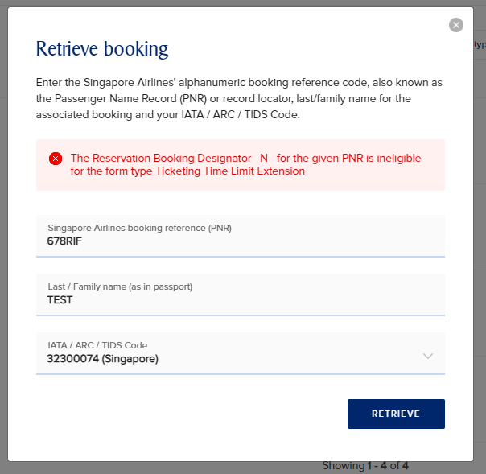

04. TTL Extension
FLIGHT SEARCH
Service Request for TTL Extension
The following RBDs are ineligible for TTL Extension
Service Request Form | Ineligible RBDs for SRF (cannot submit SRF)
TTL Extension | QNVK, R, D
5A6BCD
If an ineligible booking is retrieved, the following error appears and agent will not be allowed to proceed

Slide 33
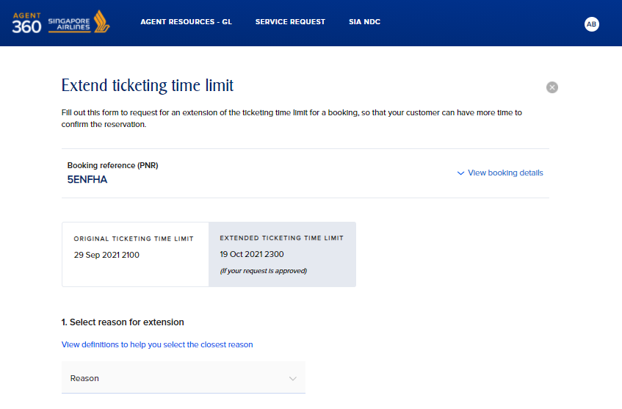
04. TTL Extension
FLIGHT SEARCH
4A5BCD
Service Request for TTL Extension
You can review the Extended TTL shown
Proceed to select reasons for TTL Extension
View definitions to select the closest reason

Slide 34
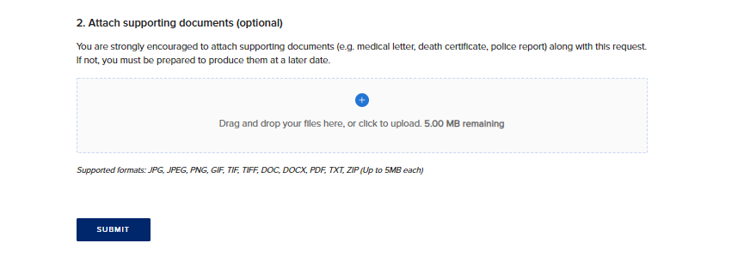
04. TTL Extension
FLIGHT SEARCH
Service Request for TTL Extension
We strongly encourage attaching supporting documents to aid processing of your service request

Slide 35
FORM 05
NAME ERROR CORRECTION

Slide 36
05. Name Error Correction
FLIGHT SEARCH
Waive Fees for Name Correction
Update the correct name for passengers (where there is an error, not for a name change)
Request for a waiver code to reissue ticket without additional fees

Slide 37
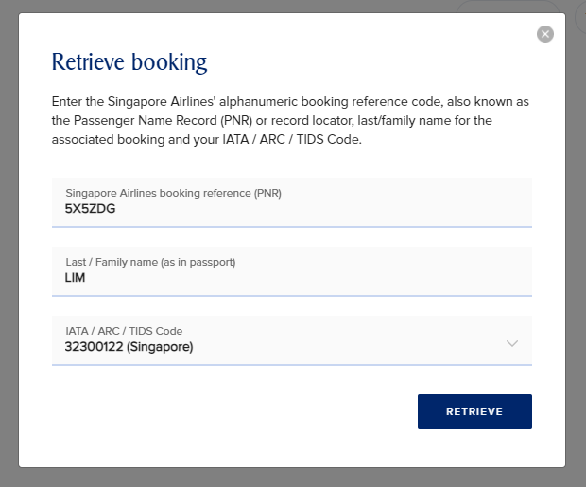
05. Name Error Correction
FLIGHT SEARCH
Waive Fees for Name Correction
You should key in the PNR, Last Name and IATA used to make the booking or issue the ticket
Proceed to retrieve the booking by clicking Retrieve
You can select between the IATA codes they have registered to their AGENT 360 account
You will not be able to retrieve a booking if it was not (I) booked or (II) ticketed by this IATA
NDC and EDIFACT bookings can be retrieved
1A2BCD

Slide 38
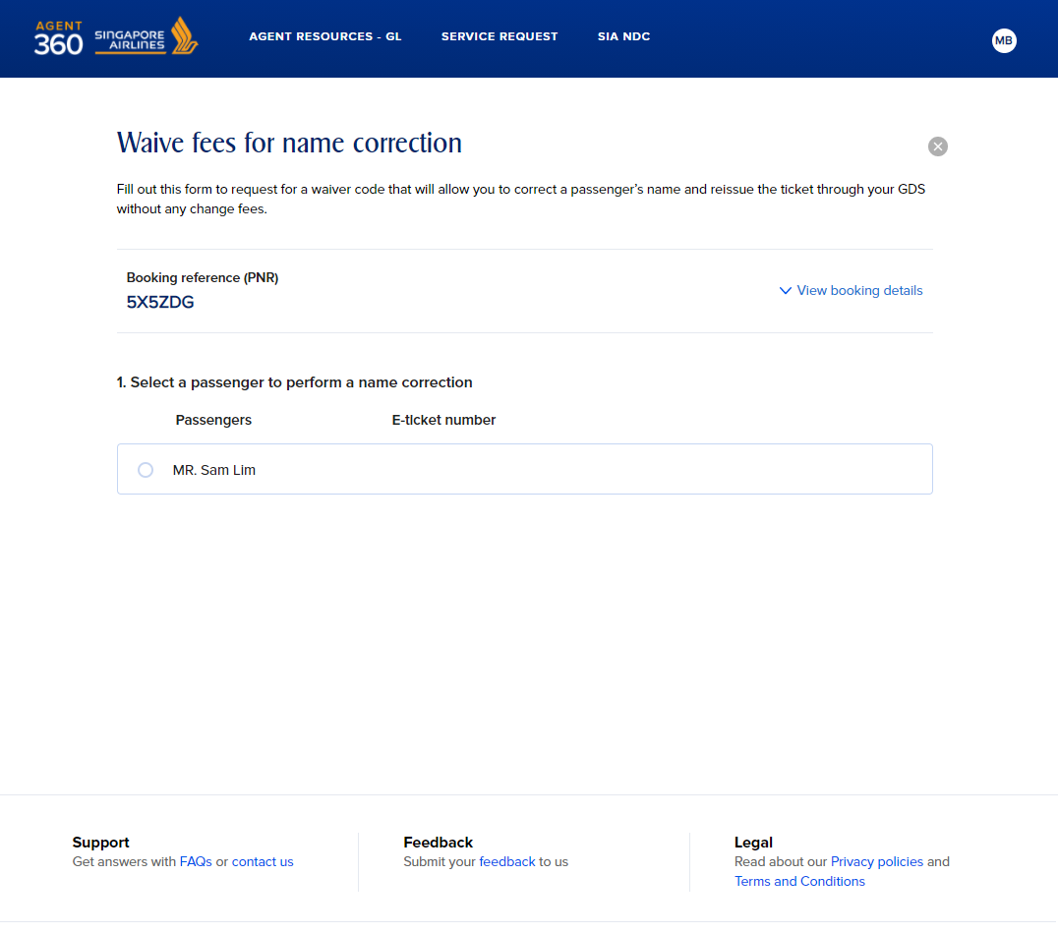
05. Name Error Correction
FLIGHT SEARCH
1A2BCD
Waive Fees for Name Correction
Select the passenger you would like to service (1 per SRF)
For PNRs with multiple passengers in the booking, all pax information will appear here.

Slide 39
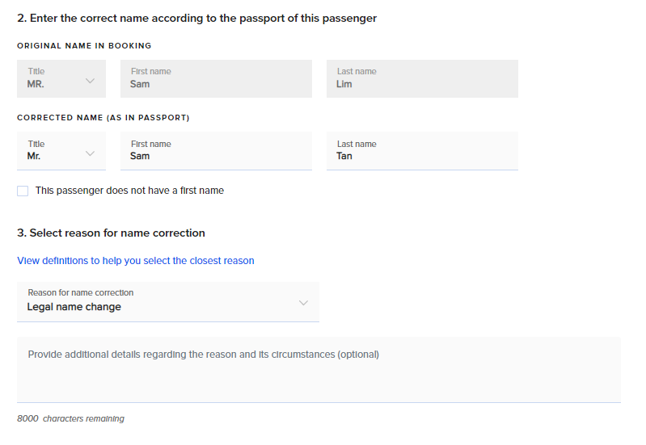
05. Name Error Correction
FLIGHT SEARCH
Lin
Waive Fees for Name Correction
Key in the name with an error
Proceed to select reasons for name correction
View definitions to select the closest reason

Slide 40
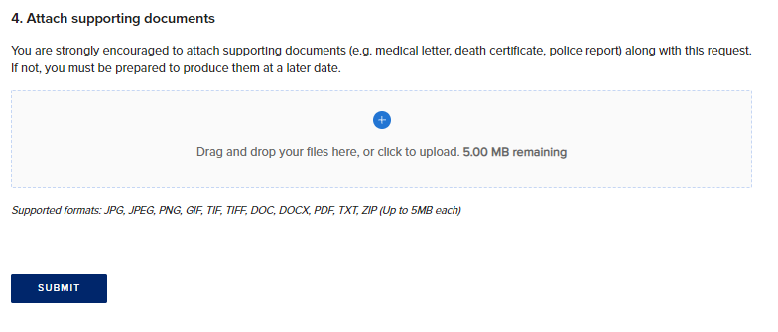
05. Name Error Correction
FLIGHT SEARCH
Waive Fees for Name Correction
Supporting documents (e.g. passport) are required for name correction SRF
Click “Submit”

Slide 41
FORM 06
WAITLIST CONFIRMATION (DAPO)

Slide 42
06. Waitlist Confirmation (DAPO)
FLIGHT SEARCH
Service Request for Waitlist Confirmation (DAPO)
Raise a DAPO request

Slide 43
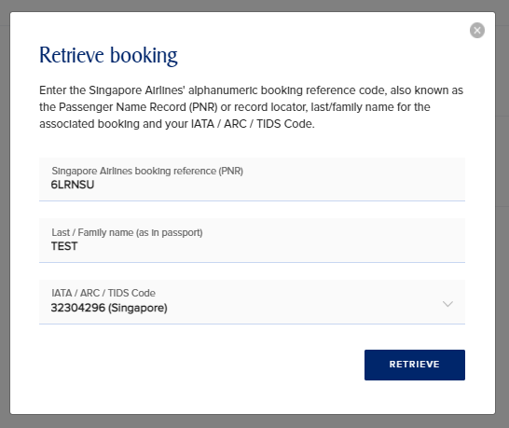
06. Waitlist Confirmation (DAPO)
FLIGHT SEARCH
Service Request for Waitlist Confirmation (DAPO)
You should key in the waitlist PNR, Last Name and IATA used to make the booking or issue the ticket
Proceed to retrieve the booking by clicking Retrieve
As waitlist bookings can only be made through EDIFACT for now, only EDIFACT bookings can be retrieved
8A9BCD

Slide 44
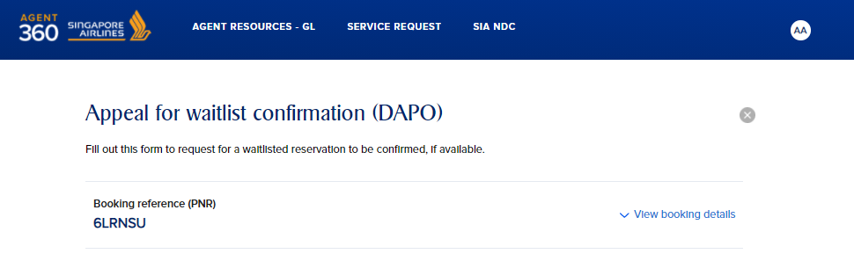
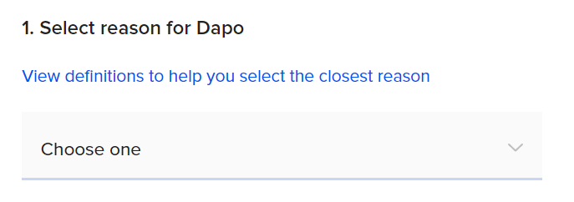
06. Waitlist Confirmation (DAPO)
FLIGHT SEARCH
Service Request for Waitlist Confirmation (DAPO)
Proceed to select reasons for DAPO
View definitions to select the closest reason
8A9BCD
Reasons | Eligible RBDs
Medical Compassionate Situations beyond Passenger’s Control Involuntary schedule / aircraft changes / Downgrade Natural / political situation / crisis | All RBDs
Others | FZSY only

Slide 45
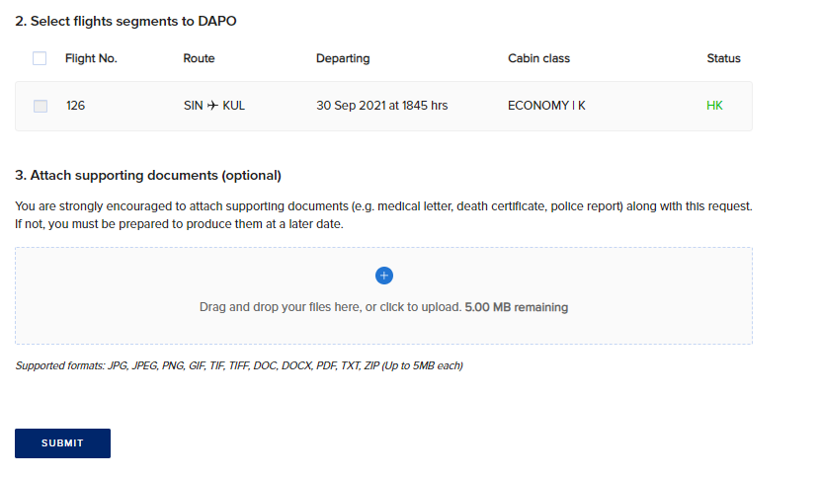
06. Waitlist Confirmation (DAPO)
FLIGHT SEARCH
If a flight segment is ineligible for DAPO, the selection box will be greyed out for that segment
114
W
WL
Service Request for Waitlist Confirmation (DAPO)
Select all waitlist flight segments to raise a DAPO request for
We strongly encourage attaching supporting documents to aid processing of your service request

Slide 46
FORM 07
GENERAL FORM
*Non-IATA/TIDS agents will only be able to submit the General Form

Slide 47
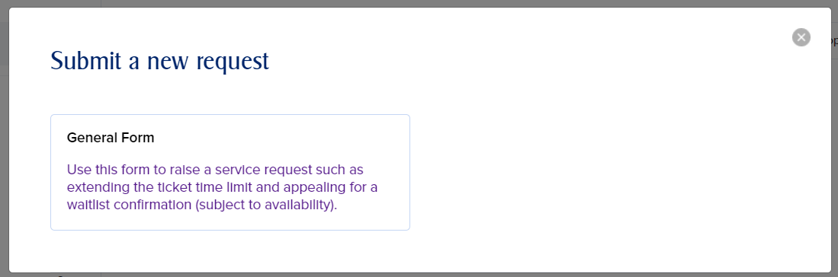
07. General Form
FLIGHT SEARCH
IATA / TIDS
Non-IATA / Non-TIDS
General Form
For other service requests
Seat Selection
Meal Selection
Unmarry Booking
Discounted tickets / FOC tickets
Excess Baggage
Wheelchair / Mobility aids
Unaccompanied Minor
Infant / Bassinet Request
Pet Handling / Requirements
Medical Information / Requirements
TTL – for bookings made via GDS PCC
DAPO – for bookings made via GDS PCC
Others

Slide 48
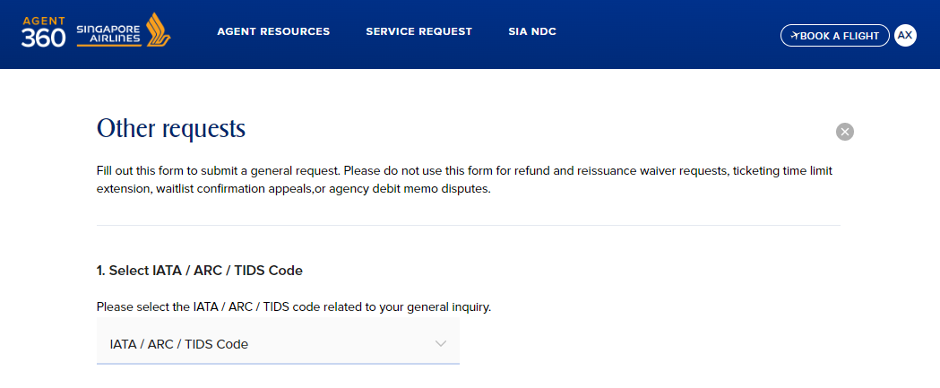
07. General Form
FLIGHT SEARCH
General Form
Select IATA / ARC/ TIDS code

Slide 49
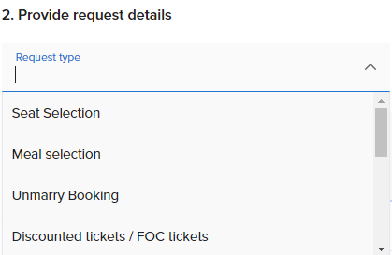
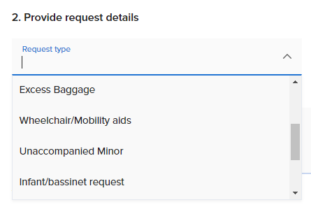
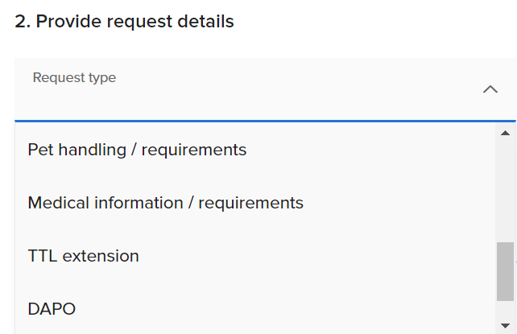
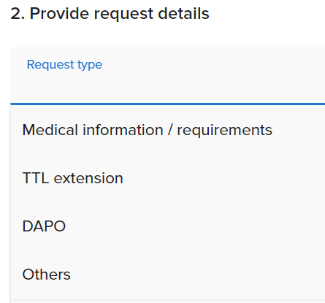
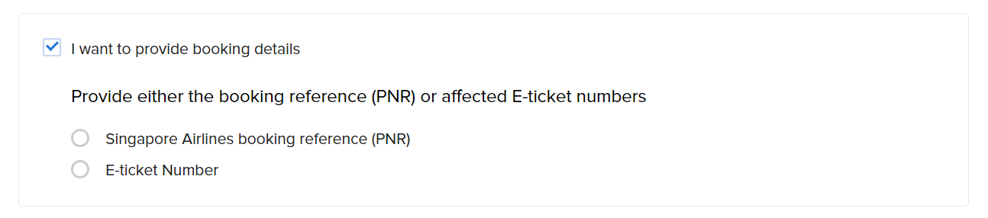
07. General Form
FLIGHT SEARCH
General Form
Select request type
You can provide more booking details like PNR and e-ticket number

Slide 50
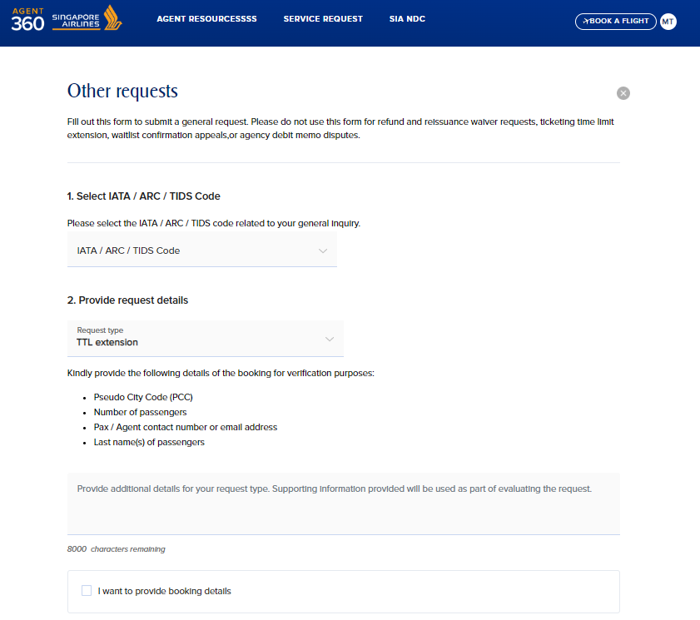

07. General Form – TTL and DAPO
FLIGHT SEARCH
General Form – TTL and DAPO
Sub-agents who need to submit a service request through a GDS PCC can submit TTL and DAPO via General Form
You will need to provide some verification details and booking details like PNR / e-ticket number

Slide 51
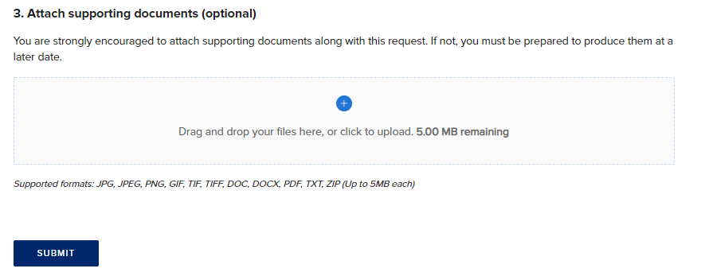
07. General Form
FLIGHT SEARCH
General Form
We strongly encourage attaching supporting documents to aid processing of your service request

Slide 52
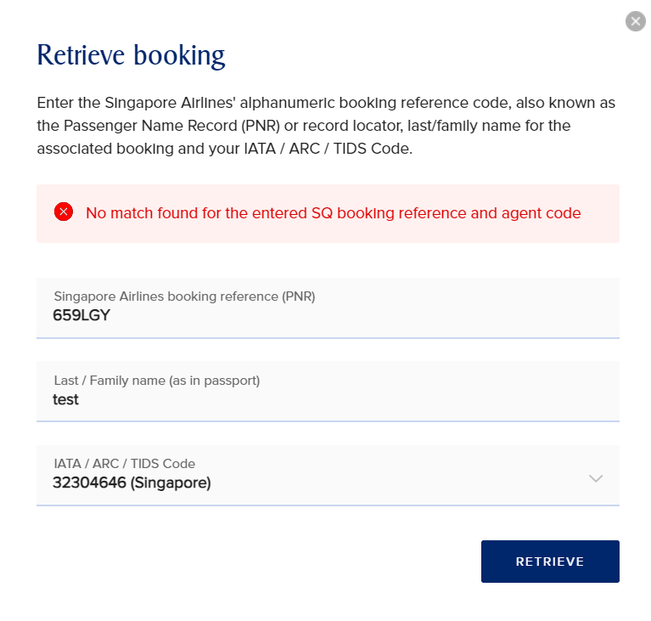
Subagents who book under GDS PCC
FLIGHT SEARCH
Bookings made under a GDS PCC
IATA and TIDS sub-agents will face this error if they retrieve a booking booked under a GDS PCC and be redirected to submit the general form instead
If the booking is made by a GDS PCC, please submit a general form.

Slide 53
EMAIL NOTIFICATIONS
FOR SERVICE REQUESTS

Slide 54
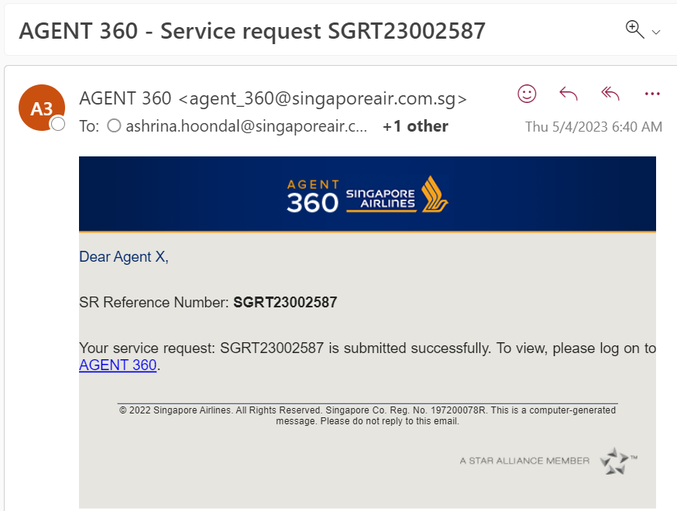
NOTIFICATION AFTER SERVICE REQUEST SUBMISSION
FLIGHT SEARCH
Notification of Submission
After you submit a service request, agent will receive an email notification that your service request has been submitted successfully
Email includes SR Reference Number

Slide 55
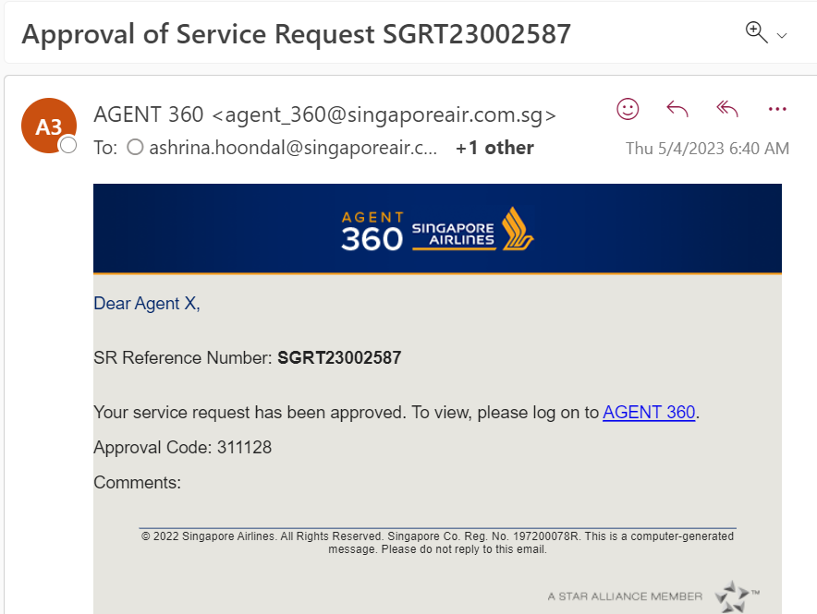
NOTIFICATION AFTER SERVICE REQUEST HAS BEEN APPROVED / REJECTED
FLIGHT SEARCH
Notification of Service Request Approval / Rejection
After SRF has been approved/rejected by SIA, agent will receive email notification
Approval code and case comments are also displayed

Slide 56
ACCESSING THE SERVICE REQUESTS DASHBOARD

Slide 57
ACCESSING THE DASHBOARD
FLIGHT SEARCH
How do Travel Agents check the
status of service requests?
You will see two options available: (1) Submit a Service Request, and (2) view Dashboard

Slide 58
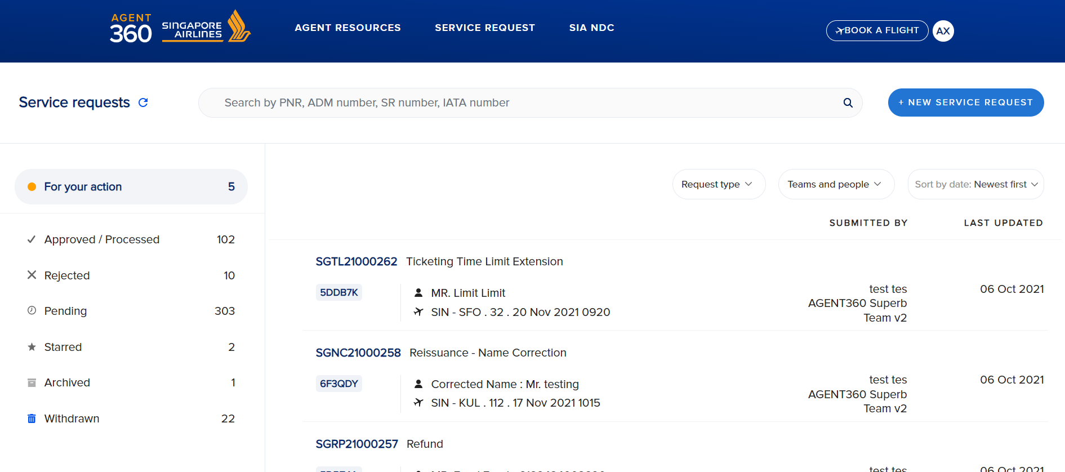
FILTERING SERVICE REQUESTS
FLIGHT SEARCH
How can Travel Agents check the
status of service requests?
Search by PNR, SRF number, IATA number
Status filters on the left
Filter by request type and people on the right
Access controls
Master can see all SRFs in agency
Admin can see all SRFs in team
User can only see individual SRFs only

Slide 59
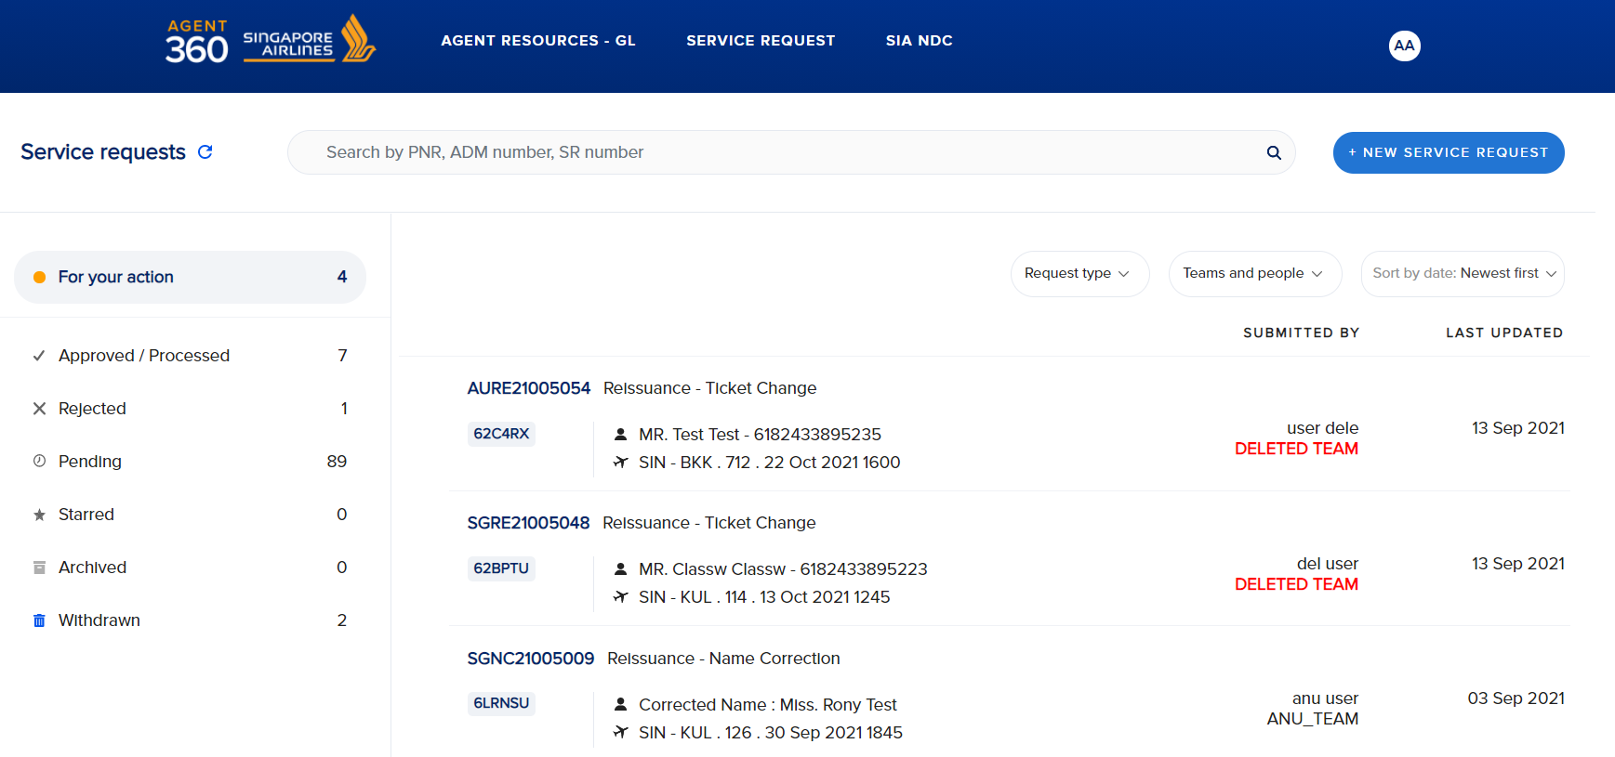
FILTERING SERVICE REQUESTS
FLIGHT SEARCH
Approved – SIA has approved service request
Rejected – SIA has rejected service request
Pending – SIA is still processing service request

Slide 60
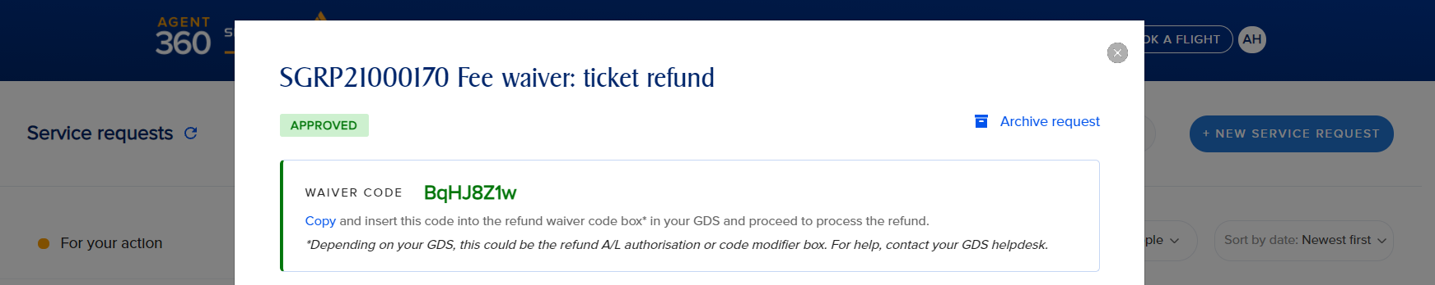
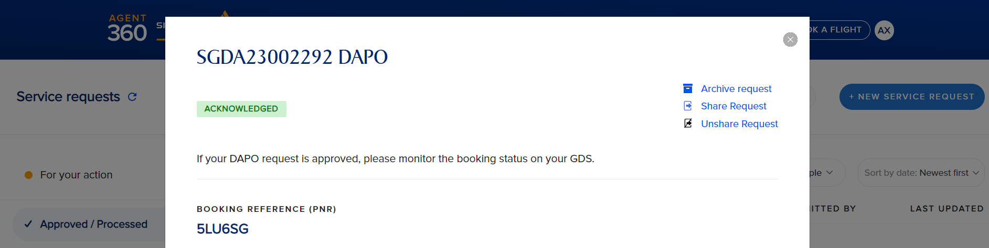
APPROVED SERVICE REQUESTS
– WAIVER CODE
FLIGHT SEARCH
Approved Service Request
You can click on the approved service request to show more details
Waiver code is displayed on top
Acknowledged DAPO
For DAPO, SRF will appear under “Approved / Processed” filter with status “Acknowledged”
Agents should monitor GDS to see if waitlist booking is confirmed

Slide 61
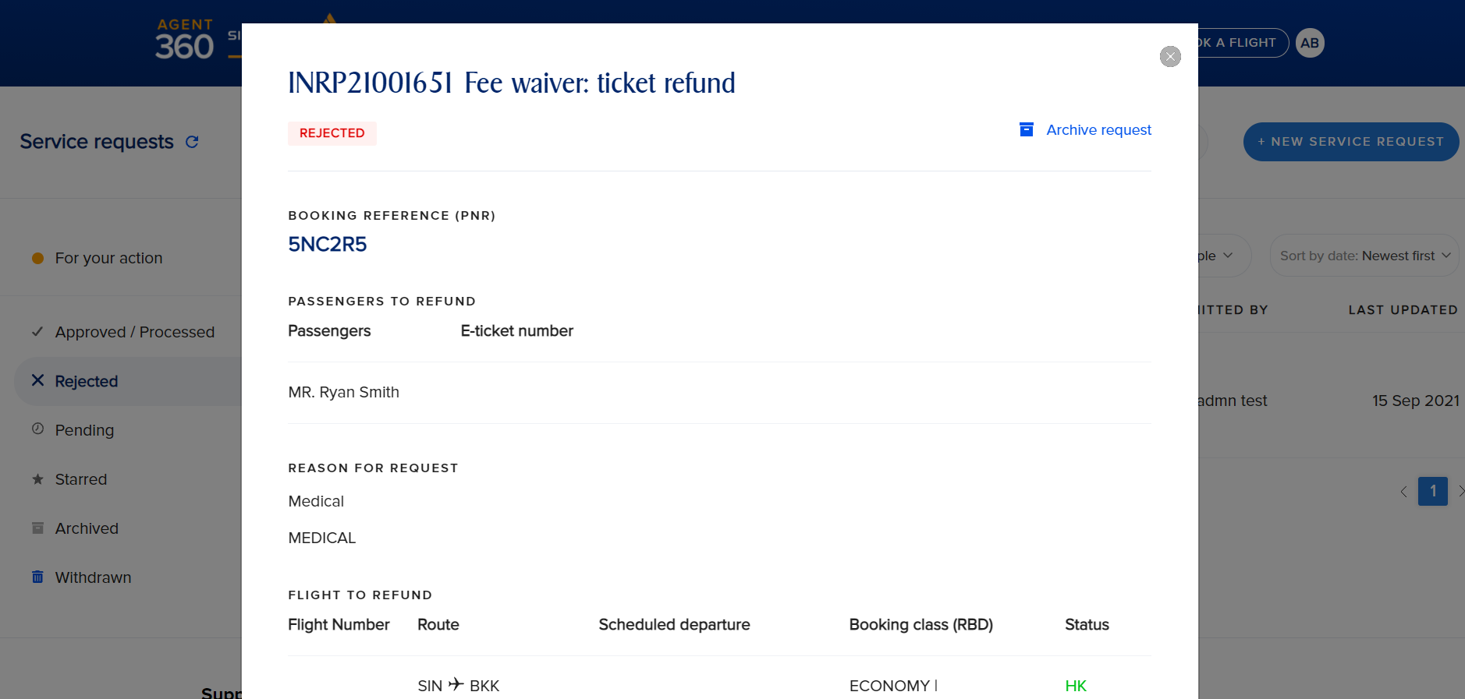
REJECTED SERVICE REQUESTS
FLIGHT SEARCH
Rejected Service Request
You can click on the approved service request to show more details
Rejected service requests will show rejected status and case comments

Slide 62
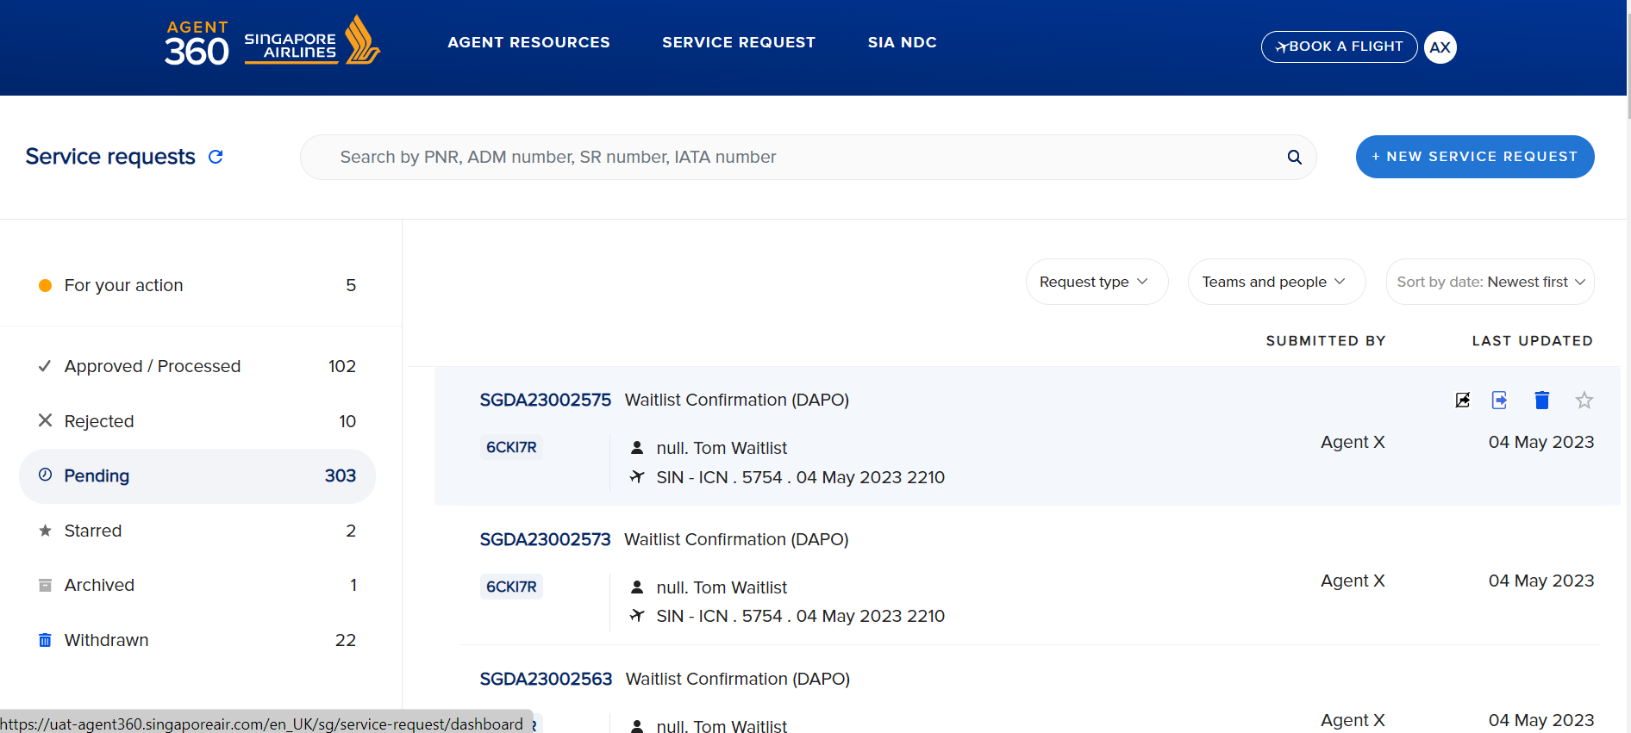
FILTERING SERVICE REQUESTS
FLIGHT SEARCH
Withdraw
Starred – You can star service requests as a bookmark for later reference
Archived – You can archive service requests that have been approved / rejected.
Withdrawn – You can withdraw a pending service request
Star

Slide 63
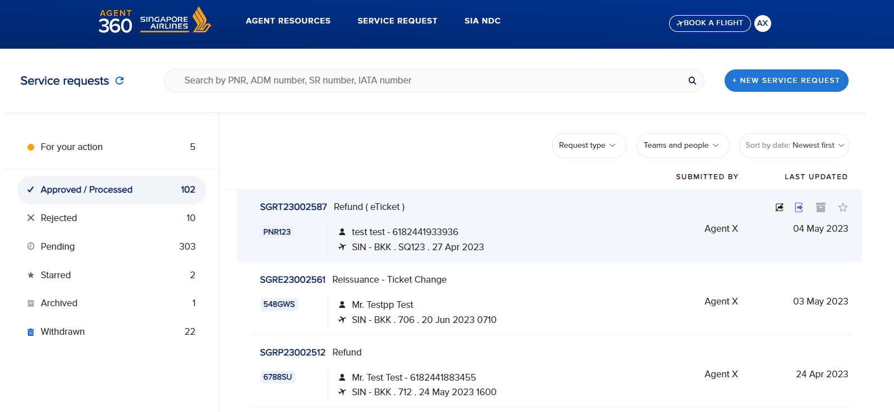
FILTERING SERVICE REQUESTS
FLIGHT SEARCH
Archive
Starred – You can star service requests as a bookmark for later reference
Archived – You can archive service requests that have been approved / rejected.
Withdrawn – You can withdraw a pending service request

Slide 64


SHARING SERVICE REQUESTS
FLIGHT SEARCH
Unshare
Share
Share Service Request
Agents can share a SRF created with any other user in the same agency regardless of their role
Select who to share SRF with​
User’s registered name on AGENT 360​
User’s registered email on AGENT 360​
SRF can be shared with multiple people within the agency​ (no limit)
Select the team to share with everyone in that team​
User A
User B
User C

Slide 65

SHARING SERVICE REQUESTS
FLIGHT SEARCH
Share Service Request
Recipient users can view SRFs shared with them on SRF dashboard​
All users with access to SRF can
View and monitor SRF
Withdraw SRF (Pending SRFs only)​​

Slide 66
SUMMARY OF
SERVICE REQUESTS EXCLUSIONS

Slide 67
SERVICE REQUESTS EXCLUSIONS
FLIGHT SEARCH
Service Request Form | Ineligible RBDs for SRF (cannot submit SRF)
Reissuance | -
Refund | -
Excess Baggage | -
TTL Extension | QNVK, R,D
DAPO | If reason is “Others”: All RBDs except F,Z,S,Y
Name correction | -

Slide 68
THANK YOU!
Please reach out to us for questions or clarifications

