Slide 1


AGENT 360
AGENT FRIENDLY DECK

Slide 2
TABLE OF CONTENTS
ONBOARDING
A360 BOOKING PORTAL
Overview
Travel Agent Roles
Travel Agent Registration
Creating/Deleting Teams
Deleting Teams
Adding Admins/Users to Teams
Delete Admin/Users from Teams
Switching Teams and Roles
Adding Additional IATA Numbers
Assigning IATA to Teams
Reactivating Account
Unlocking Account
Reset Password
Dashboard
Booking Flight
Servicing Unticketed Bookings
  Adding Ancillaries to Unticketed Booking
  Manual Reprice
  Reshop Unticketed Booking
  Reshop Unticketed Booking – Instant Payment
  Reshop Unticketed Booking – Deferred Payment
  Cancel Unticketed Booking
Issuing Tickets
Servicing Ticketed Bookings
  Adding Ancillaries to Ticketed Booking
  Reshop Ticketed Booking
    Reshop Ticketed Booking – Instant Payment
    Reshop Ticketed Booking – Deferred Payment
    Partial Mixed Cabin Class Reshop
  Void/Refund Ticketed Bookings
Order Management
  Generate itinerary/eticket
  Split PNR
  Flight Schedule Changes
  Passenger Management
  Reports
    IUR Accounting Report
  Cross-Channel Servicing
  Agency Access Controls
  Share Bookings and User Group
Subagent-Consolidator Flow
  Registration
  Subagent Appointment
  Subagent Create Booking
  Queue Bookings
  Complete Queue
Summary

Slide 3
WHAT’S NEW
Booking Portal
Dashboard includes sales from imported PNRs
Booking Flight
  Flight filters
  Prioritisation of fare types within fare family
  Save traveller and Passenger Management
  Doc info optional for all itineraries
  Pay instantly
Servicing bookings
  Reshop
    Reshop unticketed with deferred payment (double inventory)
    Reshop ticketed with deferred payment (double inventory)
  Ancillaries
    Hold ancillaries for ticketed bookings
  Reports
    Download IUR accounting files directly
    Import multiple PNRs
    Share bookings automatically in user group
Subagent-consolidator flow

Slide 4
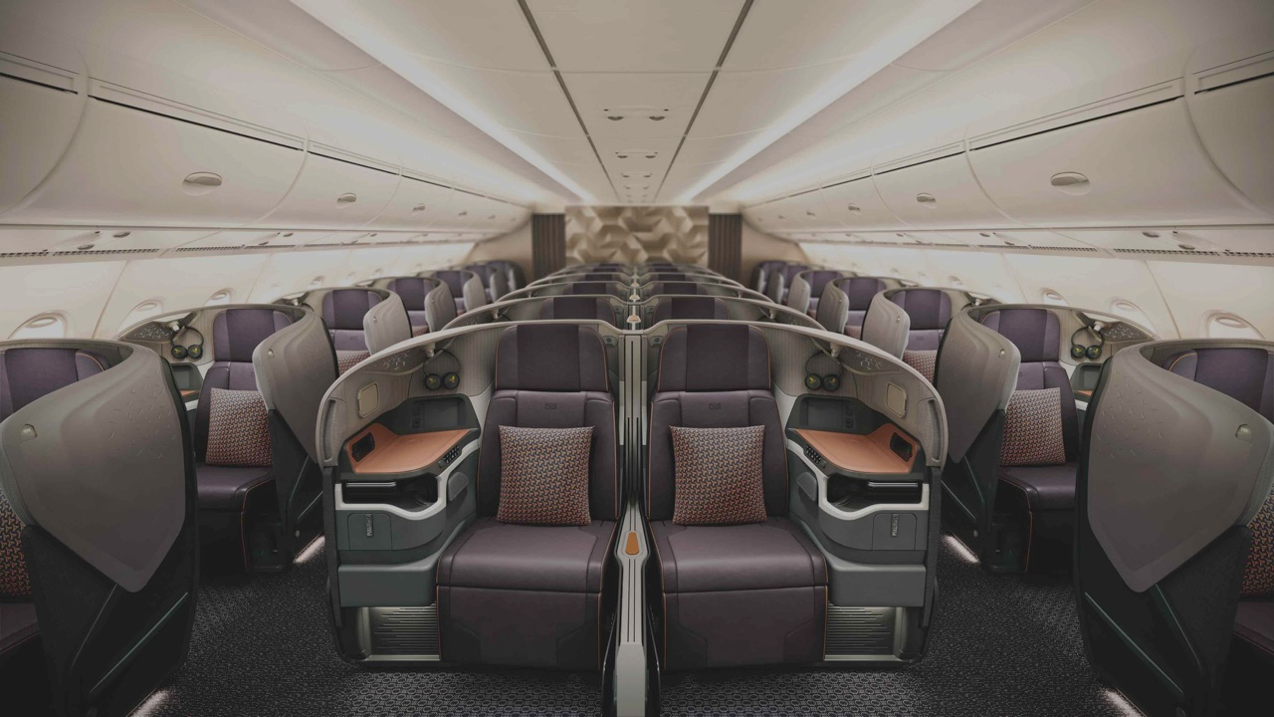
ONBOARDING
AGENT 360 Overview

Slide 5
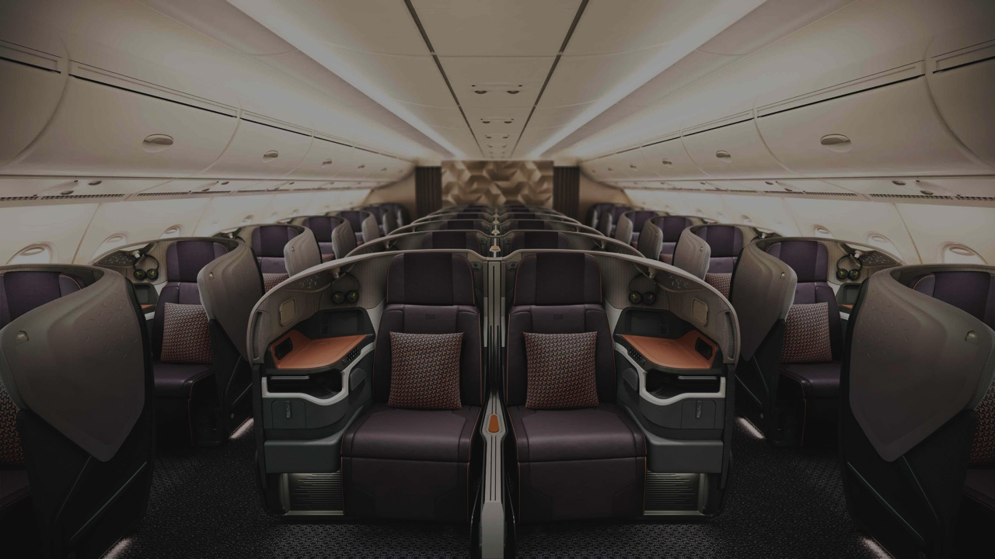
CURRENT FEATURES
A one-stop travel agent portal for our travel agents to work with Singapore Airlines.
1
2
3
Knowledge
Providing a centralized information and support portal to empower travel agents
NDC Bookings
Book flights, service bookings, add ancillaries and gain access to exclusive SIA NDC content
Servicing
Streamline service requests for more efficient servicing and tracking

Slide 6
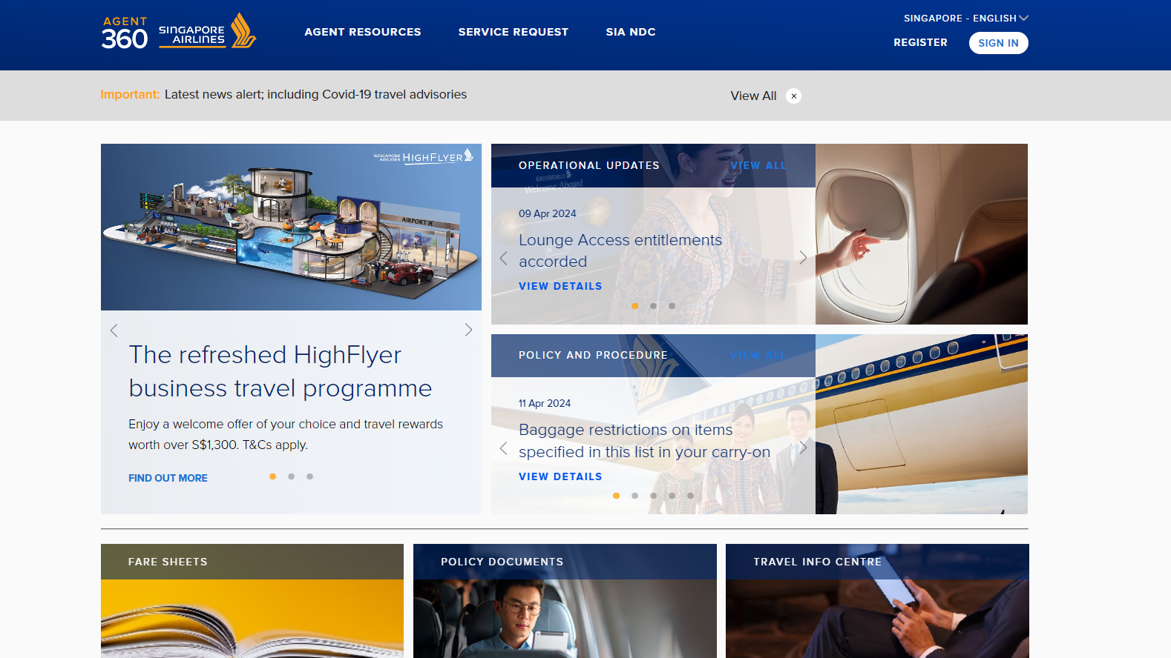
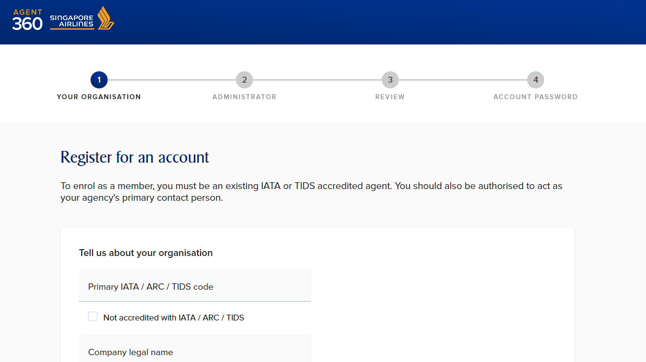
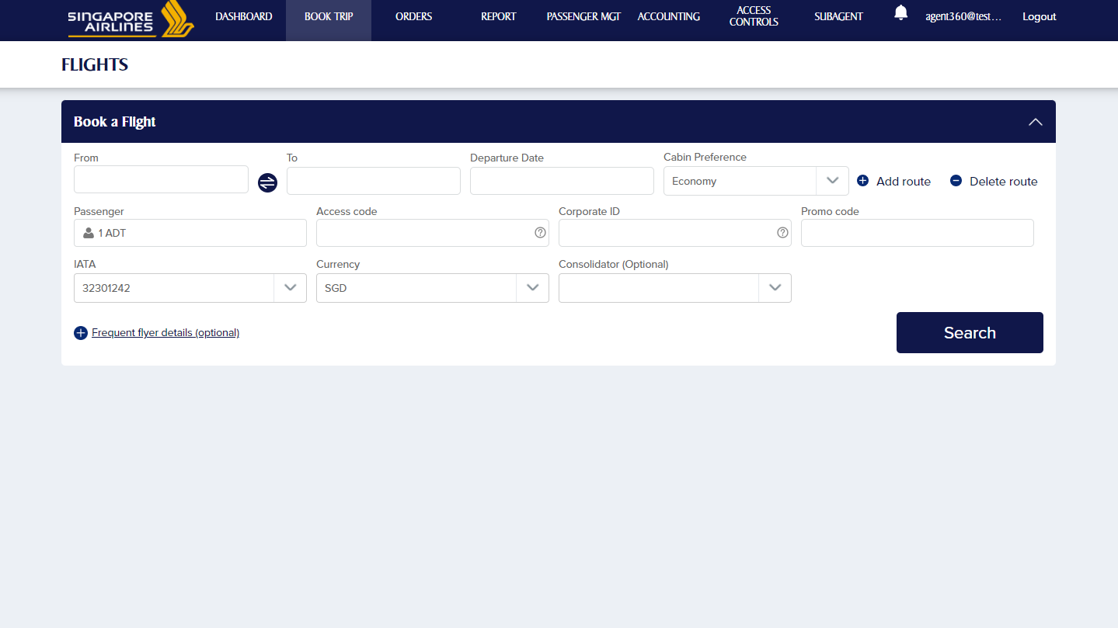
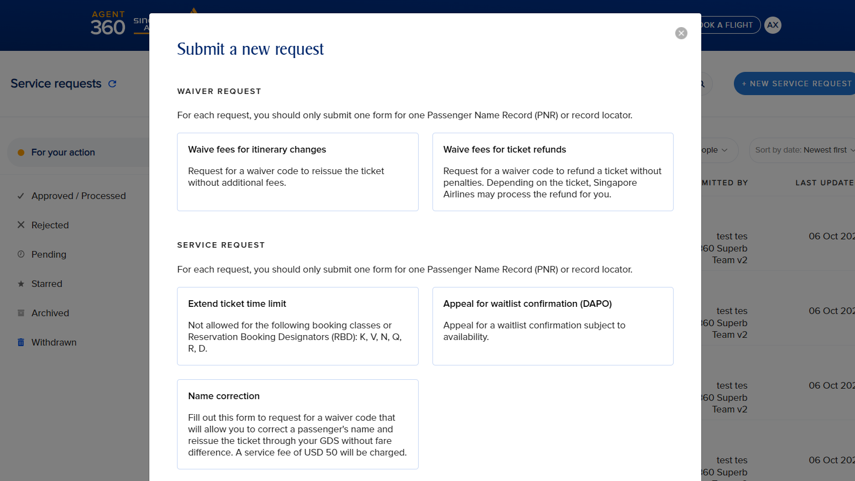
CURRENT FEATURES
Travel agents will have access to the following features on AGENT 360
Localized Content
Admin Access System
NDC Booking Portal
Service Request Forms

Slide 7
Comprehensive access management system
Caters to complex travel agency setup (from local retailers to global consolidators)
3 Travel Agent Roles (Master, Admin, User)
Multi-IATA​, Multi-Country
Flexibility to self-manage access rights to AGENT 360 features
ADMIN ACCESS

Slide 8
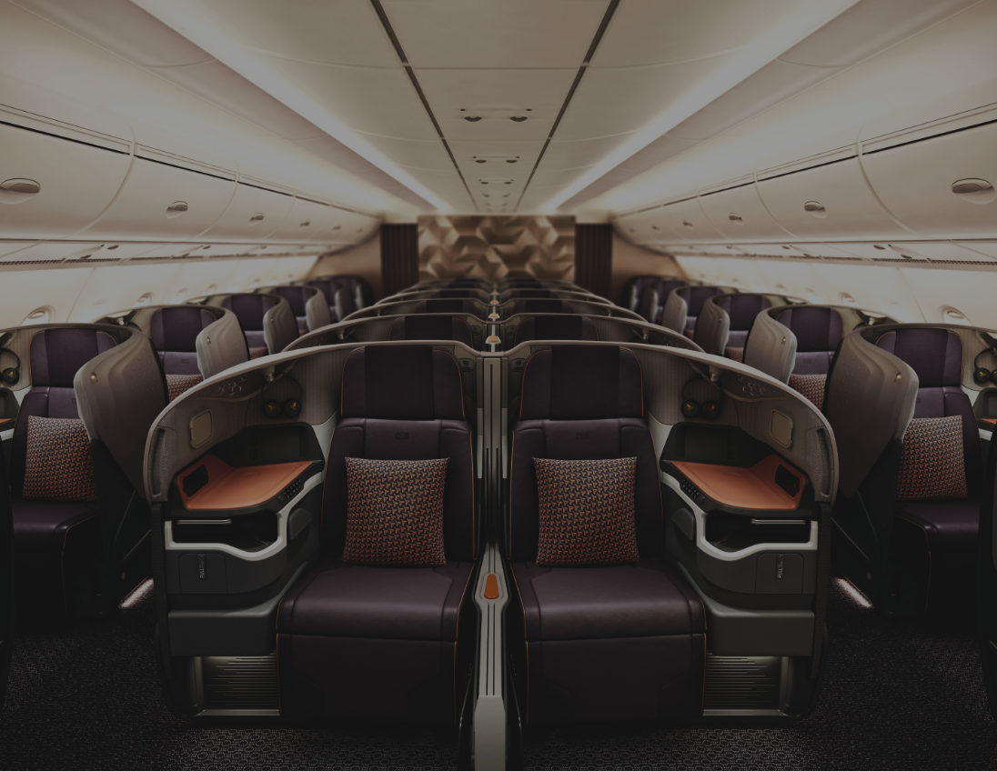

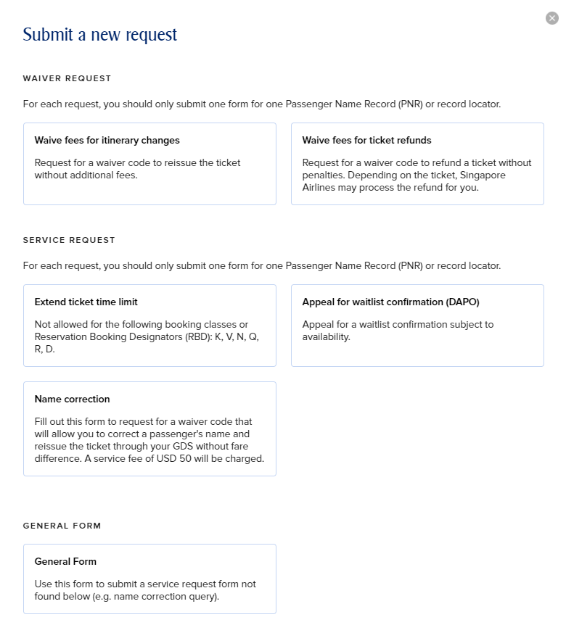

SERVICE REQUEST FORMS
Service Requests are split into 4 categories:
Waiver Request
  Waive fees for Itinerary Changes (Reissuance)
  Waive fees for Ticket Refunds
Service Request
  Extend Ticketing Time Limit (TTL)
  Name Error Correction
  Apply for Waitlist Confirmation (DAPO)
General Form*
*Non-IATA/TIDS agents will only be able to submit the General Form

Slide 9
ONBOARDING
Travel Agent Roles

Slide 10



TRAVEL AGENT ROLES
ABC International Tours
IATA 12345678, 98765432
Master
Key decision maker e.g. Supplier Manager
Master A
Team 1
IATA 12345678, 98765432
Team 2
IATA 98765432
Admin
Team Leader
Admin B
Admin F
User C
Admin G
User D
User H
User E
User I
User
Individual Travel Consultant
User J
User K

Slide 11
TRAVEL AGENT ROLES
ABC International Tours
IATA 12345678, 98765432
Master
Key decision maker. e.g. Supplier Manager
Master A
Only one Master per agency
  Shared accounts are NOT recommended as it lacks visibility at the user level e.g. transactions made by individual users
  At login, email OTP will be sent to 1 shared email address
Manage Admins & Users within the agency
Determine Team Product Access rights
  Booking Portal / AGENT 360 Credits
Add additional IATA numbers for agency and teams
View entire agency data, SRF, and bookings
How to change a Master?
Agent to contact their local SQ sales office
Team 1
IATA 12345678, 98765432
Team 2
IATA 98765432
Admin B
Admin F
User C
Admin G
User D
User H
User E
User I
User J
User K

Slide 12
TEAMS – ADMINS AND USERS
ABC International Tours
IATA 12345678, 98765432
Master creates teams to invite admins and users
Master A
Each team can have unlimited Admins & Users
(Min. 1 admin)
Team 1
IATA 12345678, 98765432
Team 2
IATA 98765432
Each Team can have
multiple IATA / ARC / TIDS codes
Admin B
Admin F
User C
Admin G
IATA numbers can repeat across teams
User D
User H
User E
User I
Master registers one IATA / ARC/ TIDS code at registration, adds additional codes later
User J
User K

Slide 13
TRAVEL AGENT ROLES
Function | Master | Admin | User
Create Agency | ✓ | ✗ | ✗
Add additional IATA / ARC / TIDS Code | ✓ | ✗ | ✗
Create Team | ✓ | ✗ | ✗
Delete Team | ✓ | ✗ | ✗
Add Admin / User | ✓ | ✓ Add user | ✗
Switch Admin / User Role | ✓ | ✗ | ✗
Switch Admin / User Team | ✓ | ✗ | ✗
Assign IATA / ARC / TIDS Code to Team | ✓ | ✗ | ✗
Unlock Admin / User Accounts are locked after 3 incorrect password attempts | ✓ Unlock admin & user | ✓ Unlock user | ✗
Reactivate Admin / User Accounts not accessed in 180 consecutive days are deactivated | ✓ | ✗ | ✗
Remove Admin / User from Team Admins / Users who are removed from a Team become floating users who can be re-assigned to another Team | ✓ | ✓ Remove user | ✗
Delete Admin / User | ✓ Delete admin & user | ✓ Delete user | ✗

Slide 14
ONBOARDING
Travel Agent Registration

Slide 15
TRAVEL AGENT REGISTRATION
How do travel agents register for an AGENT 360 account?
1
2
3
4
Register for account on AGENT 360
Verify email address by clicking email link within 72 hours
Singapore Airlines approves registration
Agents receive welcome email

Slide 16
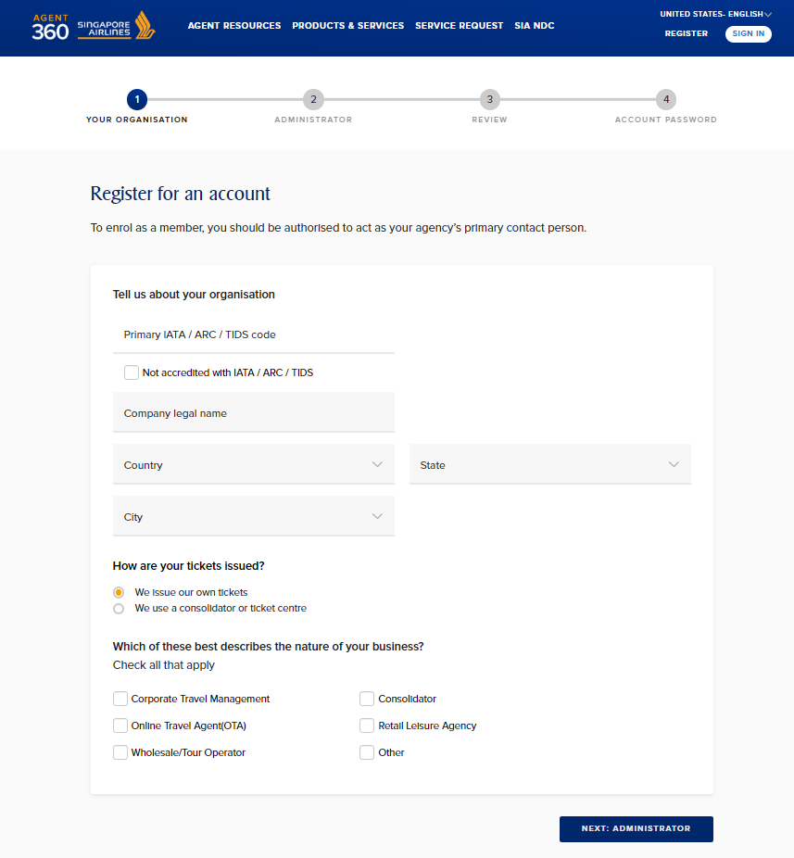
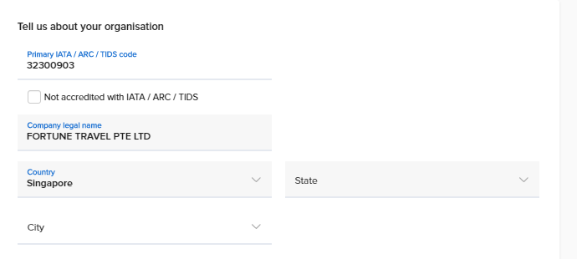
TRAVEL AGENT REGISTRATION
1
Register for account on AGENT 360
323XXXXX
Information is auto-populated based on the IATA / ARC / TIDS code submitted

Slide 17
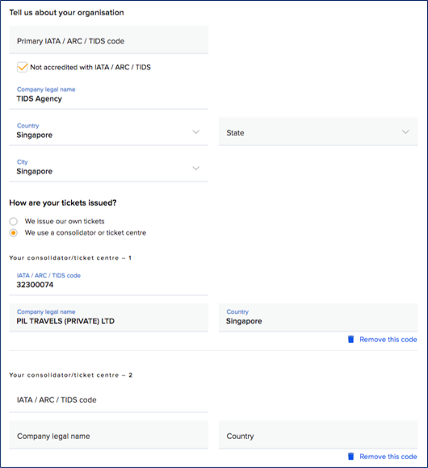
TRAVEL AGENT REGISTRATION
1
Register for account on AGENT 360
Provide information about whether tickets are issued directly or via a consolidator

Slide 18
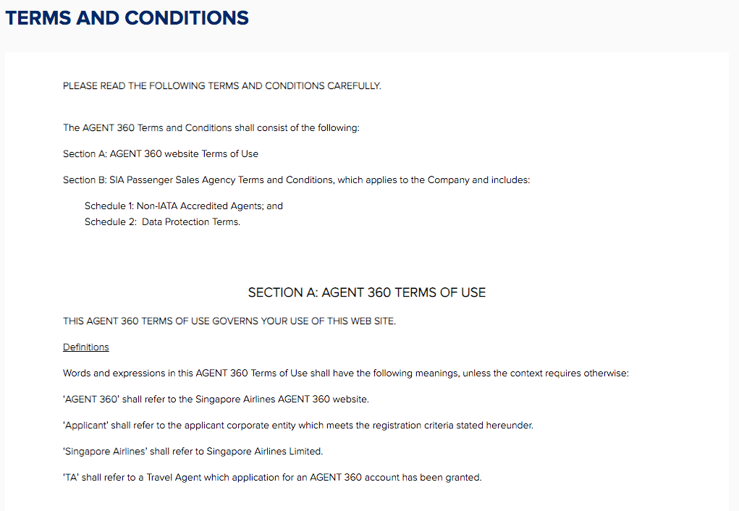
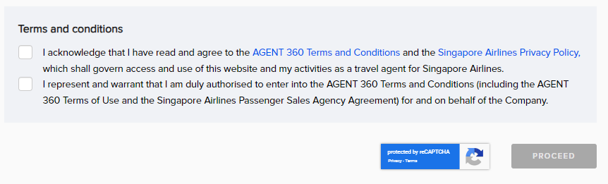
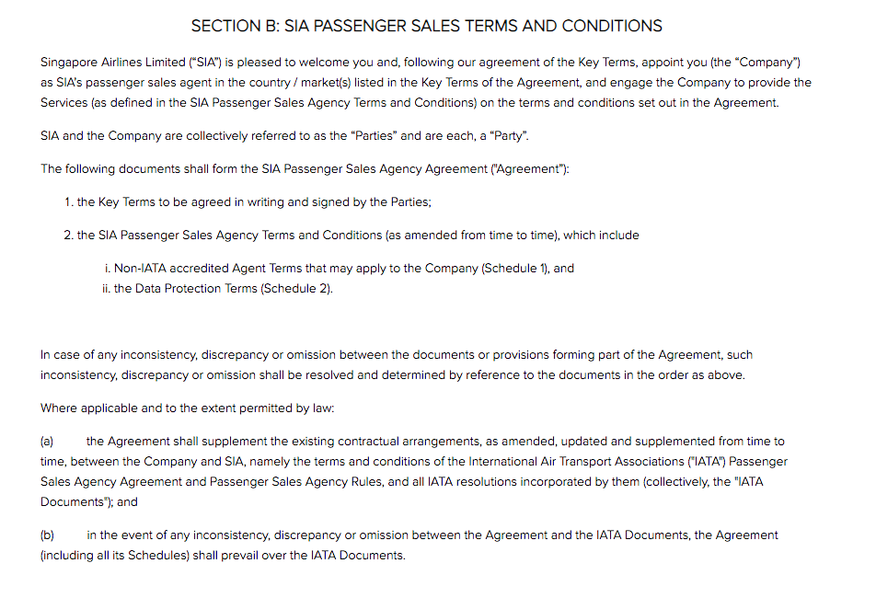
TRAVEL AGENT REGISTRATION
1a
Master acknowledge T&Cs by clicking the link
1b
AGENT 360 T&Cs include the PSAA
Section A – AGENT 360 website terms of use
Section B – SIA Passenger Sales Agency Agreement (PSAA)
Master accepts T&Cs on behalf of agency for all the IATA / ARC / TIDS codes registered to their AGENT 360 account

Slide 19
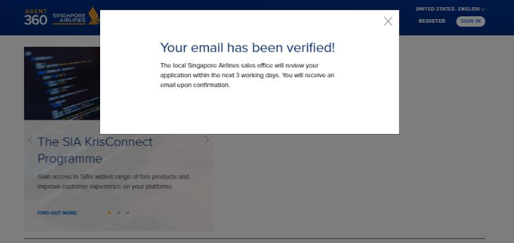
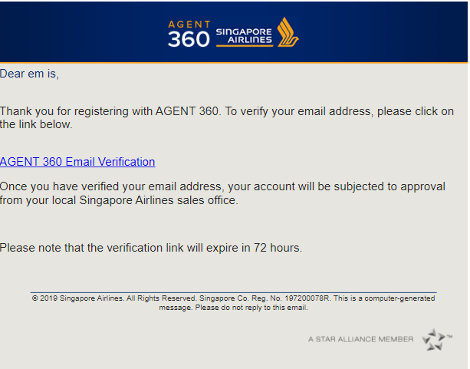
TRAVEL AGENT REGISTRATION
2
Agents verify their email address
Agent must click on verification link to complete registration
The verification link is valid for 72 hours
  If 72 hours has passed, please approach your local SQ sales office to retrigger the verification email

Slide 20
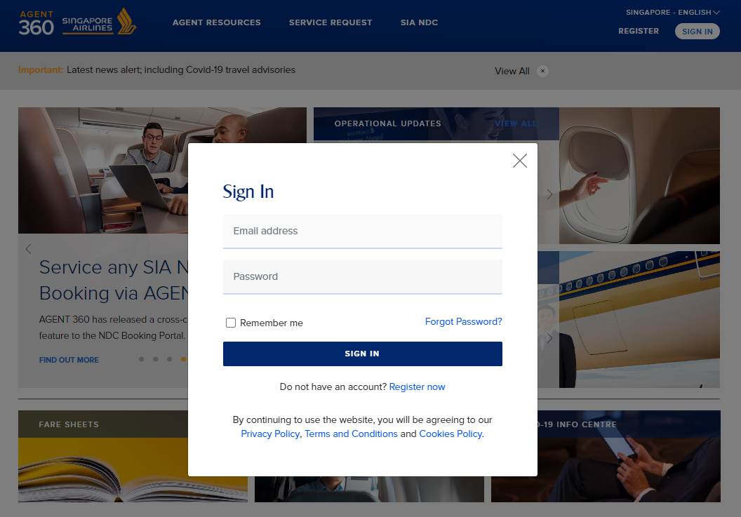
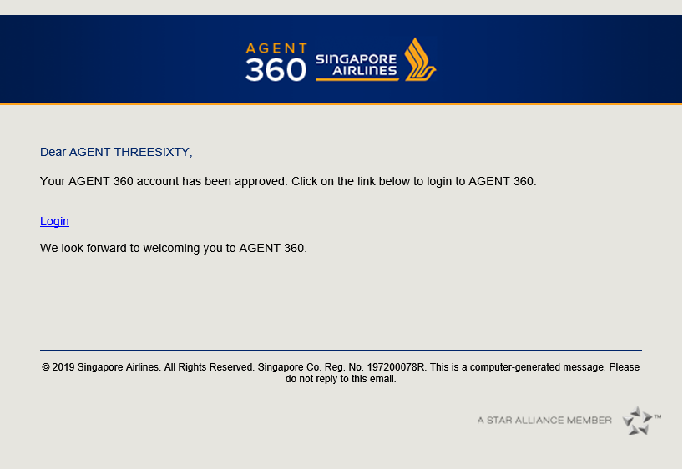
TRAVEL AGENT REGISTRATION
4
Agent receives welcome email

Slide 21
ONBOARDING
Creating a New Team

Slide 22
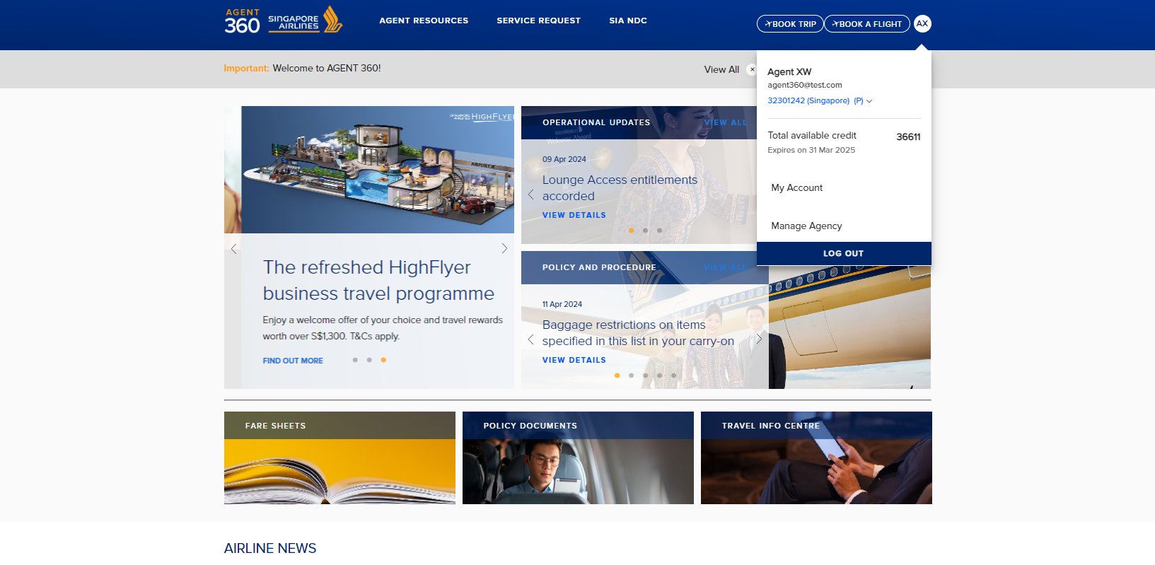

CREATING A NEW TEAM
A team must be created before admins and users can be invited
Select “Manage Agency”

Slide 23
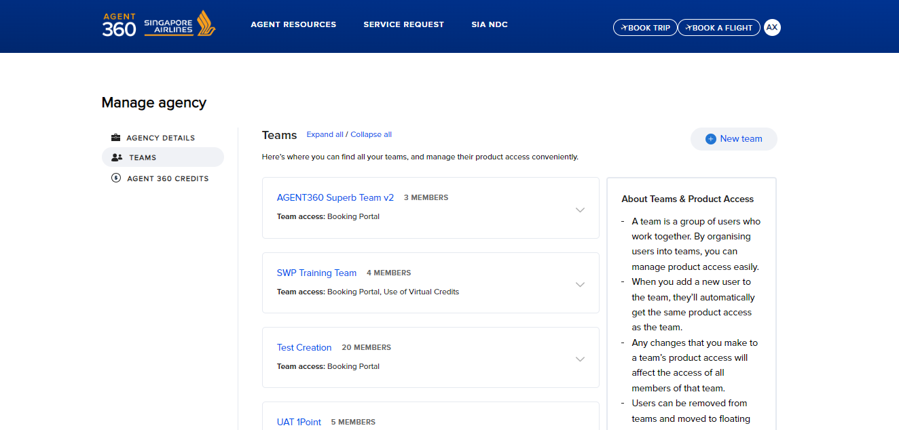
CREATING A NEW TEAM
Select “New team”
Navigate to “Teams”

Slide 24
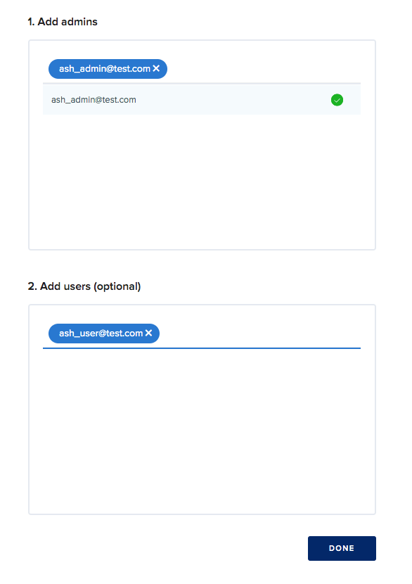
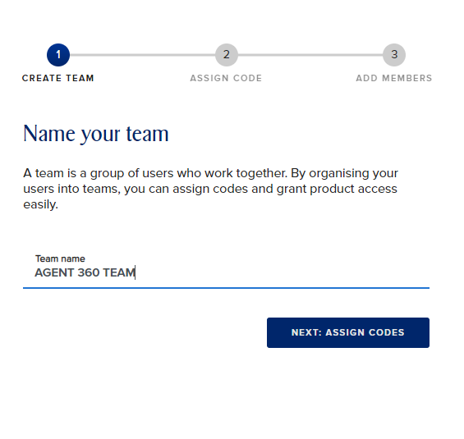
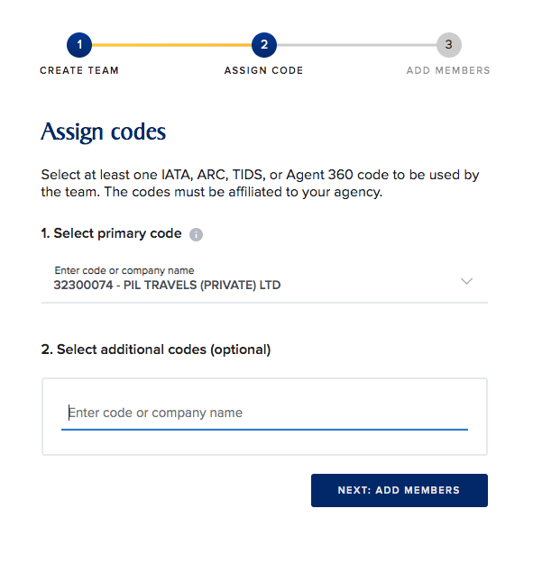
CREATING A NEW TEAM
1
Create Team Name
2
Assign Code to Team
3
Add Admins / Users to Team
Minimum 1 admin per team
323XXXXX
No limit to the number of admins/users that can be added to a team
Max 20 admins/users at a time
Admins can also add users to the same team through this method

Slide 25
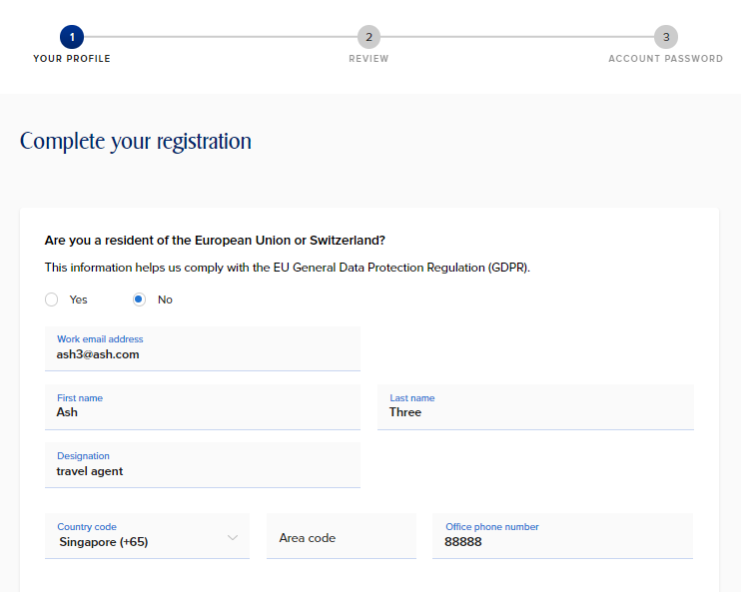
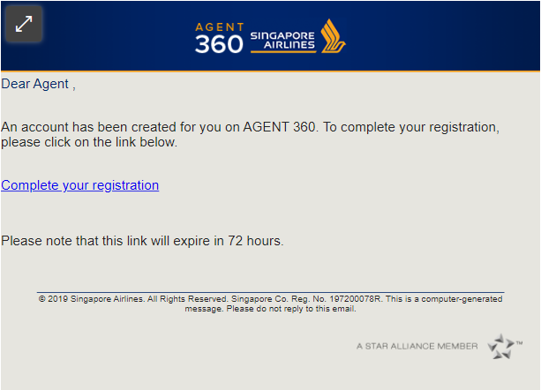
CREATING A NEW TEAM
4
Complete Registration
Admins & Users will receive an email notification link sent by Masters to complete their registration.
The invited email is auto-populated and cannot be edited.

Slide 26
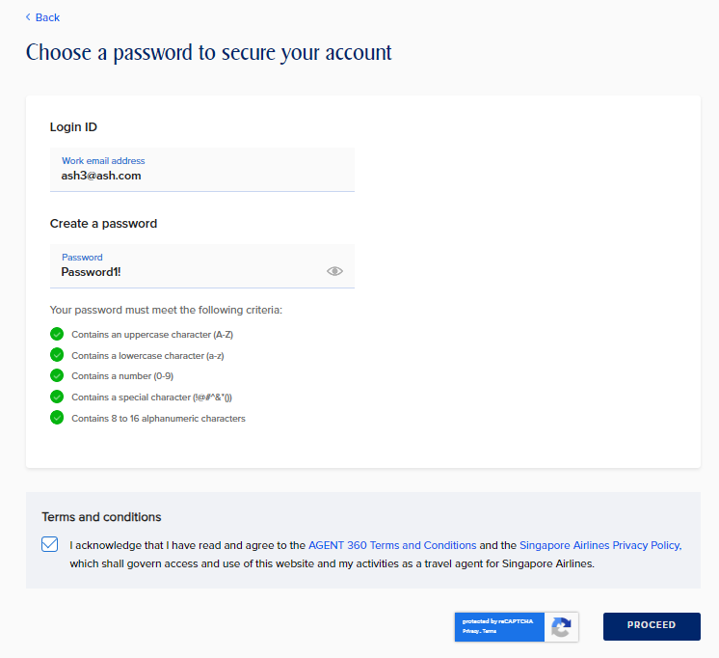
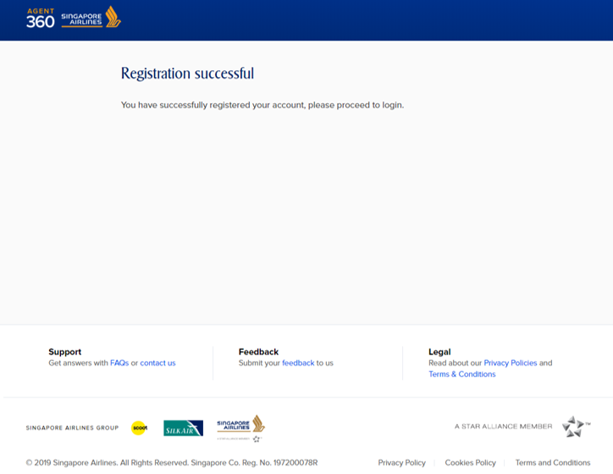
CREATING A NEW TEAM
4
Complete Registration
Admins / users set a password during registration
Account has been created and Agents can now login to AGENT 360!
Admins / users accept the general AGENT 360 T&Cs (Section A) only

Slide 27
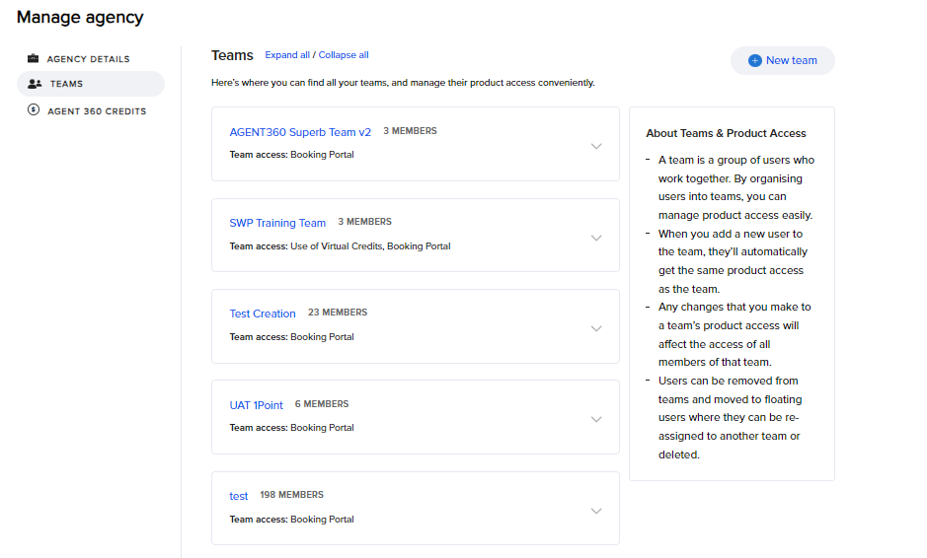
CREATING A NEW TEAM
Under “Manage Agency” > “Teams”
Masters can click on the team name to view admin and users in the team

Slide 28
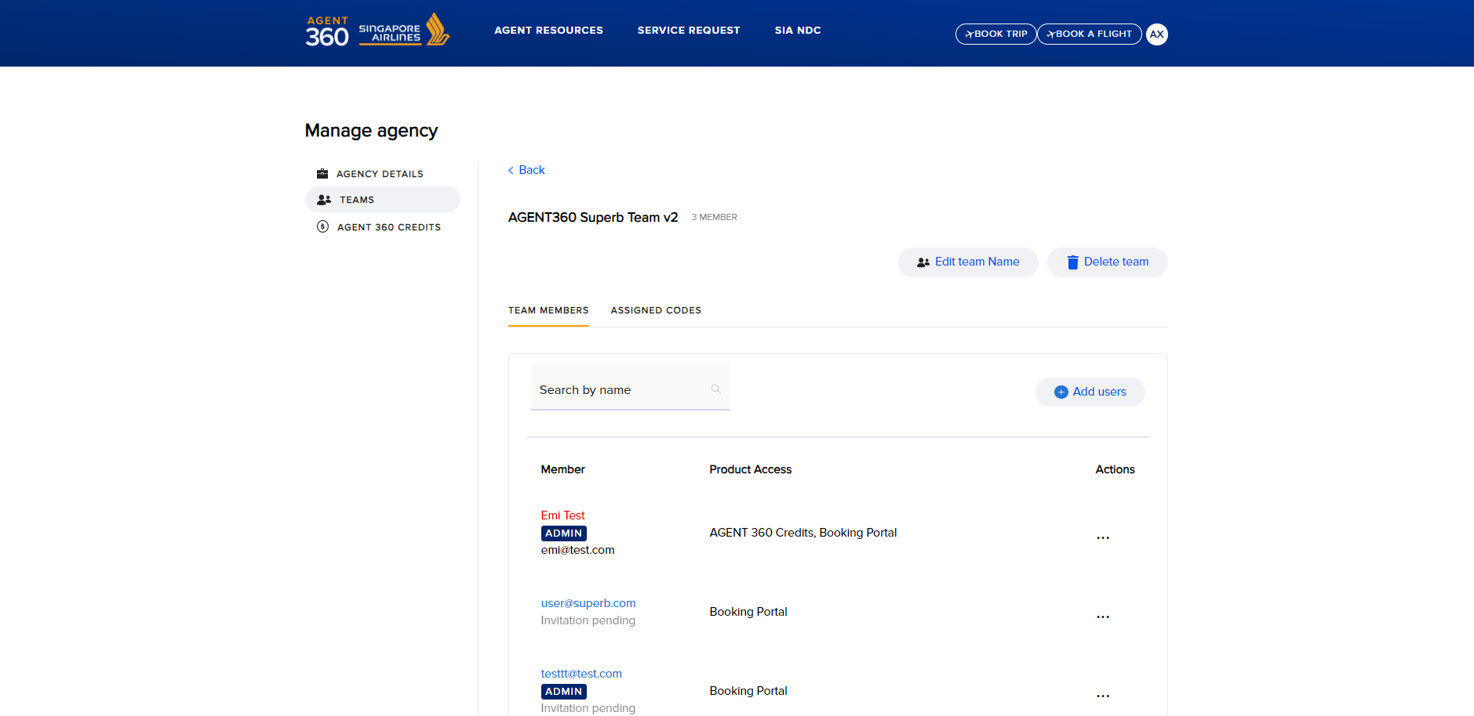
CREATING A NEW TEAM

Slide 29
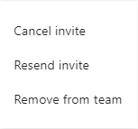
CREATING A NEW TEAM
Master will be able to track the status of their invitation.
Admins/users that have not completed registration yet have “Invitation pending” status
Once Admins/users have completed account registration, the status will be updated accordingly
The invitation email expires after 72 hours. If the team’s invitation expires, please click on resend invite to re-trigger verification email.

Slide 30
ONBOARDING
Granting Teams Product Access

Slide 31
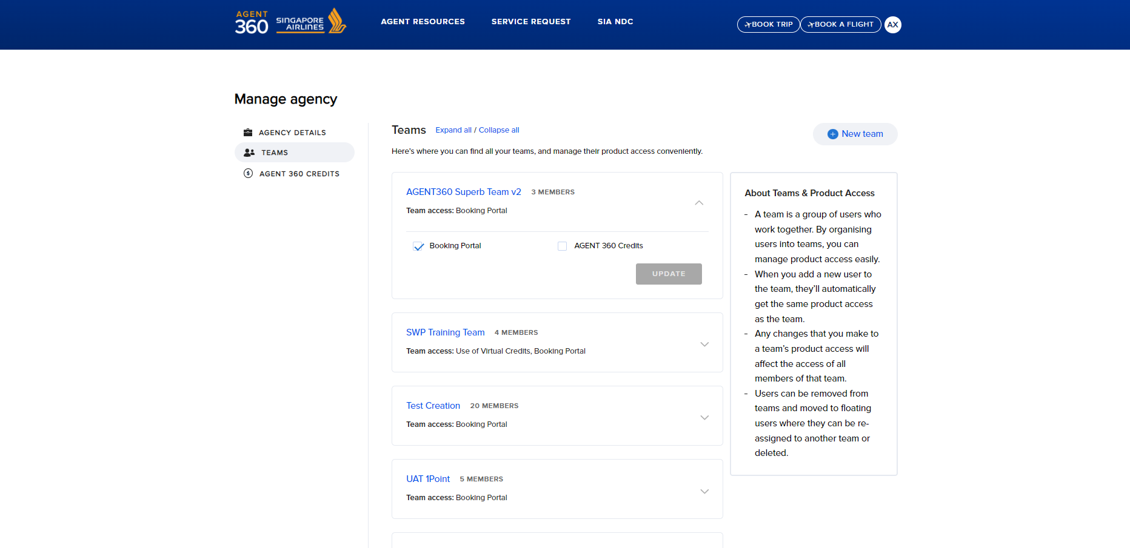
GRANTING BOOKING PORTAL ACCESS
If team booking portal access is granted, all admins/users in the team have access to the Booking Portal
The Master is responsible for granting product access to the relevant Teams.
By default, team product access is set to “none”.
Master must log in to AGENT 360 and configure the team product access settings.

Slide 32
ONBOARDING
Removing Admins/Users from Teams

Slide 33
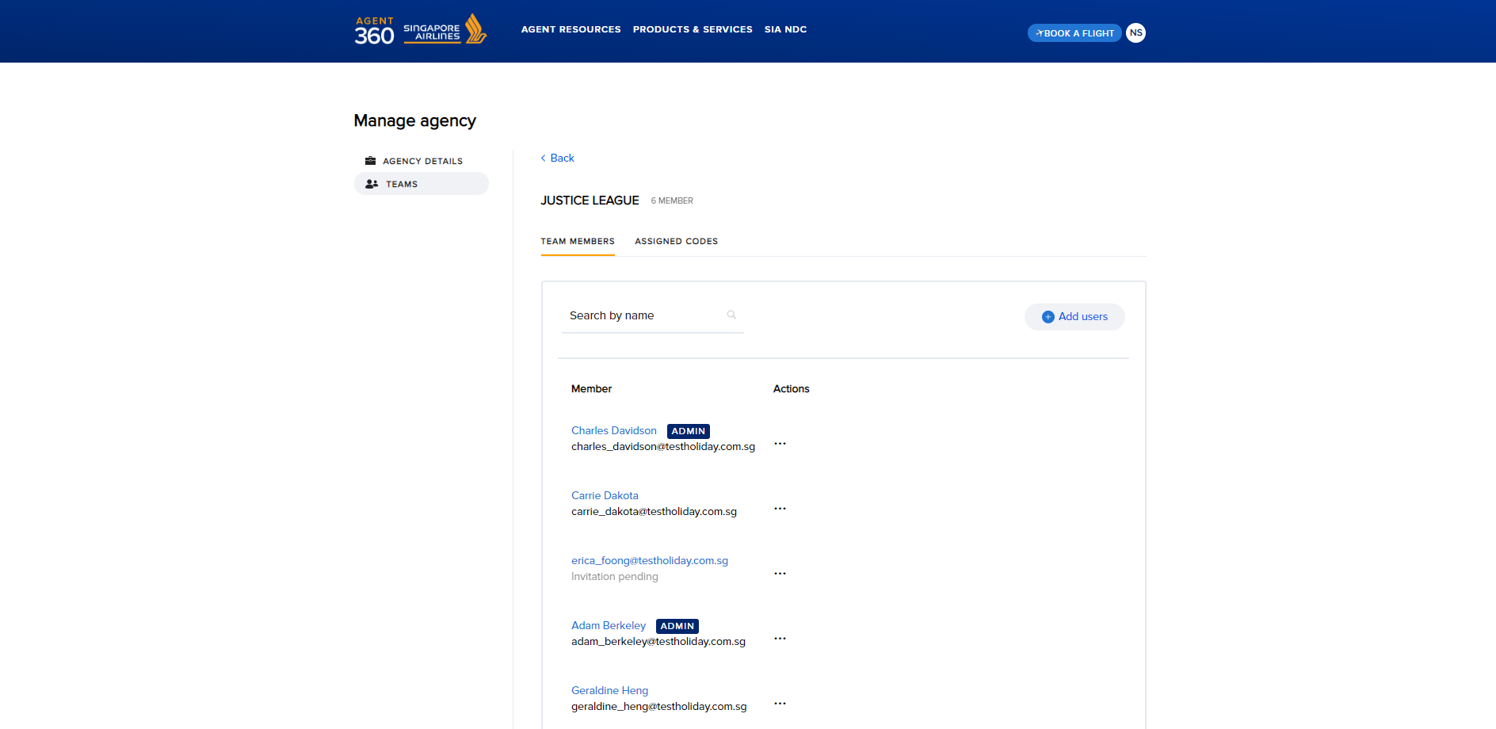

REMOVING ADMINS/USERS FROM TEAM
To remove a member, locate Admin/User that the agent wants to delete from a team and click directly on the name to enter profile.

Slide 34
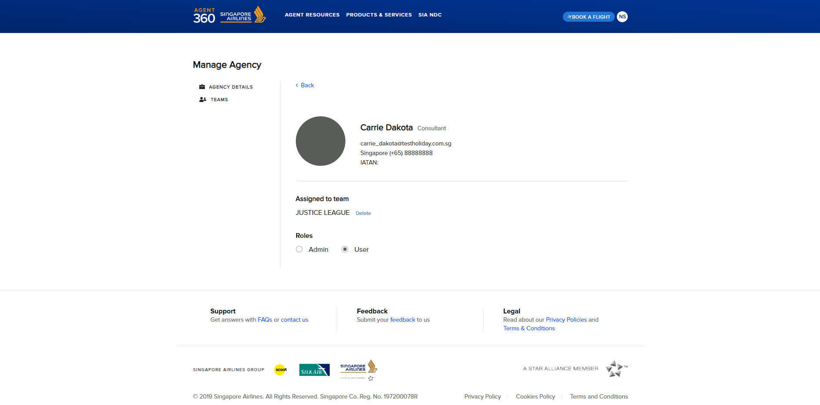
REMOVING ADMINS/USERS FROM TEAM

Slide 35
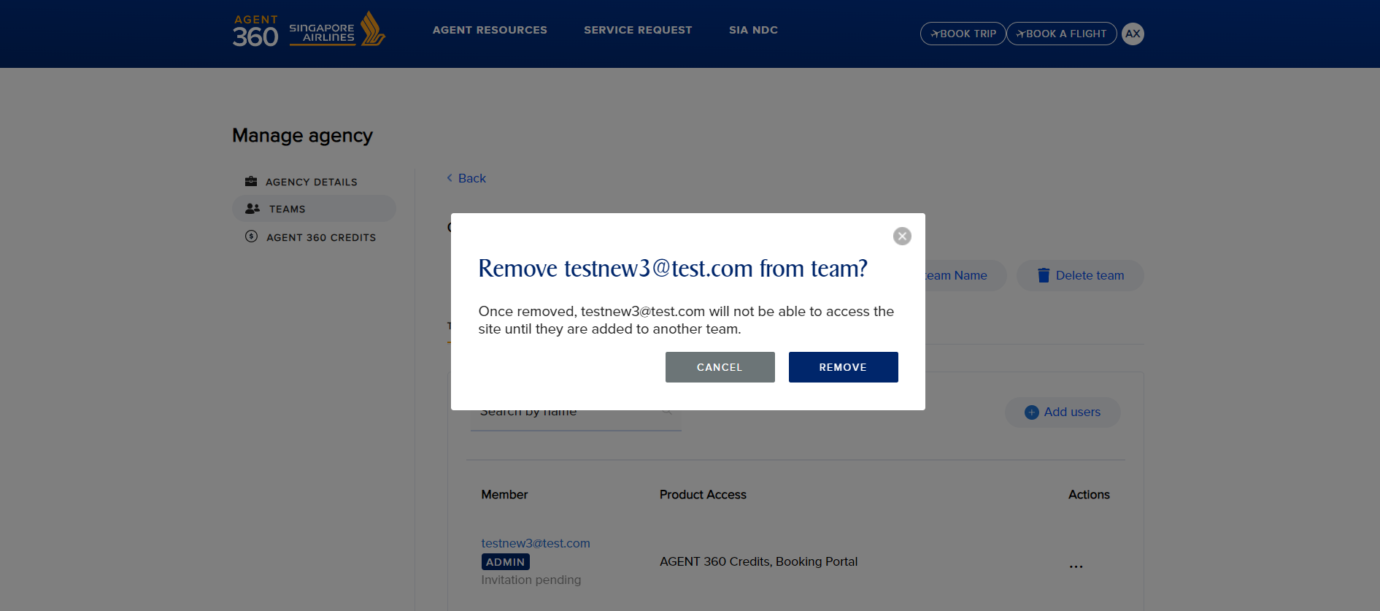
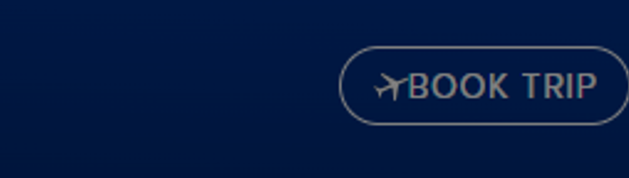
REMOVING ADMINS/USERS FROM TEAM
Once removed from a team, the user will have their account revoked and become a floating user. This user is not permanently deleted yet.
Any transactions made are still accessible by Master / Admins in the team
If there is only 1 admin left in the team, please delete team instead

Slide 36
ONBOARDING
Floating Users

Slide 37
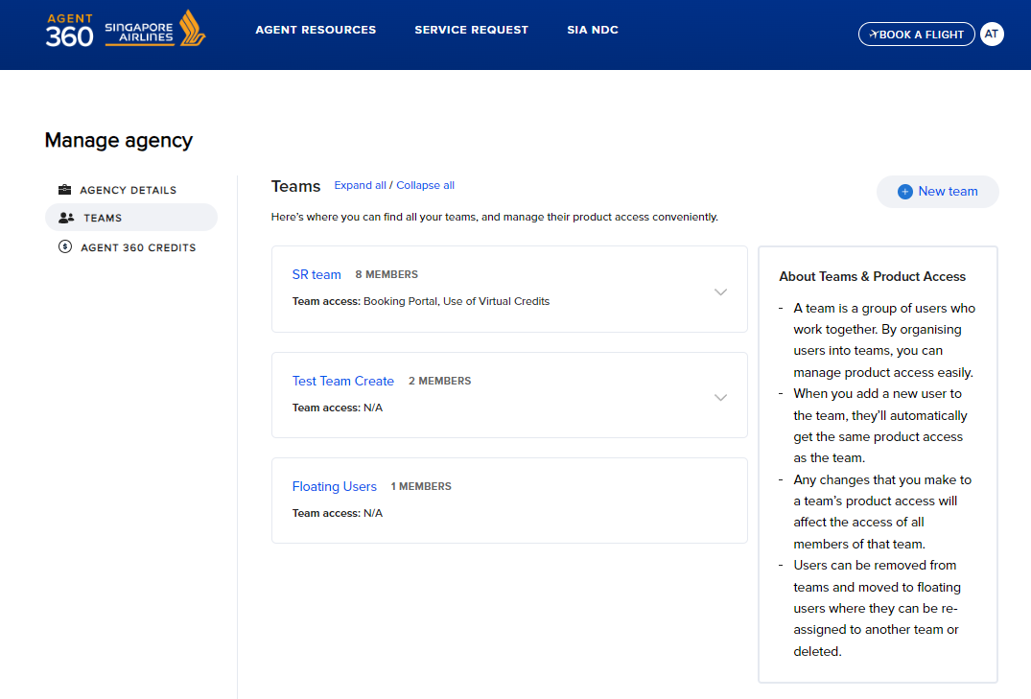
FLOATING USERS
Floating users are users who have previously been removed from a team
These floating users still have accounts on AGENT 360 but are unable to login until the Master adds them to a team.

Slide 38
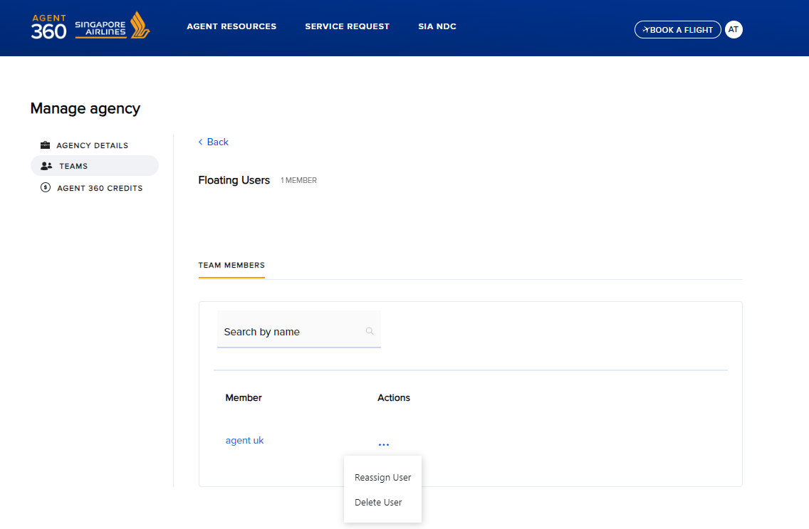
FLOATING USERS
Click on the team “Floating Users” to view a list of floating users in the team
Master can choose to
Re-assign floating users into new / existing teams
Permanently delete floating users

Slide 39
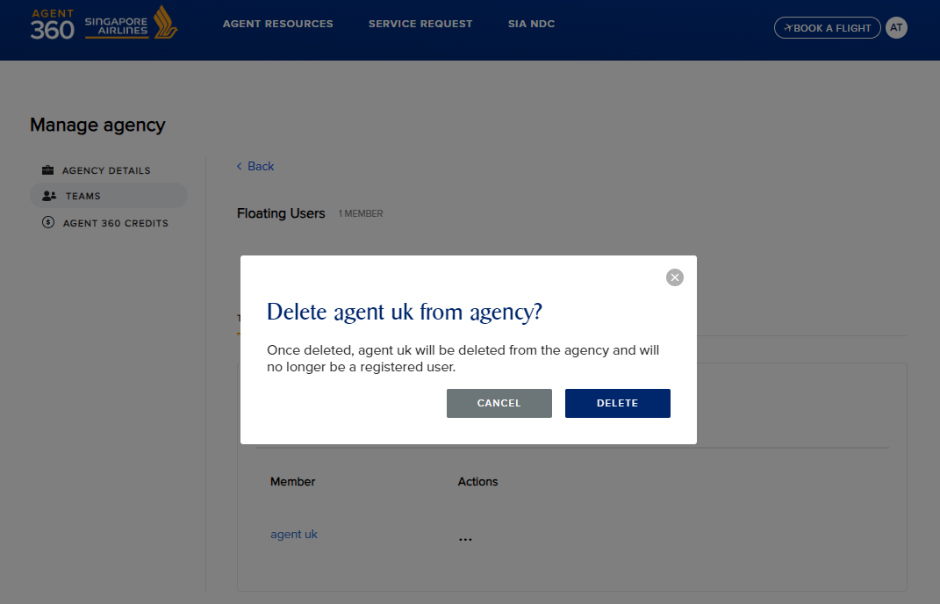
DELETING FLOATING USERS
Select Delete to permanently delete the floating user’s AGENT 360 access

Slide 40
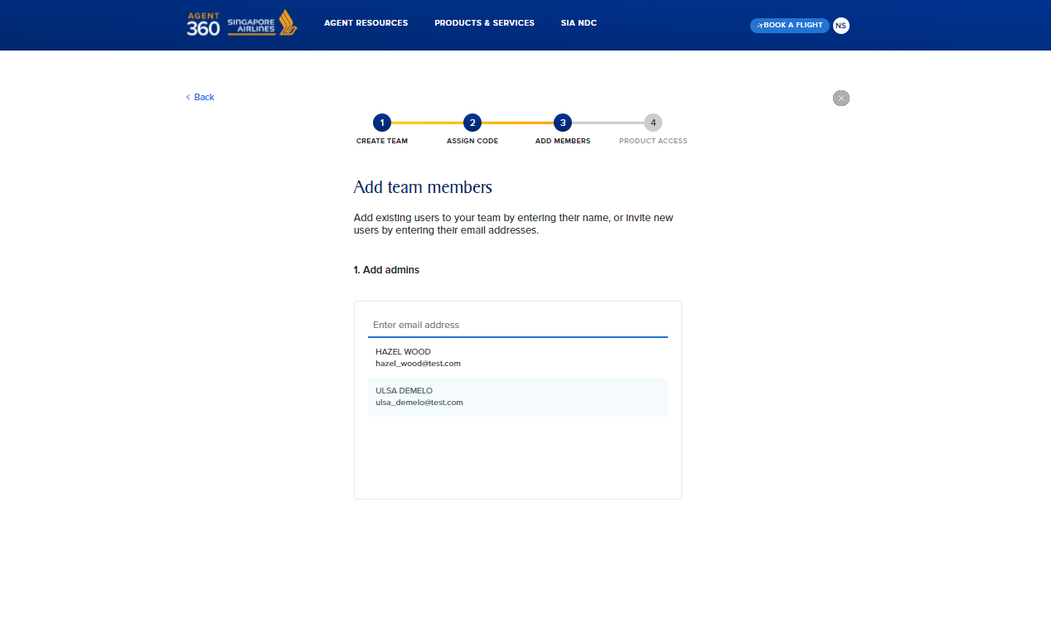
RE-ASSIGNING FLOATING USERS
Floating users can be re-assigned to a new or existing team
Appear as a drop-down option

Slide 41
ONBOARDING
Adding Admins/Users to Teams

Slide 42
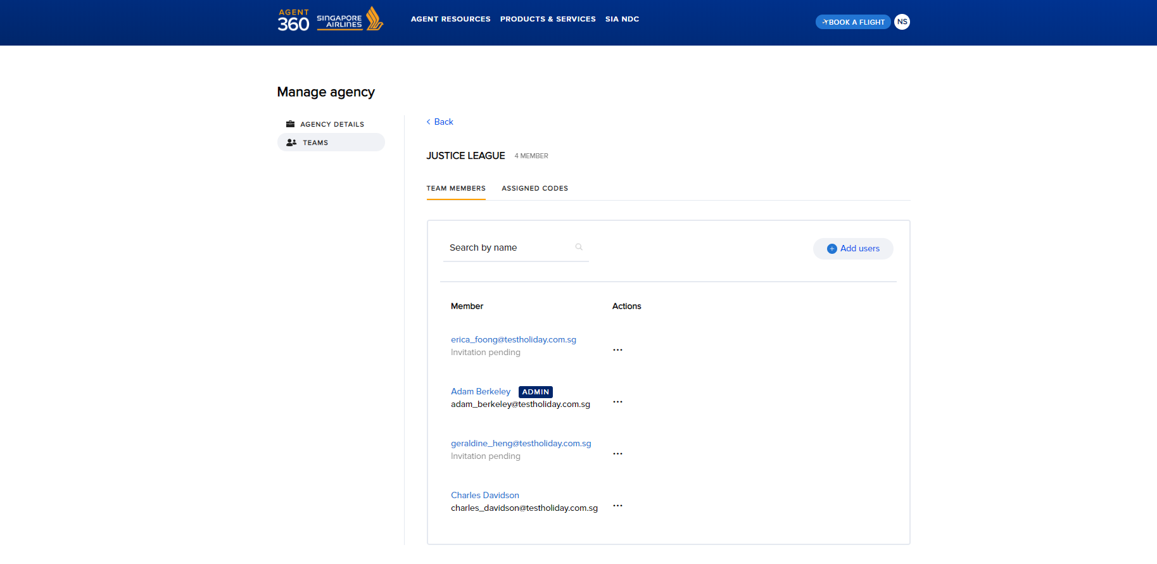
ADDING ADMINS/USERS TO TEAMS
To add admins/users to an existing team, navigate to the team and click “Add users”

Slide 43
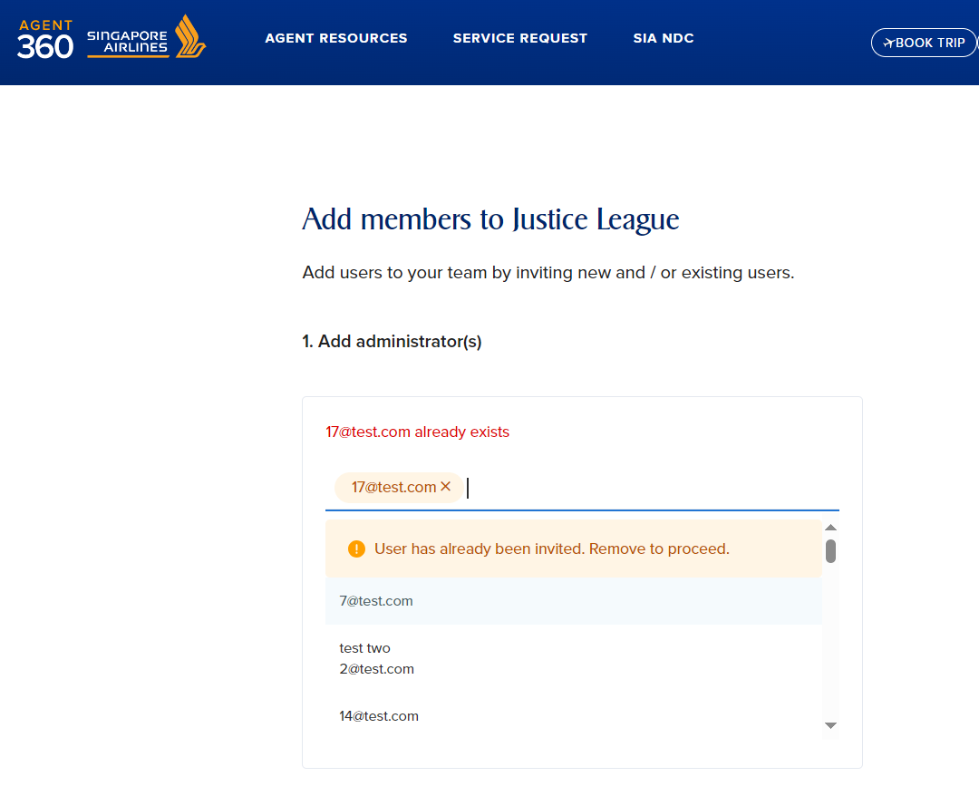
ADDING ADMINS/USERS TO TEAMS
Floating users are automatically displayed as a drop-down option and can be selected to be added to the team
An error message will appear if the admin/user’s email is already registered

Slide 44
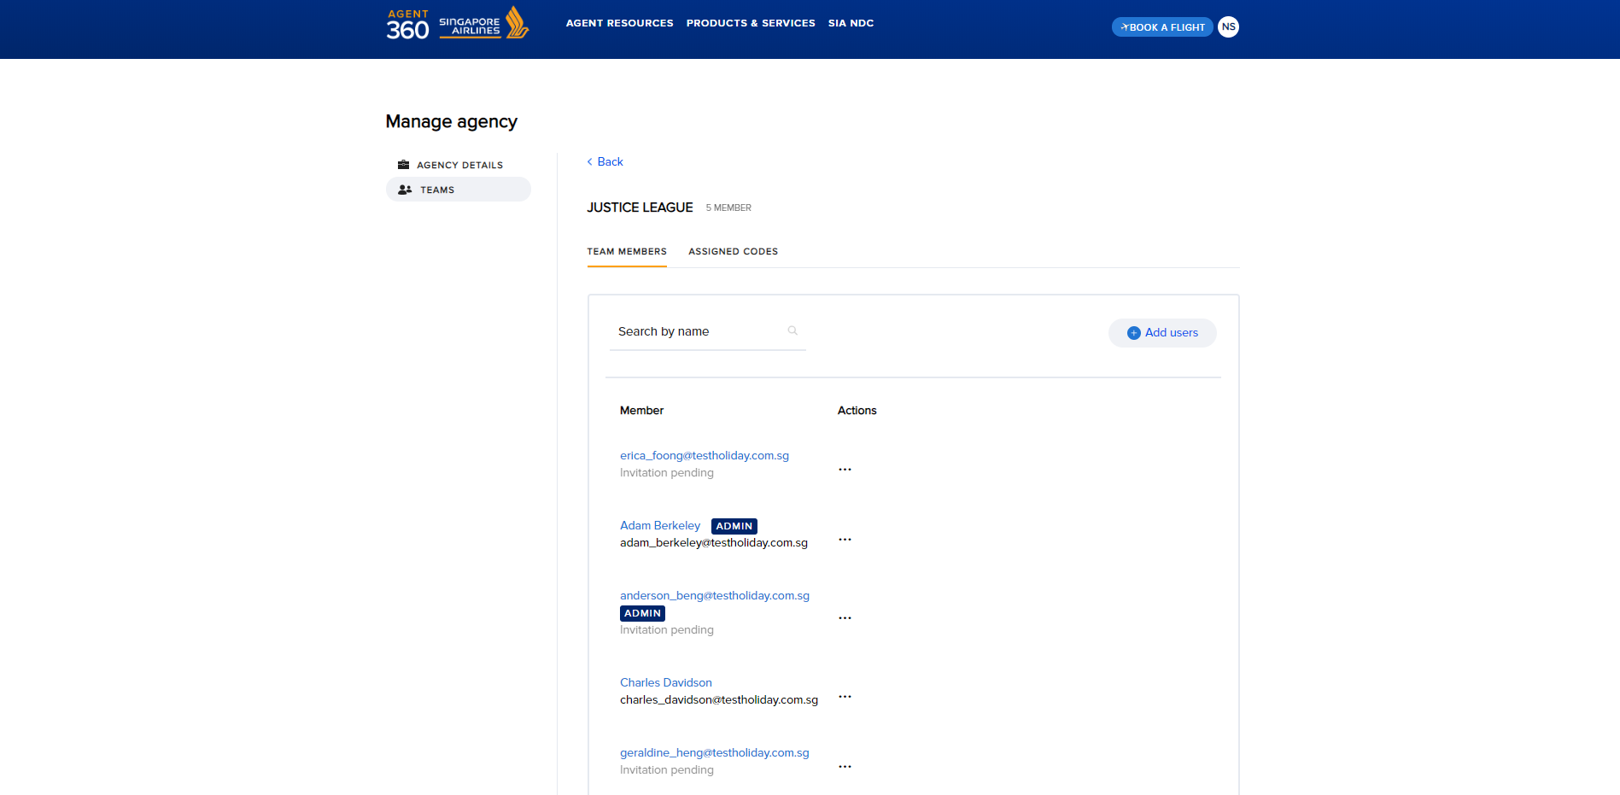
ADDING ADMINS/USERS TO TEAMS
The invitation will remain pending until the user registers the account (within 72 hours).
Once Admin/User has completed their account registration, the status will be updated accordingly

Slide 45
ONBOARDING
Deleting Teams

Slide 46
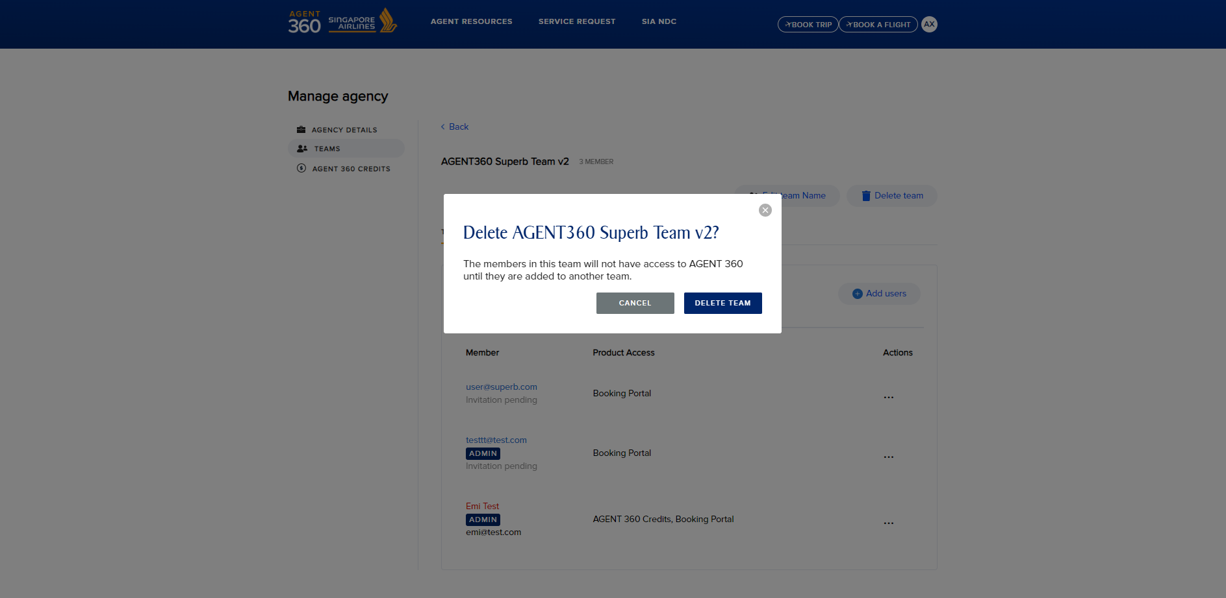
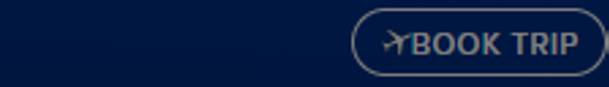
DELETING A TEAM
Master can also delete teams
Once a team is deleted, the Admins & Users will still have accounts on AGENT 360 and become Floating Users
Floating Users still have an account but are unable to login until the Master adds them to a team.

Slide 47
ONBOARDING
Switching Teams and Roles

Slide 48
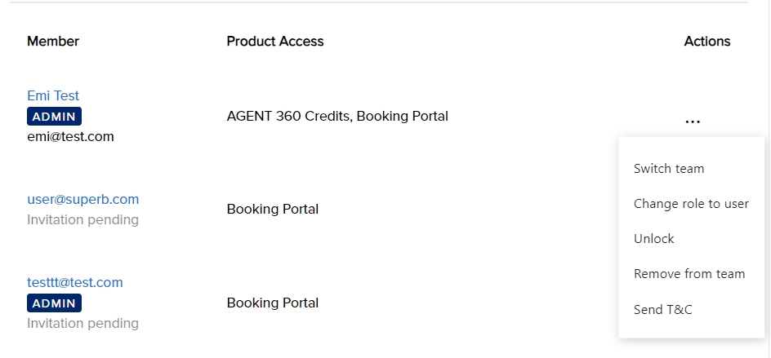
SWITCHING TEAM
To switch an admin/user’s role, select the three dots and select “Switch team”.

Slide 49
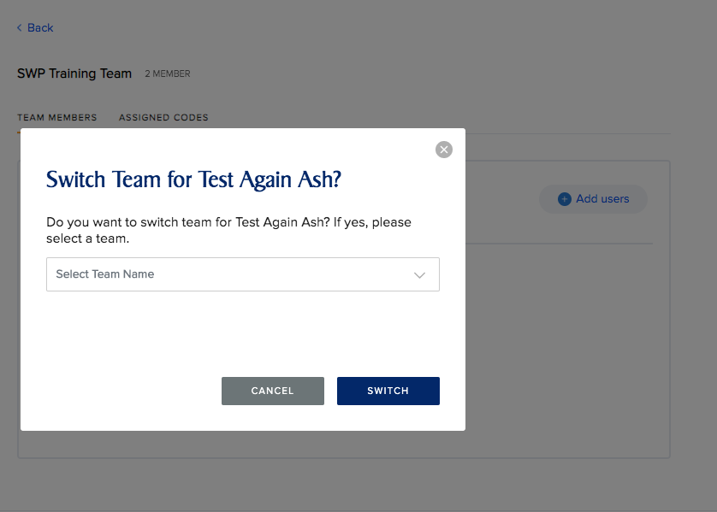
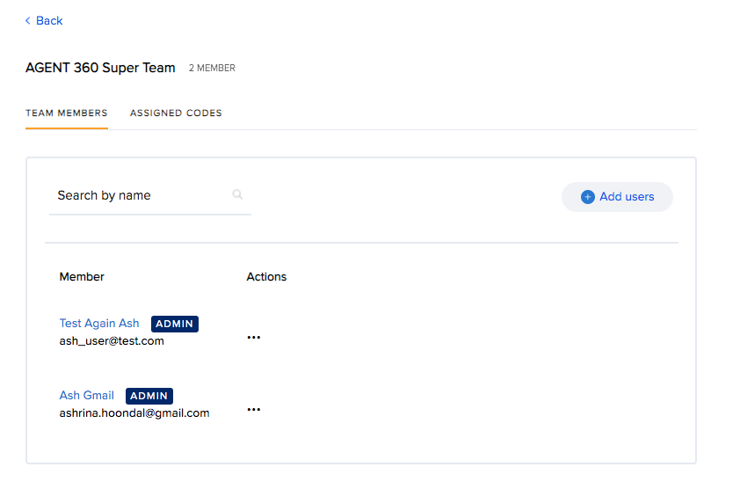
SWITCHING TEAM
Select the name of the new team that the agent would like to move this admin/user to.

Slide 50
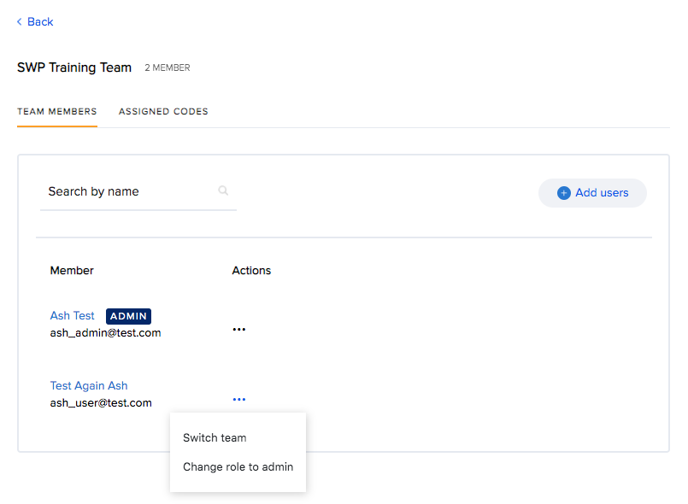
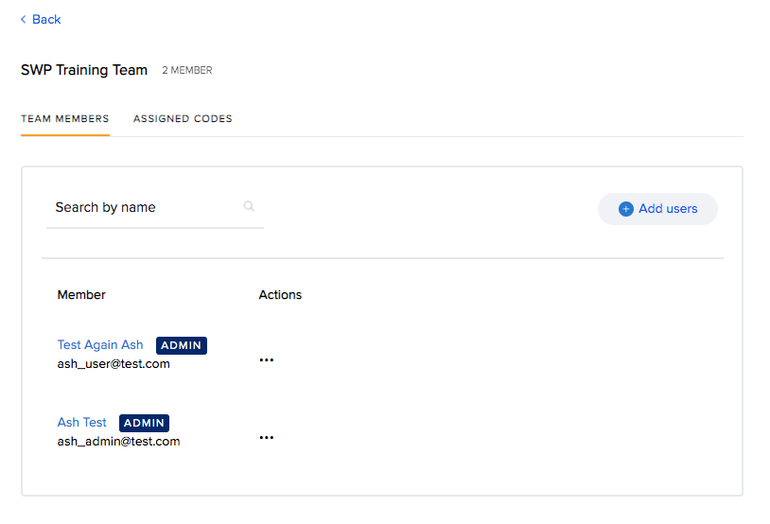
SWITCHING ROLE
To switch role, select “Change role to admin”.

Slide 51
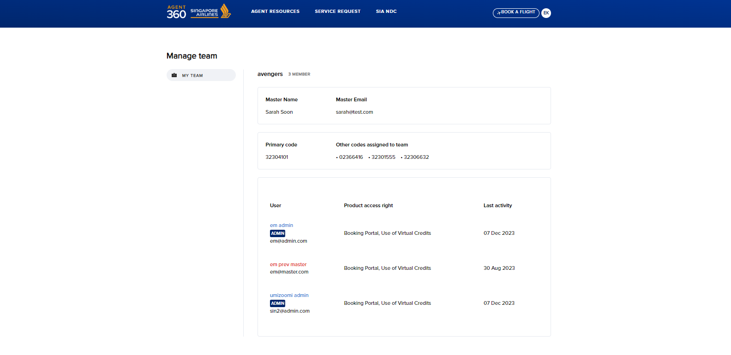
AGENCY’S MASTER
Admin/User will also be able to view who their Master and team members are under ‘My Team’

Slide 52
ONBOARDING
Adding Additional IATA Numbers

Slide 53


ADDING ADDITIONAL IATA NUMBERS
Under “Manage Agency” > “Agency Details”, Master can view list of IATA / ARC / TIDS codes registered
Click “Register another code” to register additional IATA / ARC / TIDS codes
Additional codes will be reviewed by your local SQ office

Slide 54

ADDING ADDITIONAL IATA NUMBERS
Similar to registration, enter the IATA / ARC / TIDS code details and submit

Slide 55
ONBOARDING
Assigning IATA to Teams

Slide 56

ASSIGNING IATA TO TEAM
After registering additional IATA / ARC / TIDS codes, Master can assign additional codes to Teams
Check a Team’s assigned codes under “Teams” > “Assigned Codes”
Select “Assign Codes” to assign additional IATA / ARC / TIDS codes to the Team

Slide 57

ASSIGNING IATA TO TEAM
Search for an approved IATA code and click “Assign”

Slide 58
ONBOARDING
Reactivating Account

Slide 59



REACTIVATE ACCOUNTS
Masters are never deactivated
Admin / User accounts that have not logged in for 180 consecutive days are deactivated
Reminder emails will be sent at day 170 and day 175 of inactivity
Deactivation email will be sent on day 180

Slide 60

REACTIVATE ACCOUNTS
Deactivated admin/users are highlighted in red
Master can reactivate deactivated Admin/User
If the Master is unavailable, please approach local your local SQ sales office for assistance.

Slide 61
ONBOARDING
Unlocking Account

Slide 62

UNLOCKING ACCOUNTS
After 3 incorrect password attempts, accounts are locked for 24h
All accounts – Master / admin / user can be locked

Slide 63

UNLOCKING ACCOUNTS
For locked Master accounts or urgent admin / user unlock requests, kindly approach your local SQ sales office for assistance.
For locked Admin accounts, Master can help to unlock
For locked User accounts, Master/Admin from same team can help to unlock

Slide 64
ONBOARDING
Reset Password

Slide 65



RESET PASSWORD
Agents can request for multiple password reset emails​.
To reset password, they can click on “Forgot Password”.

Slide 66



RESET PASSWORD
A password reset email will be sent
Password reset email will be sent to agents by agent_360@singaporeair.com.sg
Agents should add to safe sender’s list / whitelist this email.
After a successful password reset, agents can only make another password reset 24h later.

Slide 67
BOOKING PORTAL
Dashboard

Slide 68


ACESSING BOOKING PORTAL
How do Travel Agents access the booking portal?
Agents log into AGENT 360 > “Book Trip”
No additional login is necessary as we have enabled single sign-on

Slide 69

BOOKING PORTAL DASHBOARD
Total sales from issued tickets in that month
Includes amount from imported PNRs
Number of bookings in that month
Bookings on hold
PNRs that have TTL Expiring within 3 days
PNRs affected by Schedule/Order Changes
Viewing permissions for bookings depends on the agent’s role:​​
Master can view all bookings made by agency ​
Admin can view all bookings made by team ​​
User can view individual bookings only​​

Slide 70
BOOKING PORTAL
Booking Flights

Slide 71

BOOKING FLIGHTS – SEARCH CRITERIA
Click “Book Trip”
Types of Itineraries: One-Way, Round-Trip, Multi-city
Fare Types: Market Fare, Private Fare, Corporate Fare
Carriers: SQ / Codeshare / Interline

Slide 72
BOOKING FLIGHTS – SEARCH CRITERIA
Add/Delete route:
Click to add/delete flight segments
IATA:
Only AGENT 360 registered codes are displayed
If the agency has more than 1 IATA code, select which code to use here
Cabin Preference:
Choose Cabin Preference
Mixed Cabin Search is supported at Flight Search

Slide 73

BOOKING FLIGHTS – SEARCH CRITERIA
Passenger Type:
Max 9 pax in 1 booking:
Adult (ADT)
Child (CHD)
Infant (INF)
Special PTCs

Slide 74
BOOKING FLIGHTS – SEARCH CRITERIA
Access code:
Enter access code to unlock special/private/corporate fares
Promo Code:
Enter promo code to unlock promotional fares
Corporate ID:
Indicate corporate ID to identify this booking as a corporate booking
Currency
If the country is eligible to transact in multiple currencies, currency can be selected here

Slide 75

BOOKING FLIGHTS – SEARCH CRITERIA
Frequent flyer programme:
Indicate the frequent flyer programme (if any)
Note:
KF number must match FNAME/LNAME/DOB for KF accruals

Slide 76

BOOKING FLIGHTS – STOPOVER
Stopover:
Agents can now indicate desired stop and duration of stopover at the search page for each bound​
However, this does not apply for reshop​ (reissuance/revalidation)

Slide 77

BOOKING FLIGHTS – TIME FIELD
Time Field:
Agents can specify flight time when searching for a flight to see flights within a certain window​
Indicate desired flight time
Indicate flexible time ​
How many hours before​
How many hours after​
E.g. 12pm +/- 6h
This does not apply for reshop​

Slide 78


BOOKING FLIGHTS – FLEXIBLE SEARCH
Example 1: SIN-BKK
After performing a search, the available flight offers will be displayed
Agents can also choose to perform a flexible search to view the lowest fares.
The window of flexible search depends on the type of itinerary searched
One-way: +/- 7 days
2 bounds: +/- 3 days
3 bounds or more: No flexible search available
Example 2: SIN-BKK, BKK-SIN

Slide 79

BOOKING FLIGHTS – FLEXIBLE SEARCH
One-way: +/- 7 days flexible search
E.g. SIN-BKK
Lowest fare has a yellow marker appended​
Select the desired departure date to view offers for that date
Dep. date searched
- 7 days
+ 7 days

Slide 80




BOOKING FLIGHTS – FLEXIBLE SEARCH
Two bounds: +/- 3 days​ flexible search
E.g. SIN-BKK, LON-SIN
Lowest fare has a yellow marker appended​
Select desired combination of departure dates to view offers
- 3 days
Dep. date searched
+ 3 days
- 3 days
Dep. date searched
+ 3 days

Slide 81

BOOKING FLIGHTS – FLIGHT RESULTS
Flight offers are sorted by price by default
Agents can change the sort option
Price
Duration
Departure/arrival
Point of stopover (sorted alphabetically)
Flights can also be filtered
Stops
Operating airline
Departure / arrival time
Duration
Price range

Slide 82

BOOKING FLIGHTS – FLIGHT RESULTS
Flight offers of the selected cabin class up to the next cabin class will be displayed (depending on availability)
Select the cabin class to view offers by fare family. For each fare family, the lowest RBD offer will be displayed

Slide 83



BOOKING FLIGHTS – FLIGHT RESULTS
Three fare types are displayed:
Access Code Fare (if valid access code is entered at flight search)
NDC
Public
For the same fare family, multiple fare types can be returned and will be displayed in the above priority

Slide 84


BOOKING FLIGHTS – FARE BREAKDOWN AND FARE CONDITIONS
Select “Change” to change flights selected
A summary of the selected flight offer, flight details and price breakdown is displayed
View the
Fare breakdown by pax type
Fare rules/conditions

Slide 85


BOOKING FLIGHTS – COPY OF ITIN
Agents can do a quick copy of the itinerary on the Order Summary page. The copy button can be found beside Flight Information

Slide 86


BOOKING FLIGHTS – FARE BREAKDOWN AND FARE CONDITIONS
View the
Fare breakdown by pax type
Fare rules/conditions
Fare Breakdown
Fare Rules/Conditions

Slide 87

NEW!
BOOKING FLIGHTS – PAX DETAILS
Save Traveller:
Save entered pax details as a passenger profile. This can be reviewed under the “Passenger Mgt” tab.
Enter pax details
DOB is no longer mandatory for ADT
DOB is still mandatory for CHD & INF
Single Name
Select “I do not have a first/given name” if pax has single name
Single names will reflect as Salutation + Name e.g. Mr John
System Name Truncation for long names:
No character limit to enter name on AGENT 360
NDC will truncate names that exceed 59 characters after order creation
This includes no. of characters in first name + last name + DOB
System name truncation does not affect check-in
Document information is optional (even for US itineraries)
Known Traveler Number (KTN) is optional

Slide 88
NEW!
BOOKING FLIGHTS – PAX DETAILS
Contact Information
Select one passenger as the primary contact
Passenger and Agent email address are mandatory
  E-tickets, schedule change notifications, refund notices will be sent to both emails
There are now 2 passenger email address fields. Agents can decide if they want the pax email to receive ​
  Involuntary schedule change emails only​
  All emails - Eticket, refund notice, schedule change email​
Either (1) or (2) must be populated

Slide 89

NEW!
BOOKING FLIGHTS – PAX DETAILS
Contact Information
Agents need to input contact information (Contact No. and Email Address) for individual passengers
Option to use same contact information as Pax 1 is available
This is in line with the SAA’s current UI/UX

Slide 90

NEW!
BOOKING FLIGHTS – PAX DETAILS
Contact Information
Agent email address are mandatory
They can also add any additional email address if required
Create Order:
Book and hold an unticketed PNR
Add ancillaries:
Add ancillaries and book and hold/issue ticket instantly
Pay:
Issue ticket instantly. A PNR and eticket is generated
Note: NDC 21.3 temporarily does not support endorsement box

Slide 91


BOOKING FLIGHTS – AMEND PAX DETAILS
The quick copy of the itinerary feature is also available on the Order Details page
Passengers’ passport number, Known Traveller Number and FFP can be removed/added post-booking
Known Traveler Number (KTN):
Can indicate passengers’ KTN during order creation or anytime after booking is made for both ticketed and non-ticketed bookings
Can be removed anytime
Will be reflected in the passenger’s visa document section

Slide 92


NEW!
BOOKING FLIGHTS – PAX EMAIL FIELDS
Agents can modify passengers’ date of birth post-booking under the Traveller Information section
DOB modification can only be completed alongside passengers’ travel document information changes
i.e. existing travel document info needs to be deleted then re-added alongside the correct DOB
An alert will be displayed when agents attempt to update the date of birth without travel document information

Slide 93

NEW!
BOOKING FLIGHTS – PAX EMAIL FIELDS
There are 2 passenger email fields:​
Involuntary schedule change emails only​
All emails - Eticket, refund notice, schedule change emails​
If frequent flyer details are provided but pax email (for etkt receipt, refund notices, airline sched changes) is left blank, FF email will receive all emails​
Agents should input agent email as pax email (for etkt receipt, refund notices, airline sched changes) if they do not want pax to receive all emails
Agents can modify passengers’ contact number and email address post-booking creation under the Contact Information section on the Order Details page
Agents will need to operationalize the change via addition of the new contact detail and removal of the existing one

Slide 94



BOOKING FLIGHTS – COMMISSION
If agent books a commission fare, commission information (%) is displayed​
Fare breakdown​
Order details
Commissions are not displayed if fare does not have a commission filed​
If subagents book commission fares, commission information is only displayed to consolidators

Slide 95
BOOKING PORTAL
Add Ancillaries to Unticketed Booking

Slide 96

ADD ANCILLARIES TO UNTICKETED BOOKING
Agents can choose to add ancillaries at 2 stages
During the booking flow​
At order details
4 types of ancillaries/services are available
XBAG
Seat
Meal
Special service requests

Slide 97


ADD ANCILLARIES TO UNTICKETED BOOKING – XBAG
XBAG ​
Select XBAG for each pax and for the respective flight segment
Click Confirm to add XBAG
XBAG will be held for 72h from time of ancillary addition
Click Reset to remove all added XBAG

Slide 98

ADD ANCILLARIES TO UNTICKETED BOOKING – SEAT
For each segment, select ancillary for each pax before moving on to the next segment​
Seats ​
Hover over seat to view more details
Click seat map to select seat for each pax
Click Confirm to add seat
Click Reset to remove all added seats
Paid seats will be held 72h from time of ancillary addition
Free seats are confirmed once added to booking

Slide 99

ADD ANCILLARIES TO UNTICKETED BOOKING – MEAL
For each segment, select ancillary for each pax before moving on to the next segment​
Meals ​
Select meal for each pax
Meals are confirmed once added to booking

Slide 100

ADD ANCILLARIES TO UNTICKETED BOOKING – SSR
For each segment, select ancillary for each pax before moving on to the next segment​
Special Services Request (SSR)
Select SSR for each pax
  BLND: Blind pax info
  BCST: Random bassinet seat is assigned
  DEAF: Deaf pax info
  MAAS: Meet and assist request (requires input)
  WCHR: Wheelchair request
SSRs are confirmed once added

Slide 101

ADD ANCILLARIES TO UNTICKETED BOOKING
Ancillaries can also be added to unticketed bookings at the order details page

Slide 102

ADD ANCILLARIES TO UNTICKETED BOOKING
Paid ancillaries are held for 24h from time of addition

Slide 103

ADD ANCILLARIES TO UNTICKETED BOOKING
After ancillaries have been added, free ancillaries/services can be removed from bookings under order details​
Free seats​
Free services (meals / special service requests)
Agent will have to confirm before ancillaries are removed
Supported for unticketed and ticketed bookings

Slide 104
BOOKING PORTAL
Manual Reprice

Slide 105


MANUAL REPRICE OF FARE
Manual Reprice:
Fares (TST) are usually held for up to 4 days before they are auto-repriced
Agents can choose to manually reprice a booking pending payment
  Unticketed bookings
  Ticketed bookings where reshop - deferred payment

Slide 106
MANUAL REPRICE OF FARE
Manual Reprice with Access Code
Any access code input at flight search is displayed here
  Access codes can be added/modified
  Access codes cannot be removed
Enter access code and click reprice to update the price
  Agents can check the new price before confirming
  Once confirmed there is no rollback to the initial price
These fields can be modified after booking has been created​
Access code​
Promo code ​
Frequent flyer​ details
Corporate ID
Click manual reprice to modify promo code / frequent flyer details​ / corporate ID
Can be added​
Can be modified​
Cannot be removed​
Manual reprice is available for orders​
On hold​ (unticketed)
If agent wants to update FFP/Corp ID details and the fare has increased, FFP/Corp ID details should be updated offline

Slide 107
BOOKING PORTAL
Reshop Unticketed Booking

Slide 108



RESHOP WITH
INSTANT / DEFERRED PAYMENT
Agents can modify the booking before issuance
There are 2 reshop flows:
Reshop – Instant Payment
Reshop – Deferred Payment
Reshop – Instant Payment
Reshop – Deferred Payment
Reshop and pay immediately
Reshop first and hold inventory before making payment within the TTL
Both old and new itinerary are concurrently held
Select whether to retain original offer or select new offer before making payment
However there are some limitations (refer to next slide)
Pay immediately
Holds original and new offers and pay later

Slide 109

RESHOP WITH
INSTANT / DEFERRED PAYMENT
Agents can modify the booking before issuance
There are 2 reshop flows:
Reshop – Instant Payment
Reshop – Deferred Payment
Reshop – Instant Payment
Reshop – Deferred Payment
These limitations do not apply, reshop (instant payment) can be done to overcome these limitations
Limitations
  Only applicable for fully unflown bookings
  If segment is unchanged, the original RBD must be selected
  Example
  SIN-BKK (W)
  BKK-SIN (W) – if unchanged, W must be selected
  If original RBD is not selected, prompt to perform reshop (instant payment) to display
  If segment is changed and same flight is selected, the original RBD must be selected
  Example
  SIN-BKK (W) SQ706 – if only the date is changed but SQ706 is retained, W must be selected
  BKK-SIN (W)
  If original RBD is not available / not selected, error “Promotion code invalid” will display

Slide 110
BOOKING PORTAL
Reshop Unticketed Booking
– Instant Payment

Slide 111

RESHOP UNTICKETED BOOKING – INSTANT PAYMENT
Click “Reshop (Instant Payment)” to modify the booking and pay immediately

Slide 112

NEW!
RESHOP UNTICKETED BOOKING – INSTANT PAYMENT
Select the segment to change.
This segment will become modifiable under “Change to”
For unticketed bookings, NDC currently supports reshop within 2 bounds
Agents can input the corporate access code during reshop for a market fare booking to retrieve corporate fares
Modify itinerary and click Change Booking
Cabin Preference
Origin
Destination
Departure Date
Click “+” to add segment
Click “–” to delete segment
Tip: when deleting a segment, select all segments and delete selected segment
Unlike initial Flight Search, cabin class can only be selected for the entire itinerary at Reshop
Click “Change booking”

Slide 113

RESHOP UNTICKETED BOOKING – INSTANT PAYMENT
Select the new flight offer for the changed segment
Similar to initial flight search, for each fare family the lowest available RBD is displayed

Slide 114

RESHOP UNTICKETED BOOKING – INSTANT PAYMENT
Review the new offer
Fare difference
Tax difference
Penalties
View fare conditions and fare breakdown
If agents would like to check the reshop price only, they can stop here.
The reshop is committed once agents select “Pay and issue ticket” and complete payment

Slide 115
BOOKING PORTAL
Reshop Unticketed Booking
– Deferred Payment

Slide 116
RESHOP UNTICKETED BOOKING – DEFERRED PAYMENT
Click “Reshop (Deferred Payment)” to modify the booking first and pay later
This is reshop with double inventory, where the original and new offers are held simultaneously. Agents can decide which offer to proceed with before payment.

Slide 117

NEW!
RESHOP UNTICKETED BOOKING – DEFERRED PAYMENT
Select the segment to change.
This segment will become modifiable under “Change to”
For unticketed bookings, NDC only supports reshop within 2 bounds
Agents can input the corporate access code during reshop for a market fare booking to retrieve corporate fares
Unlike initial Flight Search, cabin class can only be selected for the entire itinerary at Reshop
Modify itinerary and click Change Booking
Cabin Preference
Origin
Destination
Departure Date
Click “+” to add segment
Click “–” to delete segment
Tip: when deleting a segment, select all segments and delete selected segment
Click “Change Booking”

Slide 118

RESHOP UNTICKETED BOOKING – DEFERRED PAYMENT
Select the new flight offer for the changed segment
Similar to initial flight search, for each fare family the lowest available RBD is displayed

Slide 119

RESHOP UNTICKETED BOOKING – DEFERRED PAYMENT
Review the new offer
Fare difference
Tax difference
Penalties
View fare conditions and fare breakdown
Click “Hold Inventory”
Payment is not required yet

Slide 120

RESHOP UNTICKETED BOOKING – DEFERRED PAYMENT
In Reshop with deferred payment, two inventories are held
Original itinerary
New reshopped itinerary
Agents can select the original or new itinerary as the final option and confirm change before payment
How long will the price be locked in?
Fare (TST) is valid for up to 4 days​ before it will auto-reprice.
Price guarantee time limit indicates the date the fare is valid before it will auto-reprice
When must payment be completed?
TTL will be re-assessed and the more restrictive TTL is displayed
Payment must be made before the TTL or both inventories are released

Slide 121

RESHOP UNTICKETED BOOKING
Once the unticketed booking has been issued, agents can see the latest eticket under Traveller Information on order details
Changes made are reflected under Change and upgrade record

Slide 122
BOOKING PORTAL
Cancel Unticketed Booking

Slide 123

CANCEL UNTICKETED BOOKING
Click “Cancel” and confirm

Slide 124

CANCEL UNTICKETED BOOKING
Status will be updated as “Cancelled”
Order details will still display but booking is no longer serviceable

Slide 125
BOOKING PORTAL
Issuing Tickets

Slide 126


ISSUING TICKETS
There are 2 options to issue tickets:
1
Create order and pay instantly
2
Create order and pay later
After creating order, status of order is On hold
After entering pax details, issue ticket instantly. PNR and eticket(s) are generated
Issue tickets within the ticketing time limit

Slide 127





ISSUING TICKETS
– FORM OF PAYMENTS*
* Form of payments enabled differ across countries
Different FOPs can be used for different transactions
e.g. Issue with BSP Cash and reissue with BSP Card
1
2
3
BSP/ARC Cash
BSP/ARC Card (including UATP)
IATA EasyPay
IATA Agents
4
5
Direct Credit Card
Direct Cash
TIDS Agents

Slide 128


ISSUING TICKETS – FORM OF PAYMENTS (BSP / ARC CASH)
Select BSP / ARC Cash and Pay

Slide 129


ISSUING TICKETS – FORM OF PAYMENTS (BSP / ARC CARD)
BSP/ARC Card
Agents are prompted to key in relevant card information. CVV is optional.
Supported card types:
Amex
Diners
Masters
Visa
UATP
Multiple card types can be used for various transactions
e.g. Issue ticket with Visa and reshop booking with Amex

Slide 130


ISSUING TICKETS – FORM OF PAYMENTS (BSP / ARC CASH)
BSP/ARC Card
What is Mail Order / Telephone Order (MOTO)?
Only applicable for BSP / ARC Card transactions (NA for Direct CC)
MOTO should be used in a card-not-present scenario (i.e. pax not physically present to provide card details and complete 3DS2 authentication​)
When MOTO is checked, transaction is not subjected to 3DS2 authentication
  Agents are liable for any chargebacks if 3DS2 authentication is not triggered
  Highly recommended for agents to uncheck MOTO and proceed with 3DS2 whenever pax is physically present to provide card and OTP details
MOTO Type
  Mail Order: Pax provides payment details by mail​
  Telephone Order: Pax provides payment details by telephone

Slide 131

ISSUING TICKETS – FORM OF PAYMENTS (BSP / ARC CASH)
In line with regulatory requirements and to ensure a more secure payment process for customers, sellers and the airline, SQ mandates 3DS2 authentication for all BSP / ARC Card, IATA EasyPay, and Direct Credit Card transactions
Benefits of 3DS2
  Certain flows are frictionless - agents may successfully pass 3DS2 without having to enter OTP
  If 3DS2 session is closed prematurely (e.g. agent closes 3DS2 OTP tab) agent can still retry payment

Slide 132


ISSUING TICKETS – FORM OF PAYMENTS (IATA EASYPAY)
Enter IATA EasyPay card details and Pay

Slide 133

ISSUING TICKETS – FORM OF PAYMENTS (DIRECT CREDIT CARD)
Direct Credit Card (DCC) only appears for TIDS agents
MOTO does not apply for DCC transactions

Slide 134

DIRECT CASH
Direct Cash only appears for TIDS agents in selected markets

Slide 135

PAYMENT HISTORY
Agents can view payment information and payment type under Payment Info

Slide 136
BOOKING PORTAL
Add Ancillaries to Ticketed Booking

Slide 137

ADD ANCILLARIES TO TICKETED BOOKING
Agents can add ancillaries for ticketed bookings at the order details page

Slide 138

ADD ANCILLARIES TO TICKETED BOOKING
4 types of ancillaries/service are available
XBAG
Seat
Meal
Special service requests
Ancillaries/service can be added for each flight segment and each passenger
Refer to Ancillaries for more details on adding each ancillary
Hold ancillaries for ticketed bookings
Free ancillaries/services (e.g. free seat, meals, SSR) are confirmed once added
Paid ancillaries (e.g. XBAG, paid seat) are held for 72h from time of ancillary addition

Slide 139

ADD ANCILLARIES TO TICKETED BOOKING
Added ancillaries are reflected on order details

Slide 140

ADD ANCILLARIES TO TICKETED BOOKING
Ancillaries can be added to booking multiple times​
After ancillary has been added to booking, if agent tries to add more ancillaries there will be a reference of previously selected ancillaries on the ancillary selection page

Slide 141
BOOKING PORTAL
Reshop Ticketed Booking

Slide 142

RESHOP WITH
INSTANT / DEFERRED PAYMENT
Agents can modify the booking after issuance as well
There are 2 reshop flows:
Reshop – Instant Payment
Reshop – Deferred Payment
Reshop – Instant Payment
Reshop – Deferred Payment
Reshop and pay immediately
Reshop first and hold inventory before making payment within the TTL
Both old and new itinerary are concurrently held
Select whether to retain original offer or select new offer before making payment
Pay immediately
Holds original and new offers and pay later

Slide 143
BOOKING PORTAL
Reshop Ticketed Booking
– Instant Payment

Slide 144

RESHOP TICKETED BOOKING – INSTANT PAYMENT
Click “Reshop (Instant Payment)” to modify the booking and pay immediately

Slide 145

NEW!
RESHOP TICKETED BOOKING – INSTANT PAYMENT
Select the segment to change.
This segment will become modifiable under “Change to”
Agents can input the corporate access code during reshop for a market fare booking to retrieve corporate fares
Modify itinerary and click Change Booking
Cabin Preference
Origin
Destination
Departure Date
Click “+” to add segment
Click “–” to delete segment
Tip: when deleting a segment, select all segments and delete selected segment
Unlike initial Flight Search, cabin class can only be selected for the entire itinerary at Reshop
Click “Change booking”

Slide 146

RESHOP TICKETED BOOKING – INSTANT PAYMENT
Select the new flight offer for the changed segment
Similar to initial flight search, for each fare family the lowest available RBD is displayed

Slide 147

NEW!
RESHOP TKT BOOKING – INSTANT PAYMENT (PENALTY FEE WAIVER)
Review the new offer
Fare difference
Tax difference
Penalties
View fare conditions and fare breakdown
Agents can opt to not pay penalty fees when they do a reshop instant payment when they have an approved waiver for the change
​
When agents opt to waive penalties, they will be prompted with a reminder that they should have received an approved waiver code
​
Agents will be ADM-ed if otherwise
If agents would like to check the reshop price only, they can stop here.
The reshop is committed once agents select “Pay and issue ticket” and complete payment

Slide 148

RESHOP TICKETED BOOKING
Once the booking is reissued, the agent can see the changes made under Change and upgrade record.

Slide 149
BOOKING PORTAL
Reshop Ticketed Booking
– Deferred Payment

Slide 150

RESHOP TICKETED BOOKING – DEFERRED PAYMENT
Click “Reshop (Deferred Payment)” to modify the booking first and pay later
This is reshop with double inventory, where the original and new offers are held simultaneously. Agents can decide which offer to proceed with before payment.

Slide 151

NEW!
RESHOP TICKETED BOOKING – DEFERRED PAYMENT
Select the segment to change.
This segment will become modifiable under “Change to”
Agents can input the corporate access code during reshop for a market fare booking to retrieve corporate fares
Modify itinerary and click Change Booking
Cabin Preference
Origin
Destination
Departure Date
Click “+” to add segment
Click “–” to delete segment
Tip: when deleting a segment, select all segments and delete selected segment
Unlike initial Flight Search, cabin class can only be selected for the entire itinerary at Reshop
Click “Change Booking”

Slide 152

RESHOP TICKETED BOOKING – DEFERRED PAYMENT
Select the new flight offer for the changed segment
Similar to initial flight search, for each fare family the lowest available RBD is displayed

Slide 153

RESHOP TICKETED BOOKING – DEFERRED PAYMENT
Review the new offer
Fare difference
Tax difference
Penalties
View fare conditions and fare breakdown
Click “Hold Inventory”

Slide 154

RESHOP TICKETED BOOKING – DEFERRED PAYMENT
In Reshop with deferred payment, two inventories are held
Original itinerary
New reshopped itinerary
Agents can select the original or new itinerary as the final option and confirm change before payment
How long will the price be locked in?
Fare (TST) is valid for up to 4 days​ before it will auto-reprice.
Price guarantee time limit indicates the date the fare is valid before it will auto-reprice
When must payment be completed?
TTL will be re-assessed and the more restrictive TTL is displayed
Payment must be made before the TTL or both inventories are released

Slide 155

RESHOP TICKETED BOOKING
Once the booking is reissued, the agent can see the changes made under Change and upgrade record.

Slide 156
BOOKING PORTAL
Partial Mixed Cabin Class Reshop

Slide 157


PARTIAL MIXED CABIN CLASS RESHOP
Although NDC does not currently support mixed cabin class reshop, it can sometimes be performed on AGENT 360 within limitations for consecutive cabin classes (e.g. Economy + Premium Economy).
If the desired itinerary cannot be reshopped on AGENT 360, please approach your local SQ sales office for assistance.
Offers for the selected cabin class up to the next cabin class are returned (depending on availability)​
Select Economy → Economy & Premium Economy offers returned​
Select Premium Economy → Premium Economy & Business offers returned​
Select Business → Business & First Class offers returned​
At Shopping, mixed cabin class search is supported
At Reshop, mixed cabin class search is partially supported as NDC only supports selecting 1 cabin class for the whole itinerary

Slide 158
PARTIAL MIXED CABIN CLASS RESHOP
At reshop only 1 cabin class can be selected
Offers for the selected cabin class up to the next cabin class are returned (depending on availability)​
Select Economy → Economy & Premium Economy offers returned​
Select Premium Economy → Premium Economy & Business offers returned​
Select Business → Business & First Class offers returned​
Example 1
Example 2
Segment 1: SIN-LHR Economy
Segment 2: LHR-SIN Economy
Segment 1: SIN-LHR Economy
Segment 2: LHR-SIN Economy
Agent reshop Segment 1 to Premium Economy while maintaining Segment 2 at Economy
  Select Economy as reshop cabin class – Available Econ & Premium Econ offers are returned
  Select Premium Econ offer for Segment 1 and the same Economy offer for Segment 2
Agent reshop Segment 1 to Business while maintaining Segment 2 at Economy
  Once Business is selected Segment 2 will also be forced to upsell to Business / First Class
  Offline servicing is required

Slide 159
BOOKING PORTAL
Void / Refund Ticketed Bookings

Slide 160

VOID TICKETED BOOKINGS
Void can be done until 2359 of the same BSP Day and no penalty fee is charged.
Void can only be done for the first issuance
Imported bookings cannot be voided on AGENT 360, they must be voided in the original NDC platform

Slide 161


VOID TICKETED BOOKINGS
After confirming void, booking status changes to “Void”

Slide 162

REFUND TICKETED BOOKINGS
After the same BSP day, “Void” button is replaced with “Refund” where refund penalties may apply

Slide 163


NEW!
REFUND TICKETED BOOKINGS
When agents reshop to an itinerary which has cheaper airport taxes, SIA will refund the difference ​
Enhancement has been done to call out and specify the amount which will be refunded for clarity​
The refund will be via EMD which can be found under the ancillary section of the order details page​
After confirming refund, booking status changes to “Refunded”

Slide 164


NEW!
OPEN BOOKINGS
When doing a Refund, agents will see the option to cancel the order but retain ticket value
No amount will be refunded or charged at point of confirmation
Agents will only be allowed to proceed with Reshop – Instant Payment on the order afterwards and all segments will need to be part of the Reshop
Select all segments and remove segments under the “Change to” sections if necessary
Reshop needs to be completed within 90 days and all change fees and fare difference will apply

Slide 165
BOOKING PORTAL
Partially Flown Bookings

Slide 166

PARTIALLY FLOWN BOOKINGS
For partially flown bookings, agents can choose to either do:
Reshop (Instant Payment)
Reshop (Deferred Payment)

Slide 167
PARTIALLY FLOWN BOOKINGS
Agents will also be able to refund for partially flown bookings, for the unflown segment.

Slide 168
BOOKING PORTAL
Order Management

Slide 169

ORDER MANAGEMENT
– ORDER DASHBOARD
Click on “Orders” to view all orders/bookings
Click “Order ID” to load Order details
View booking status, user details, TTL

Slide 170
ORDER MANAGEMENT
– ORDER STATUS
Status | What it means
On hold | Tickets have not been issued yet Bookings where TTL has lapsed, the status will still show ‘On Hold’
Ticketed | Tickets have been issued
Cancelled | Unticketed booking was cancelled by agent
Reshop on hold - UNTKT | Unticketed booking that has been reshopped with deferred payment and is pending payment
Reshop on hold - TKT | Ticketed booking that has been reshopped with deferred payment and is pending payment
Void | Ticketed booking voided within same BSP day
Refunded | Ticketed booking refunded
Cancelled Offline | Booking cancelled outside of AGENT 360 AGENT 360 has no visibility on whether it was a cancellation/void/refund
Status

Slide 171

ORDER MANAGEMENT – TICKETING AND PRICE GUARANTEE TIME LIMIT
Unticketed Booking
Ticketing time limit (TTL): Latest date to issue ticket before inventory expires.
Price guarantee time limit: Latest date to issue ticket at this price before fare is auto-repriced. This takes into consideration any special sales period.

Slide 172

ORDER MANAGEMENT – OAL TICKETING TIME LIMIT
Unticketed Booking
Ticketing time limit (TTL): Latest date to issue ticket before inventory expires.
New booking portal displays other airlines TTL as well
OAL TTL appears as a string of text

Slide 173

TICKETING TIME LIMIT (TTL) EXPIRY EMAIL REMINDER
Daily email reminders of TTL expiry is sent starting from 3 days before TTL expiry.
TTL Expiry Email Reminder will be sent
T-3 days
T-2 days
T-1 day

Slide 174


ORDER MANAGEMENT
– GENERATE ITINERARY
Unticketed Booking
Itinerary can be generated for unticketed bookings
Agent can choose to:
Email itinerary
  Option to mask fares and taxes
  Option to mask fares with taxes details
Download itinerary as pdf
  Option to mask fares and taxes
  Option to mask fares with taxes details
Fare masking
Applicable for all fare types
Tax details will still display

Slide 175


ORDER MANAGEMENT
– GENERATE ITINERARY
Unticketed Booking
Itinerary can be sent via email to​
Agent email entered in booking​
Agent’s A360 registered email​
Can choose to either mask fares only or mask fares and taxes

Slide 176


ORDER MANAGEMENT
– GENERATE ITINERARY
An email will be sent from agent_360@singaporeair.com.sg
​​Itinerary will be attached as .pdf
Fares have been masked in this example

Slide 177

ORDER MANAGEMENT
– GENERATE ETICKET
Ticketed Booking
Once tickets are issued, etickets are sent to the pax and agent emails entered in the booking.
A copy of etickets can be generated on AGENT 360 for ticketed bookings.
Agent can choose to:
Email eticket
  Option to mask fares and taxes
  Option to mask fares with taxes details
Download eticket as pdf
  Option to mask fares and taxes
  Option to mask fares with taxes details
Fare masking
Applicable for all fare types
Tax details will still display
Note: For IT fares, the original eTicket will mask the fares. Mask fares should be selected when generating AGENT 360 eTicket for IT fares

Slide 178



ORDER MANAGEMENT
– GENERATE ETICKET
An email will be sent from agent_360@singaporeair.com.sg
​​E-ticket attached as .pdf
Fares have been masked in this example

Slide 179

ORDER MANAGEMENT – SPLIT PNR
Agents can Split PNR for unticketed / ticketed bookings with multiple pax and continue to service bookings as separate PNRs after splitting.

Slide 180


ORDER MANAGEMENT – SPLIT PNR
Select one passenger to split into a separate PNR for.
Note: NDC 21.3 can only support splitting out 1 pax at a time

Slide 181

ORDER MANAGEMENT – SPLIT PNR
Select the passenger(s) to split into a separate PNR for. Selected names will be in the booking with the same original PNR. This is will be recorded as the Parent order ID.

Slide 182


ORDER MANAGEMENT – SPLIT PNR
Original PNR is the PARENT booking
Associated CHILD booking order ID is also displayed
Child’s booking will have a New PNR
Associated PARENT booking Order ID is also displayed

Slide 183
BOOKING PORTAL
Flight Schedule Changes

Slide 184



FLIGHT SCHEDULE/ORDER CHANGES
When there is an involuntary schedule change, SQ will send a notification to both the pax and agent emails in the booking.
A360 also displays indicators of flight schedule/order changes at these areas:
Dashboard
Recent schedule changes
Orders
Schedule change indicator
Order details
Banner

Slide 185
FLIGHT SCHEDULE/ORDER CHANGES
No. | Change Description on AGENT 360 | What it means
1 | Sched change – flight number change (including change of date and change of routing) | Flight change due to involuntary schedule change
2 | Sched change – flight retimed | Flight retimed due to involuntary schedule change
3 | Sched change – flight cancelled | Flight cancelled due to involuntary schedule change
4 | No reason given (addition, modification or deletion of a SSR or a seat) | SSR/seat was added/modified/deleted offline
5 | Flight cancelled (booking cancelled by the airline outside schedule change situation) | Flight was cancelled offline
6 | Order Affected (Voluntary changes to flights effected outside NDC) | Flight change was performed offline
7 | Cancellation due to TTL | Flight automatically cancelled as TTL has lapsed
8 | Order Affected (Pax no-show) | Pax no-show
Besides involuntary schedule changes, agents will also see the earlier indicators in non-schedule change scenarios
e.g. when certain offline changes are made / TTL has lapsed / pax no show

Slide 186


FLIGHT SCHEDULE CHANGES:
SELF RE-ACCOMMODATION
When a booking is affected by an involuntary schedule change, agents can self re-accommodate flights directly on AGENT 360
Agents have 3 options:​
Accept change​ - Itinerary will be updated to new flights
Reshop without penalties​
Refund without penalties
After selecting one of these options, the booking can continue to be serviced on AGENT 360
Flight Schedule Change
A flight schedule change has been made by the airline. Please proceed to accept, reshop, or refund the booking (without penalties).
Origin | Destination | Departure Date | Arrival Date | Flight number | Cabin class | Aricraft type | Duration | Status code
SIN | HKG | 04 Jul 2024 19:00 | 04 Jul 2024 22:45 | SQ898 | W | 359 | 7h | HK
HKG | SIN | 05 Jul 2024 19:00 | 05 Jul 2024 22:45 | SQ900 | W | 359 | 7h | TK
Accept
Reshop

Slide 187
BOOKING PORTAL
Passenger Management

Slide 188

PASSENGER MANAGEMENT
Passenger profiles can be reviewed under “Passenger Management”
If Save Traveller is selected, passenger profile is saved when booking is created
Title
First/Last name
DOB
Document info
Passenger email

Slide 189

PASSENGER MANAGEMENT
View and add saved passengers under “Passenger Management”
Saved passengers are saved on agency level
Click “details” to view saved frequent flyer details
Add saved passenger manually
Edit saved passenger details
Delete saved passenger

Slide 190

PASSENGER MANAGEMENT
Mandatory fields
Title
First / Last name
DOB
Passenger type
If pax contact no. is saved, it will populate the pax contact no. field at booking

Slide 191
BOOKING PORTAL
Reports

Slide 192

DEFAULT AND SETTING PREFERRED TIME ZONE
By default, the following times are displayed according to browser/PC time zones​:
Ticketing time limit​
Price guarantee time limit​
Booking time​
Ticketing time​
Agents can change to preferred time zone by clicking on:
User profile
Time Zone​
Preferred time zone will always be used once it has been selected

Slide 193



REPORTS
Unticketed Report
5 types of reports can be generated
  Unticketed report
  Ticketed report
  EMD report
  Credit/Debit Transaction Report
  IUR files
Master can view all reports
Admin/users can only view reports (a) – (c)
Max date range of 92 days within a 2 year period
Filter criteria and download report as Excel
Ticketed Report
EMD Report

Slide 194


REPORTS
5 types of reports can be generated
  Unticketed report
  Ticketed report
  EMD report
  Credit/Debit Transaction Report
  IUR files
Master can view all reports
Admin/users can only view reports (a) – (c)
Max date range of 92 days within a 2 year period
Filter criteria and download report as Excel
Credit/Debit Report
IUR Report

Slide 195



TICKETED REPORT
For ticketed reports, agents can choose to filter by:
Date of booking​
Date of ticketing​
Combination of date of booking and ticketing

Slide 196

REPORTS
Reports will export as Excel files
Booking agent and consolidator (if any) info is also indicated
Unticketed Report
Ticketed Report
EMD Report

Slide 197

REPORTS
Reports will export as Excel files
Credit/Debit Report

Slide 198
BOOKING PORTAL
IUR Accounting Files for
Agency Accounting Systems

Slide 199

NEW!
COMPATIBILITY WITH
AGENCY ACCOUNTING SYSTEMS
Whenever a transaction occurs, an IUR transaction file (.pnr file) is generated
  Issue
  Reissue
  Void/Refund
  EMDs
Previously, agents had to complete a technical set-up to download IUR files, we have streamlined the process of generating IUR files
Instead, agents can now directly download IUR files from Reports for a given date range
IUR files are compatible to be fed into agency back-office accounting systems
By default, only the Master can view IUR files – agency access controls can be set to extend access to other users
Under reports, select “IUR Files”
Filter criteria and download
Max date range of 92 days

Slide 200
BOOKING PORTAL
Cross-Channel Servicing / Import PNR

Slide 201

CROSS-CHANNEL SERVICING
/ IMPORT PNR
NDC bookings created on other NDC platforms besides AGENT 360 can be imported and serviced based on AGENT 360’s servicing capabilities
Whether servicing done on the imported booking in AGENT 360 is reflected on the original NDC platform depends on the original NDC platform’s capability
Only ticketed bookings can be imported
Imported bookings must be voided on original NDC platform and cannot be voided on AGENT 360
Click “Import PNR”

Slide 202


CROSS-CHANNEL SERVICING
/ IMPORT PNR
Agents have 2 options
Import a single PNR
Import multiple PNRs

Slide 203

CROSS-CHANNEL SERVICING
/ IMPORT PNR
1. Import single PNR:
Enter PNR
Select booking IATA/ARC/TIDS code – only AGENT 360 registered codes can be selected
AGENT 360 will validate the PNR and agent code entered

Slide 204


CROSS-CHANNEL SERVICING
/ IMPORT PNR
2. Import multiple PNRs:
Download excel template
Complete template
  Enter PNR
  Enter IATA/ARC/TIDS codes – these must be registered to agent’s AGENT 360 account
  No limit to number of PNRs
  AGENT 360 will validate the PNR and agent code entered
Upload template

Slide 205
BOOKING PORTAL
Agency Access Controls

Slide 206
AGENCY ACCESS CONTROLS
By default, Master / admins / users can perform all booking and ticketing-related functions (e.g. book, issue, reshop, refund etc.)
Master or a delegated admin/user can choose to set access controls within the agency to limit the functions each user / admin can do under Access Controls
1
2
Add Access Control Role
Define what booking portal functions the role can perform
Assign Access Control Role
Assign the role to desired users/admins

Slide 207


AGENCY ACCESS CONTROLS
Under Access Controls, select Role Mgt
Only Masters and delegated users can view this section
Step 1: Click “Add” to create a new role

Slide 208

STEP 1: ADD ACCESS CONTROL ROLE
Give the Role a name
Select the function to enable it for the role
Unselect the function to disable it for the role
Click “Submit” to save changes

Slide 209



STEP 1: ADD ACCESS CONTROL ROLE
Example
If Instant Ticketing is enabled, agent has option to pay instantly after searching for an itinerary
Enabling/disabling the function will enable/disable the respective buttons for the function
Enabled
If disabled, agent only has the option to create and hold order
Disabled

Slide 210
STEP 1: ADD ACCESS CONTROL ROLE
Access controls are split into 4 categories
General: General booking functions
Transactional: Payment-related functions
Manage bookings: Assign delegates to help set agency access controls, other manage booking features
Sub-agent management: Assign delegates to help manage subagents and consolidators
Category | Function | What it allows
General | Search | Search for itinerary
 | Create Order | Create unticketed booking
 | Cancel | Cancel unticketed booking
 | Reshop – Deferred payment (pre-ticketing) | Reshop and hold double inventory for unticketed booking
 | Reshop – Deferred payment (post-ticketing) | Reshop and hold double inventory for ticketed booking
 | Seats (pre-ticketing) | Add seat for unticketed booking
 | XBAG (pre-ticketing) | Add XBAG for unticketed booking
 | SSR (pre-ticketing) | Add SSR for unticketed booking
 | Meals (pre-ticketing) | Add meal for unticketed booking
 | Seats (post-ticketing) | Add seat for unticketed booking
 | XBAG (post-ticketing) | Add XBAG for ticketed booking
 | SSR (post-ticketing) | Add SSR for ticketed booking
 | Meals (post-ticketing) | Add meal for ticketed booking
Category | Function | What it allows
Transactional | Instant Ticketing | Issue tickets instantly
 | Payment of tickets | Pay for issue / reshop
 | Payment of ancillaries | Pay for on hold ancillaries
 | Void | Void
 | Refund | Refund
 | Reshop - Instant Payment (pre-ticketing) | Pay for reshop instantly for unticketed booking
 | Reshop - Instant Payment (post-ticketing) | Pay for reshop instantly for ticketed booking

Slide 211
STEP 1: ADD ACCESS CONTROL ROLE
Access controls are split into 4 categories
General: General booking functions
Transactional: Payment-related functions
Manage bookings: Assign delegates to help set agency access controls, other manage booking features
Sub-agent management: Assign delegates to help manage subagents and consolidators
Category | Function | What it allows
Manage Bookings | Split PNR | Split PNR
 | Manual Reprice | Manual reprice
 | Import PNR | Import PNR for cross-channel servicing
 | Order Summary (pre-ticketing) | Generate itinerary for an unticketed booking
 | Order Summary (post-ticketing) | Generate a copy of the eticket
 | Mask fares | Mask fares on eticket and itinerary generated
 | Report – Unticketed | Download unticketed report
 | Report – Ticketed | Download ticketed report
 | Report – EMD | Download EMD report
 | Report – IUR Files | Download IUR report
 | Report – Transaction | Download credit/debit report
 | Agency Access Controls | Delegate a user to set agency access controls
 | Passenger Management | Manage saved passenger profiles
 | Modify Pax Details | Update pax details post booking creation for untkt & tkt bookings

Slide 212
STEP 1: ADD ACCESS CONTROL ROLE
Access controls are split into 4 categories
General: General booking functions
Transactional: Payment-related functions
Manage bookings: Assign delegates to help set agency access controls, other manage booking features
Sub-agent management: Assign delegates to help manage subagents and consolidators
Category | Function | What it allows
Sub-agent Management | Subagent Mgt | Delegate a user to manage subagents/consolidators
 | Subagent Bookings | Booking queued to consolidators by their subagents
 | My Queued Bookings | Bookings queued by subagents to their consolidators

Slide 213
EDIT AND DELETE ACCESS CONTROLS
Roles created and their access control permissions are displayed here
Edit role
Modify name
Modify access controls set
Delete role
All assigned users will revert to the default of having full booking portal functionality access

Slide 214
STEP 2: ASSIGN ACCESS CONTROL ROLE
Step 2: Click “Assign” to assign users to the agency access control role

Slide 215

STEP 2: ASSIGN ACCESS CONTROL ROLE
All agency users are displayed here
Users can be searched via email or name
Select the users to assign the role to and click “Submit”

Slide 216



AGENCY ACCESS CONTROLS -DELEGATED USERS
Delegates can
  View all agency access roles
  Add new role
  Edit / Assign / Delete other roles
    Blocked from editing their own assigned role
Users tagged to an agency access control role with access to “Agency Access Controls” are delegated users who can help manage agency access control roles

Slide 217
BOOKING PORTAL
Share Bookings and User Group

Slide 218

SHARING BOOKINGS
The viewing permissions for bookings depends on the agent’s role:
  Master can view all agency transactions
  Admin can view all team transactions
  User can view individual transactions only
At the Order Details page, agents can choose to “Share” the booking to anyone within the same agency

Slide 219

SHARING BOOKINGS
All agency users will be displayed
Navigate to the team and select the admin/user to share the booking with

Slide 220
VIEW SHARED BOOKINGS
Shared bookings will appear in the recipient’s order management page
The agent can see which user created the order by referring to “User”
Recipients can view and service the booking with the booking function capabilities they have access to

Slide 221

VIEW SHARED BOOKINGS
For unticketed bookings, the ticketing agent will need to select the IATA code to issue the booking with

Slide 222

ORDER HISTORY
Order history can be viewed on order details
  Email
  Type of servicing done
    OrderCreate: Booking created
    AirDocIssue: Ticket issued
    OrderChange: Reshop / add ancillaries
  IATA number

Slide 223
UNSHARE BOOKINGS
Bookings can be un-shared by unselecting the user
Recipients can also help share the booking with other users

Slide 224


USER GROUP
Master can set up a user group for users who regularly share bookings with each other
Users in the same user group automatically share bookings
Click “Create Group” to create a user group

Slide 225

USER GROUP
All users will be displayed here, choose which users to be added into the user group and click Save
Users in the same user group will now automatically share bookings without having to manually share bookings

Slide 226
SUMMARY OF BOOKING PORTAL ACCESS RIGHTS
 | Master | Admin | User | Remarks
What booking functions can be performed? | All | All unless assigned to an access control role | All unless assigned to an access control role
Can set Access Controls? | Yes | Only if assigned an access control role has access to “Agency Access Controls” | Only if assigned an access control role has access to “Agency Access Controls”
What bookings can be viewed / serviced? | All bookings in agency | All bookings in team | Individual bookings only | Bookings can be shared manually within agency Bookings are auto-shared within user group

Slide 227
BOOKING PORTAL
Subagent-Consolidator Flow

Slide 228
SUBAGENT-CONSOLIDATOR FLOW
OVERVIEW
AGENT 360 now supports a subagent-consolidator flow
Each subagent and consolidator will have their own Master account
Subagents can use multiple consolidators and vice versa
Consolidator 1
32300001
Consolidator 2
32300002
Master
Master
Team
32300001
Team
32300002
Admin
Admin
User
User
Subagent 1 queue to consolidator 2
Subagent 1 queue to consolidator 1
Subagent 2 queue to consolidator 2
Subagent 1
98700001
Subagent 2
32300003
Master
Master
Team
98700001
Team
32300003
Admin
Admin
User
User

Slide 229
SUBAGENT-CONSOLIDATOR FLOW
OVERVIEW
1
2
3
4
5
Registration
Consolidator and subagent each register their own Master account
Appoint Subagent
Consolidator appoints subagent
Subagent accepts appointment
Subagent create booking
Using subagent’s own agent code
Queue to consolidator for payment
Complete Queue
Return booking to subagent
Subagent
98700001
Consolidator
32300001
Master
Master
Team
98700001
Team
32300001
Admin
Admin
User
User
Queue booking to consolidator

Slide 230

SUBAGENT-CONSOLIDATOR FLOW - REGISTRATION
1
Registration
Consolidator
Subagent
Consolidators and subagents should each register for their own Master account and have their own team structures
Subagents can register with
  IATA/ARC/TIDS code
  Register as non-IATA accredited agent
Consolidator
32300001
Subagent
98700001
Master
Master
Team
32300001
Team
98700001
Admin
Admin
User
User

Slide 231

SUBAGENT-CONSOLIDATOR FLOW – APPOINT SUBAGENT
2
Appoint Subagent
Consolidator
Only the Master can access the “Subagent” sub-menu
Master can grant delegates in the agency to access this under agency access controls
There are 2 tabs
Manage Sub-agent – for Consolidators
Manage Consolidator – for Sub-agents
Click “Appoint” to appoint a subagent
Please reach out to your local SQ office to help batch appoint subagents

Slide 232


SUBAGENT-CONSOLIDATOR FLOW – APPOINT SUBAGENT
2
Appoint Subagent
Consolidator
Select ticketing IATAs to be used when issuing tickets for the subagent
Only IATA / ARC codes are selectable options
Enter sub-agent details
Mandatory fields
  Sub-agent ID: Nickname for sub-agent
  Sub-agent’s AGENT 360 Master email
Contact and address fields are optional for consolidator’s reference
Determine sub-agent access controls
For convenience, consolidator can disable all transactional features

Slide 233



SUBAGENT-CONSOLIDATOR FLOW – APPOINT SUBAGENT
2
Appoint Subagent
Consolidator
Sub-agent status
Invited: Pending sub-agent Master to accept appointment
Requested: Pending consolidator to appoint sub-agent
Enabled: Active sub-agent who can queue bookings to consolidator
Disabled: Inactive sub-agent who cannot queue bookings to consolidator
Actions
Consolidators can now resend and delete invited subagents​
Resend: Subagent Master will receive another email to accept subagent invitation​
  Only the latest email will have a valid link to accept appointment​
Delete: Subagent is deleted​
  Consolidator can appoint subagent again
Sub-agent Master will receive email notification to accept appointment
Sub-agent status is “Invited”

Slide 234



SUBAGENT-CONSOLIDATOR FLOW – APPOINT SUBAGENT
2
Appoint Subagent
Consolidator
If sub-agent email entered does not belong to the Master but an existing admin/user, AGENT 360 will identify the Master and send the email to the sub-agent Master
If the sub-agent email entered is not a registered email, AGENT 360 will send an email to remind the sub-agent to register on AGENT 360

Slide 235

SUBAGENT-CONSOLIDATOR FLOW – REQUEST SUBAGENT (OPTIONAL)
2
Appoint Subagent
Subagent
There are 2 tabs
Manage Sub-agent – for Consolidators
Manage Consolidator – for Sub-agents
Under Manage Consolidator, sub-agent Master can also request consolidator to appoint them
This is an optional step - consolidator can appoint the sub-agent under Manage Sub-agent without this step

Slide 236


SUBAGENT-CONSOLIDATOR FLOW – REQUEST SUBAGENT (OPTIONAL)
2
Appoint Subagent
Subagent
Enter Consolidator’s AGENT 360 Master email
The consolidator will receive an email reminder with the sub-agent’s Master email which they can use to appoint the sub-agent
This is an optional step - consolidator can appoint the sub-agent under Manage Sub-agent without this step

Slide 237



SUBAGENT-CONSOLIDATOR FLOW – REQUEST SUBAGENT (OPTIONAL)
2
Appoint Subagent
Subagent
If consolidator email entered does not belong to the Master but an existing admin/user, AGENT 360 will identify the Master and send the email to the sub-agent Master
If the consolidator email entered is not a registered email, AGENT 360 will send an email to remind the consolidator to register on AGENT 360

Slide 238


SUBAGENT-CONSOLIDATOR FLOW – CREATE BOOKING
3
Create Booking
Subagent
IATA / ARC / TIDS
IATA / ARC / TIDS sub-agents will perform search using their own agent code
Non-IATA
Non-IATA sub-agents do not have an agent code
Sub-agents can select a consolidator they are appointed under and create the order as usual
Consolidator can be changed later on after booking is created

Slide 239


SUBAGENT-CONSOLIDATOR FLOW – QUEUE BOOKING
3
Queue Booking
Subagent
Sub-agent can select a consolidator to queue to
Once booking is ticketed, only the ticketing consolidator can be selected
Select the transaction they need the consolidator to pay for or select “Others” to input free text
On the Order Details page, sub-agent can click “Queue” to queue the booking to the consolidator for payment.

Slide 240

SUBAGENT-CONSOLIDATOR FLOW – QUEUE BOOKING
3
Queue Booking
Subagent
Queue details will be displayed above
Once a booking is queued to the consolidator, the sub-agent will not be able to continue servicing the booking until the queue is complete
Sub-agent can select “Unqueue” to remove the booking from the queue

Slide 241

SUBAGENT-CONSOLIDATOR FLOW – QUEUE BOOKING
3
Queue Booking
Subagent
Sub-agent can manage queued bookings under
Subagent > My Queued Bookings
The viewing permissions for bookings depends on the agent’s role:​
Master can view all queued bookings made by agency ​
Admin can view all queued bookings made by team ​
User can view individual queued bookings only​
Queued bookings are arranged by queue date (most recent first)
Queue status indicates if queue is still pending consolidator or completed

Slide 242
SUBAGENT-CONSOLIDATOR FLOW – DELETE CONSOL (OPTIONAL)
Subagent
Under Manage Consolidator, sub-agent Master can also choose withdraw from the Subagent-Consolidator relationship
Access to any existing ticketed bookings remain accessible by the consolidator
Queued bookings pending the removed consolidator’s action will be automatically unqueued

Slide 243

SUBAGENT-CONSOLIDATOR FLOW – QUEUE BOOKING
3
Queue Booking
Consolidator
Consolidator can manage queued bookings under
Subagent > Subagent Bookings
All users in the consolidator can access bookings queued to the consolidator
Anyone in the consolidator can action on queued bookings
Queued bookings are arranged by queue date (most recent first)
Queue status indicates if queue is still pending consolidator or completed

Slide 244


SUBAGENT-CONSOLIDATOR FLOW – COMPLETE QUEUE
4
Complete Queue
Consolidator
Refer to queue details above to view what transaction sub-agent has requested
When opening the order details of a queued booking, consolidator will be prompted to select the IATA / ARC code to service the booking
Consolidator can perform any action on the booking and is not limited to what the subagent has requested
Once consolidator is done, click “Complete Queue”.

Slide 245

SUBAGENT-CONSOLIDATOR FLOW – COMPLETE QUEUE
4
Complete Queue
Consolidator
Enter any comments for the sub-agent’s reference and complete queue

Slide 246

SUBAGENT-CONSOLIDATOR FLOW – COMPLETE QUEUE
4
Complete Queue
Subagent
After the consolidator has completed queue, the booking is released back to the sub-agent to continue servicing
Bookings can be queued and completed as many times as required

Slide 247
SUBAGENT-CONSOLIDATOR SETUP
ICYMI: AGENT 360’s Booking Portal now supports a Subagent-Consolidator Setup where consolidators can appoint subagents and subagents can queue bookings to consolidators
 | Consolidator | Subagent
User setup and access | Need not manage subagent’s users Clear segregation of own agency’s staff vs subagents | Independent agency setup Own management of user access
Booking Management | Clear segregation of own agency’s bookings vs subagent bookings Access controls remain available | Conveniently choose consolidator to ticket via
Invitation and Appointment | Invite, appoint and remove subagents conveniently | Can be appointed by more than one consolidator Self-nomination subject to consolidator’s appointment

Slide 248
BOOKING PORTAL
Summary

Slide 249
SUMMARY OF
AGENT 360 CAPABILITIES
*varies across markets
Booking portal access | All agent types IATA / ARC TIDS Non-IATA sub-agents
Itineraries | One-way Round-trip Open-jaw Multi-city (up to 6 bounds)
Carriers | SQ Codeshare partners Interline
Fare Types | NDC Market Fares Public Fares (e.g. SQTR fares) Private/Corporate Fares unlocked by access code Promo Fares
Pax Type | FIT (1-9 pax) For all markets: ADT, CHD, INF, INS, SEA, STU Special PTCs*: B15​, C02​, C03​, C04​, C15​, CMA​, CMP​, EMI​, HOF​, IIT​, IMF​, INE​, INN​​, ITF​, ITS​, JCB​, JNF​, JNN​, JNS​, LBR​, LIF​, LNN​, MIL​, NTL​, OFW​, SPS​, SRC​​, UNN​, VFR​, YTH​
Payment* | For IATA / ARC Agents BSP / ARC Cash BSP / ARC CC (including UATP) IATA EasyPay For TIDS Agents Direct CC Direct Cash
Ancillaries | Seats Excess Baggage Standard meals Special Service Requests (BLND, DEAF, MAAS, WCHR)
Servicing | Manual reprice Cancel Void / Refund Reshop Instant payment Deferred payment – reshop with double inventory Split PNR Cross-Channel Servicing (Import Ticketed PNR) Passenger profiles Reports Download IUR Accounting Files

Slide 250
SUMMARY OF
AGENT 360 FUNCTIONS
Type of Booking | Type of Booking | Split PNR Split single pax | Manual Reprice | Void | Cancel / Refund | Reshop Immediate / deferred payment | Add Seats | Add XBAG | Add Meals | Add SSR BLND, DEAF, MAAS, WCHR
AGENT 360 Booking | Unticketed | Y | Y | N | Y Cancel | Y | Y | Y | Y | Y
 | Ticketed | Y | N | Y Within same BSP day | Y Refund | Y | Y | Y | Y | Y
Imported Booking from other NDC platforms | Unticketed | Unticketed bookings cannot be imported
 | Ticketed | Y |  | Bookings must be voided in original NDC platform | Y Refund | Y | Y | Y | Y | Y

Slide 251


CONTACT SUPPORT
If Agent have feedback for us for the following: | Agents can reach out to us via the following platform:
General feedback, AGENT 360 technical support​ | Reach out to your local SIA Sales Office with: 1. Description of issue 2. Email address, IATA number used & PNR (if applicable) 3. Screenshots with timestamp where applicable 4. Browser version
NDC servicing that cannot be self-serviced via the AGENT 360 NDC Booking Portal | Reach out to your local SIA Sales Office.

Slide 252
THANK YOU
Please reach out to your local SQ Sales Office
for questions or clarifications.

